Slide 1
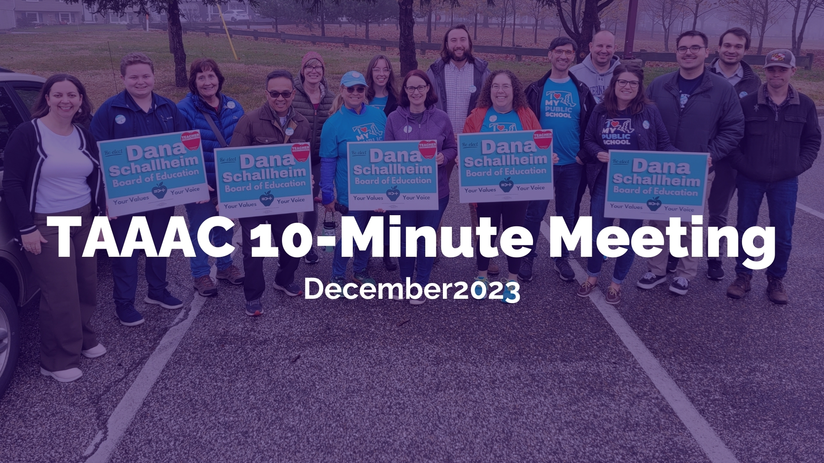
Notes:
Hello! It’s the last 10-minute meeting of 2023. [NOTE FOR Building Reps: If you’re hosting this in January before the RA, most of this information is still relevant!]

Slide 2
Notes:
Today we’ll discuss events in December and January, how you can get involved with our committees, and what you need to know from your contract.

Slide 3
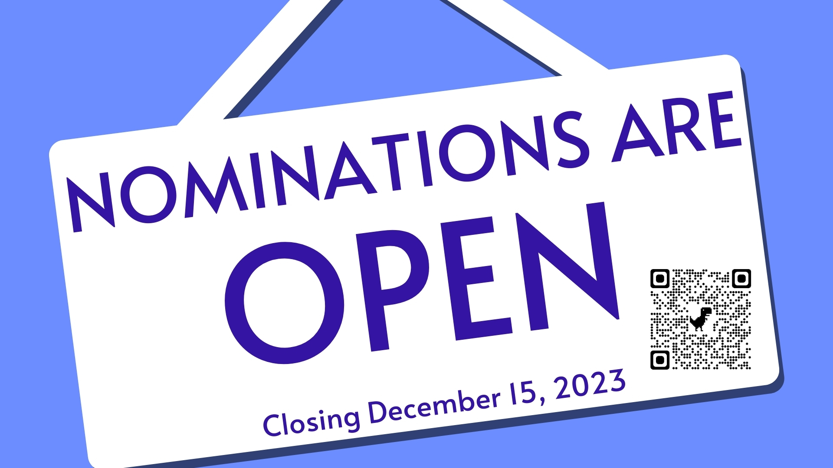
Notes:
First! The deadline for union nominations closes Friday, December 15. Nominations are open for TAAAC President, Vice President, Board of Directors, and MSEA and NEA Delegates. Voting will open on January 29!

Slide 4
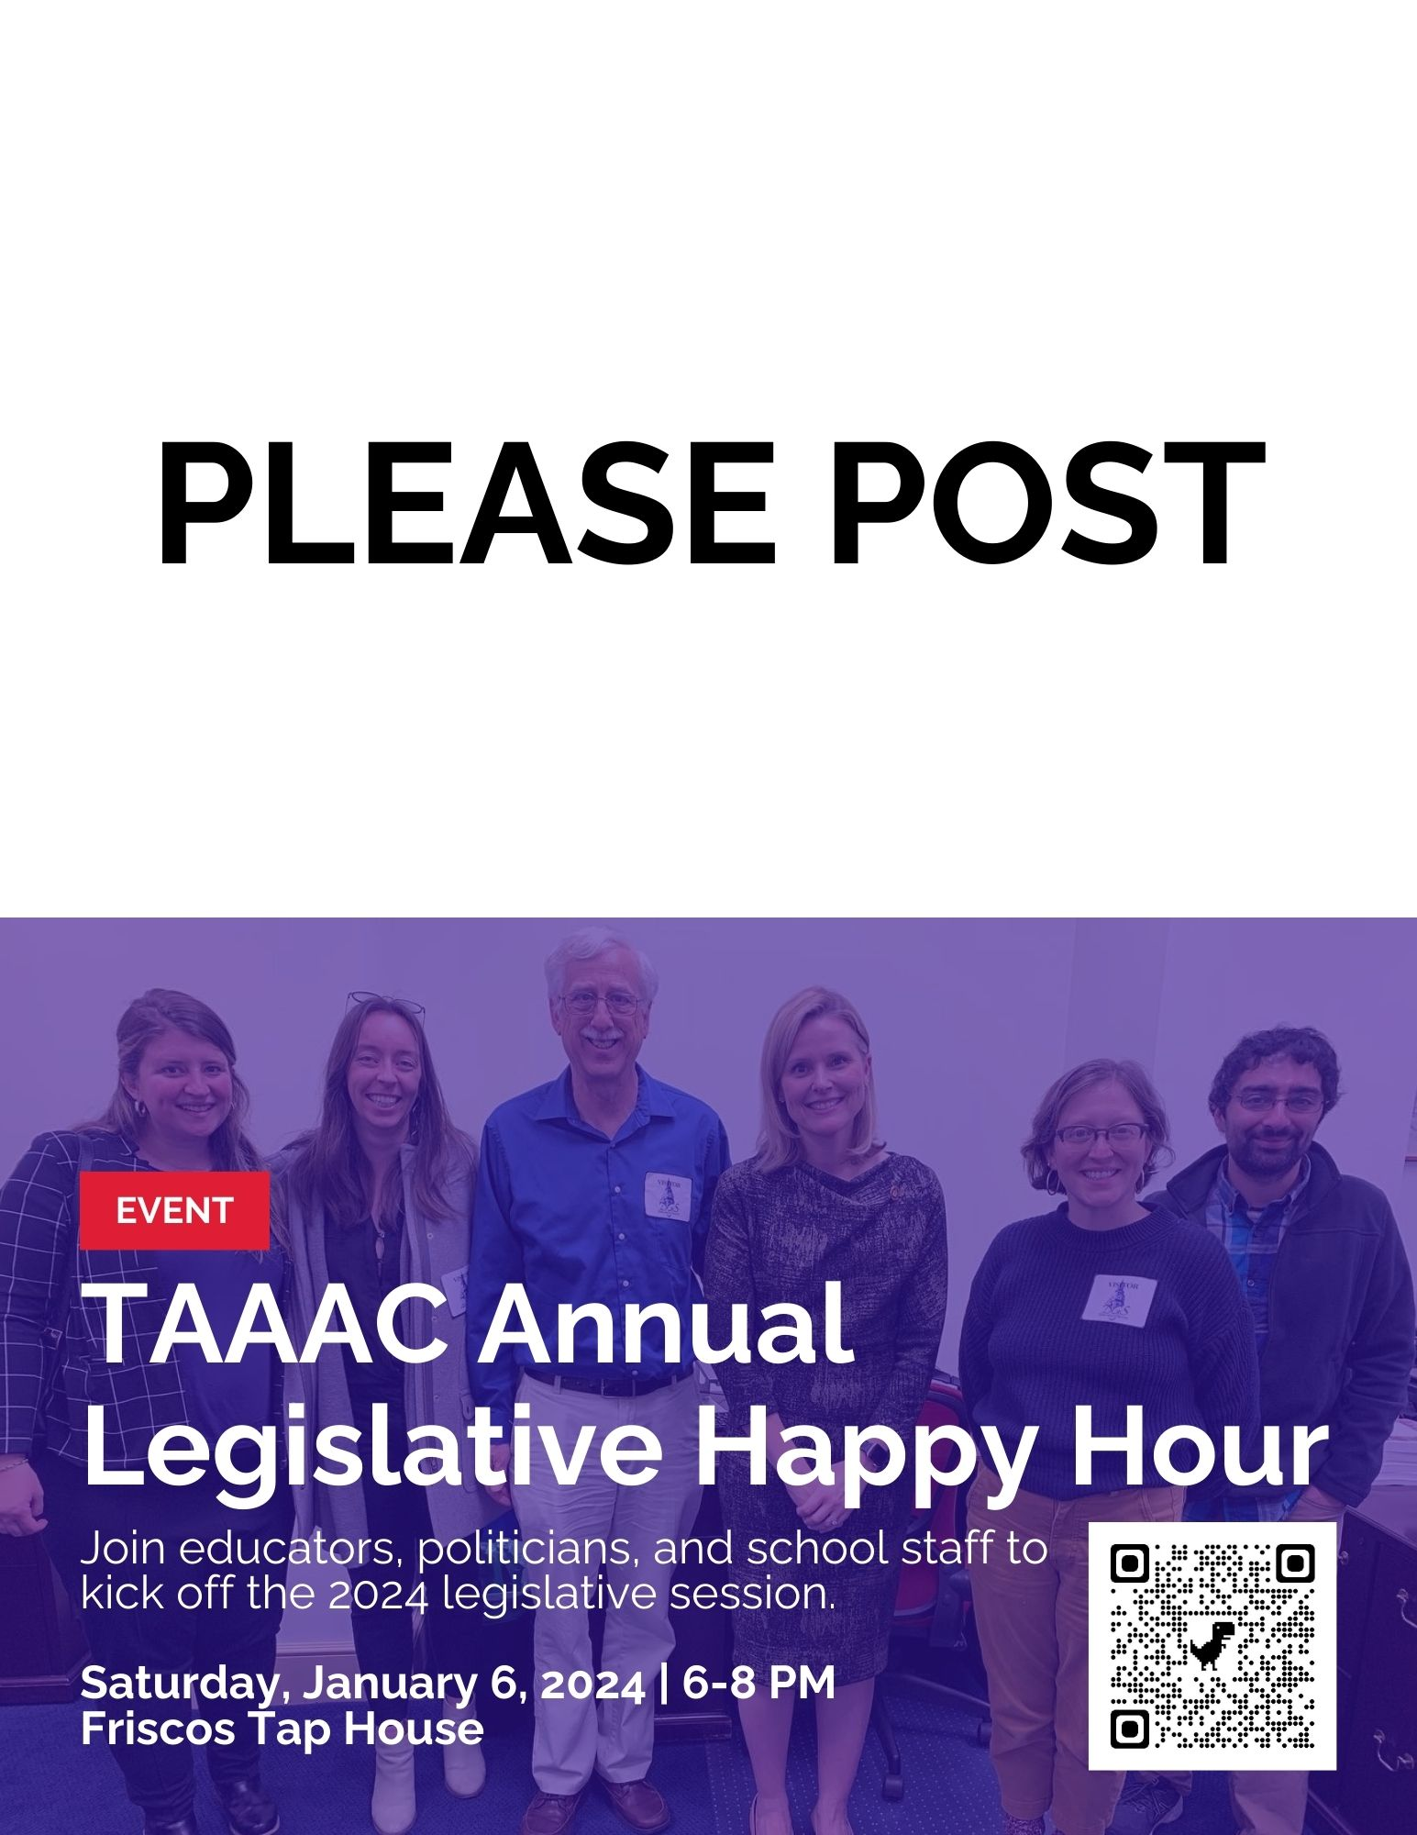
Notes:
First up in 2024 is our annual legislative happy hour! This is a great opportunity to speak with members of our board of education, county council, and legislators in Annapolis in a casual setting. Meet them now so that they trust us when we ask for support in our schools and our profession!
The event is January 6 from 6-8PM at Frisco’s in Gambrills. Email amenas@mseanea.org to RSVP.

Slide 5
Notes:
Quickly following in the second week back from break is the Board of Education budget hearing. This is our first opportunity to help our bargaining team advocate for the 10% COLA we want! It’s our opportunity also to call for challenge stipends, equity with Blueprint implementation, community schools, and more. The hearing is January 9 from 6-8PM at Old Mill High School. Join us ahead of time at Libations for a happy hour!

Slide 6
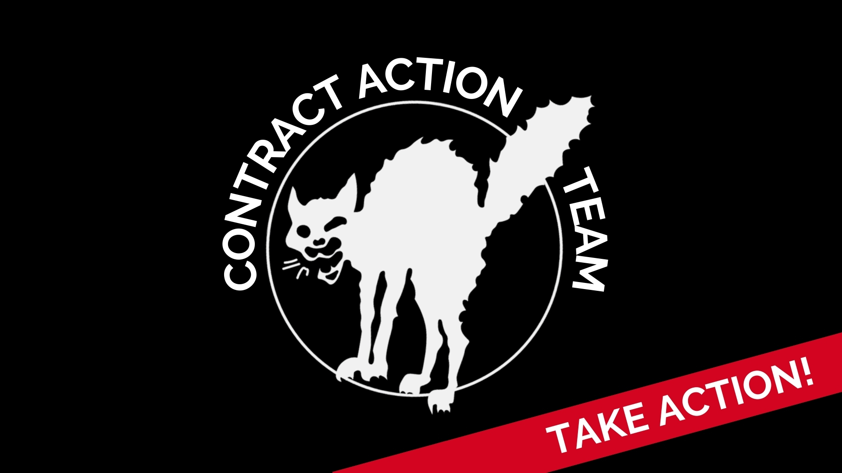
Notes:
If you want to get more involved with supporting turnout or planning for the events on the last two slides, consider joining the Contract Action Team. We’re asking members to help us advocate for the rights we deserve that make our schools strong! Whether it’s planning events, talking to legislators, or testifying throughout the school year, there are so many opportunities to get involved. Reach out to Mike Magee at mmagee@mseanea.org to learn more.

Slide 7
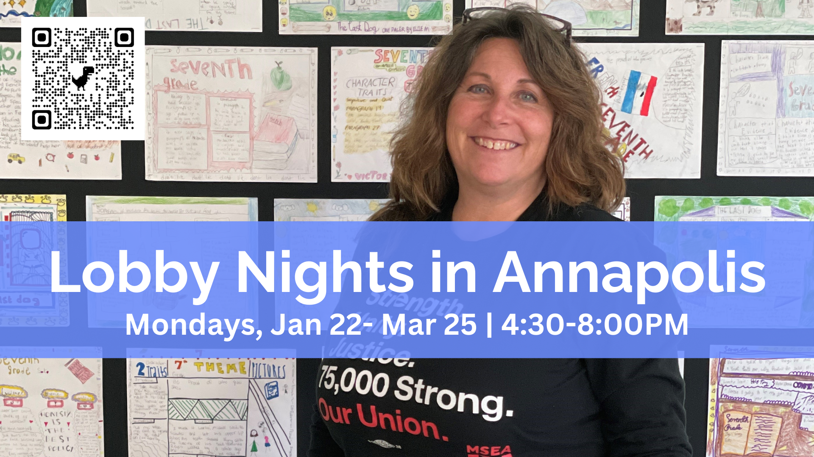
Notes:
Join our Government Relations Committee on Monday nights for the next few months to have conversations with delegates and senators on pro-public education legislation! We’ll meet at Stan+Joe’s for a briefing then walk over together to each of our meetings. Use the QR code to sign up if you’re interested!

Slide 8
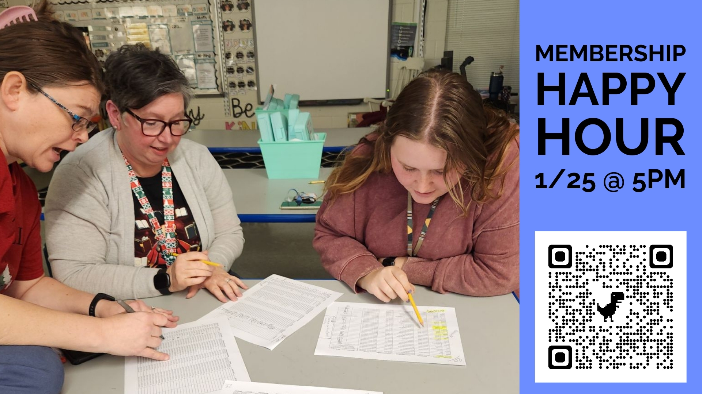
Notes:
Our Membership Committee is hosting a happy hour on January 25 at Ellie’s in Millersville. First round and appetizers on TAAAC!

Slide 9
Notes:
Our Early Career Educator Committee is hosting the next Hot Topic Collaborative on Tackling Student behaviors and discipline… not literally tackling though! Join us to learn about your rights as a teacher in dealing with extreme student behaviors, the rights your students have, and the actionable steps you can take to protect yourself and your students. Use the QR code for the virtual event on January 30 at 4:30PM

Slide 10
Notes:
Contract Highlight: One of the unfortunate realities of teaching is dealing with unreasonable parents. Here are your rights and options when parents cross the line from well-intentioned concern into harassment or threats:
You can firmly, but calmly, assert to the parent that you will no longer be engaging with them directly and that they can forward any further communication to your supervisor.
Work with your supervisor to create a plan for how to handle a harassing/threatening parent. Administration CANNOT force you to put yourself in harm’s way by continuing to engage with a threatening parent.
Document any negative interactions with the parent and limit those interactions to writing where possible. Keep a digital and hard copy of all correspondence.
If tensions escalate, you can pursue a “peace order” (Maryland’s version of a restraining order) at your local Maryland state courthouse that would limit the form and degree of contact from the parent. Your UniServ Director can help you navigate this process.
In extreme situations where your safety or that of others is threatened, you can contact law enforcement to intervene.
MSEA Legal Staff and your UniServ Directors are available to assist with any questions or incidents that emerge.

Slide 11
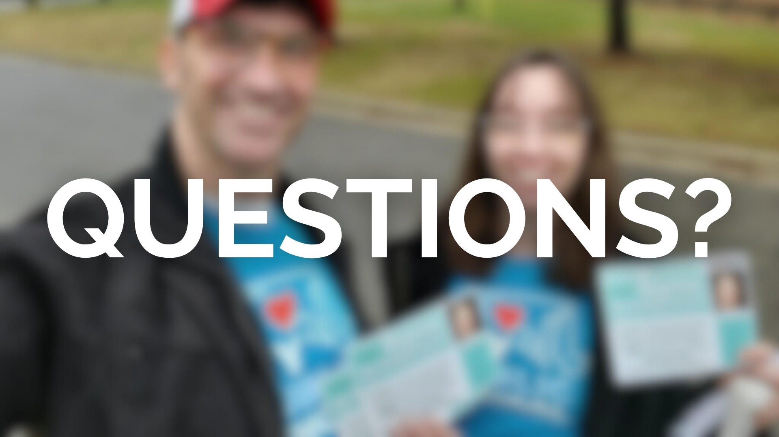
Notes:
Questions?

