Slide 1
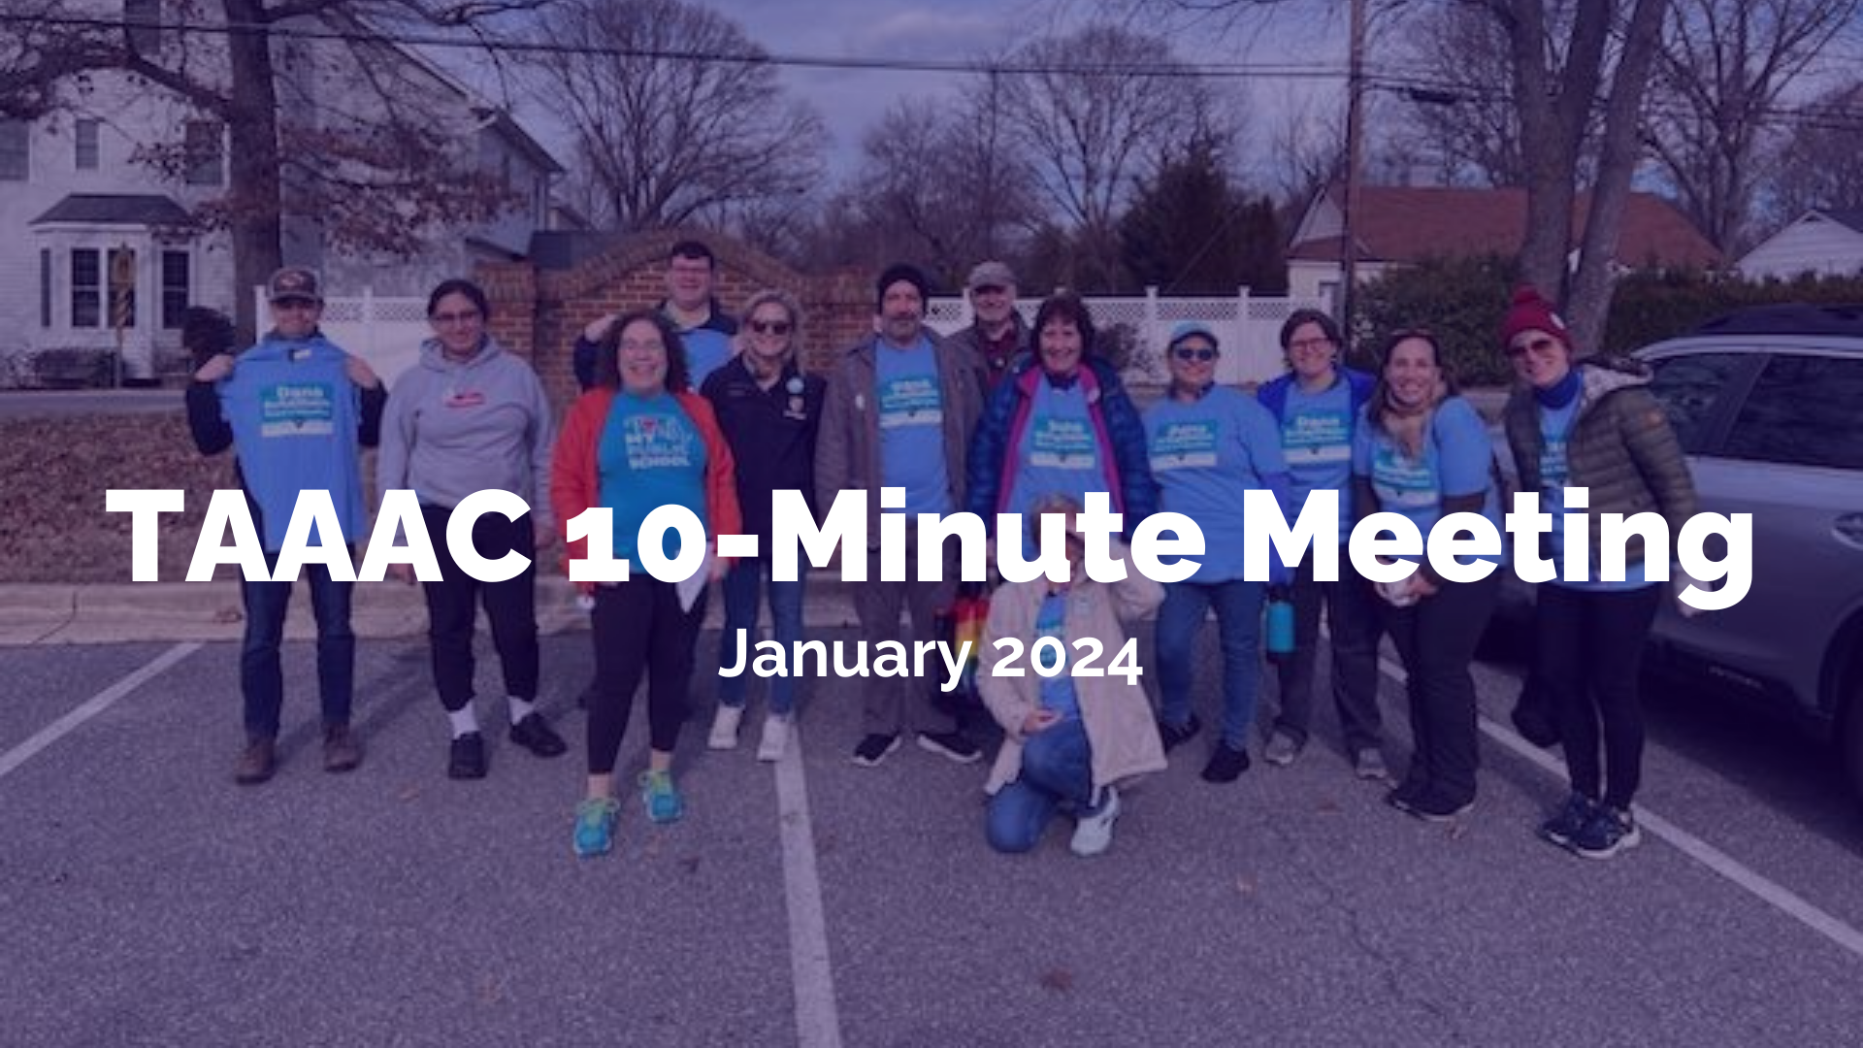
Notes:
Happy new year! 2024 is going to be a busy year for our union from advocating around the budget and bargaining our contract, to organizing around school board elections and more. Together, we’re already hitting the ground running having hosted our Legislative Happy Hour, attended the Board of Education budget hearing, and are ready to keep advocating for what we deserve.

Slide 2
AGENDA
TAAAC Elections
County Budget Hearings
Lobby Nights
Membership Happy Hour
Early Career Educator Committee
Contract Highlights
Notes:
This month, we’ll go over what events are lined up, how we in this building can support union-wide actions, and hear from our UniServ Directors about parts of our contract that can help us!

Slide 3
ELECTION SEASON IS
HERE
January 29-February 16, 2024
Notes:
First up, we have internal union elections that will open at the end of the month. We can vote for TAAAC President, Vice President, Board of Directors, and MSEA and NEA candidates. To vote, you’ll need your MSEA ID and the last four of your social security number. If you don’t know your MSEA ID, I (your building rep) have a list. If anything has changed, we can get your number by calling the TAAAC Office at 410-224-3330.

Slide 4
County Council Budget Hearings
District 6: January 17
District 2: January 23
District 5: January 25
District 3: January 30
District 1: January 31
District 4: February 6
Notes:
When it comes to advocacy, the first thing on many of our minds is how much our salary might increase this bargaining cycle. Our Negotiations Team proposed a 10% COLA plus a step, but AACPS has responded by only proposing a 3% COLA in their annual budget. This is unacceptable and we know we deserve more. With the wins we saw last year with auto-workers and the Hollywood strike, we know we can get more too if we speak up. Check out the dates here and pick one that you can attend, either where you live or work, to show up on behalf of our colleagues. The County Executive has said before that when educators show up to these hearings, we are more likely to get more money. Use the QR code to RSVP directly.
The BOE budget hearing was postponed tentatively to January 25 – stay tuned for more info on how to sign up and testify! We’ll have new red t-shirts!
https://www.aacounty.org/openarundel/yourbudget/budget-townhalls

Slide 5
Notes:
If you can’t make it in person, we still want to hear from you. AACPS’s bargaining team thinks our proposals at the table don’t reflect what we’re seeing in our schools, so we need to show them specific examples. One of our proposals is around student violence: think about a time you were injured by a student or a referral wasn’t processed. Another proposal is around pay for Department Chairs: Would more people be willing to stay in the position as it has evolved if there was more money? Do you think that a 3% COLA will keep educators in this county? Use the QR code to tell AACPS what you need, both at the bargaining table and in their budget. You can submit stories anonymously too!
https://docs.google.com/forms/d/e/1FAIpQLSfsur4fBIanzcO5dOtHRZIQq_CDDuILMU9H5qObCYClYiRw5Q/viewform?usp=sf_link

Slide 6
Lobby Nights in Annapolis
Mondays, Jan 22- Mar 25 | 4:30-8:00PM
Notes:
On the other hand, If you’re ready to get personal with legislators at the local and state levels to advocate for everything from the budget to student loan forgiveness to the number of days in our school calendar to protections against book bans, this is the opportunity for you! Join TAAAC members each week for lobby sessions. These are open to anyone, even if you haven’t spoken out like this before. We’ll have a briefing on the legislator and talking points each Monday afternoon before walking into the capital together for meetings. This is our opportunity to ensure people in power know what is happening in our schools so they don’t make policies that will negatively impact our students and our profession. Use the QR code to RSVP.
https://www.signupgenius.com/go/10C0945ADAB28A0F4CF8-46172888-taaac#/

Slide 7
MEMBERSHIP
HAPPY
HOUR
1/25 @ 5PM
Notes:
There are less serious opportunities to get involved with TAAAC too! Come to our happy hour hosted by the membership and special events committees at the end of the month! We’ll meet at Ellie’s in Millersville on Thursday the 25th. Use the QR code to RSVP.
https://secure.ngpvan.com/yKIeXYgtn0GoQ10K9Z5I2A2

Slide 8
Notes:
While hosted by the Early Career Educator Committee, this event on student discipline is for all educators to learn about your rights in dealing with extreme student behaviors, what rights your students have, and what actionable steps you can take to protect yourself and your students. We’re hosting this event virtually on the 30th. Use the QR code to RSVP.

Slide 9
Notes:
Finally, a word from our UniServ Directors:
Unlike most other professions, as a public-school educator in Maryland you can suffer negative consequences for resigning your position outside of certain timelines. If you resign during the school year (with limited exceptions, see Article 17 B), the following will occur:
Any accumulated summer pay is forfeited, and you will not receive it (COMAR 13A.07.02.01).
The Board of Ed, at its sole discretion, may suspend your Maryland teaching certificate (typically for one year, but can be for longer).
AACPS and its agents are not required to provide you with a letter or recommendation or positive reference (though they may individually choose to do so).
Your insurance ends at the end of the month in which you resign.
If you are not vested in the Maryland state public employee retirement system, your contributions will be returned to you. If you are vested, that money will remain until you retire.
To avoid these consequences, members should provide their notice of intent to resign by April 15 (and continue to work through the end of the school year), and actually resign no later than July 15 before the next school year. By following these timelines, members will not suffer any of the above consequences and your insurance will continue through the end of August.

Slide 10
QUESTIONS?
Notes:
Any questions?

