Slide 1
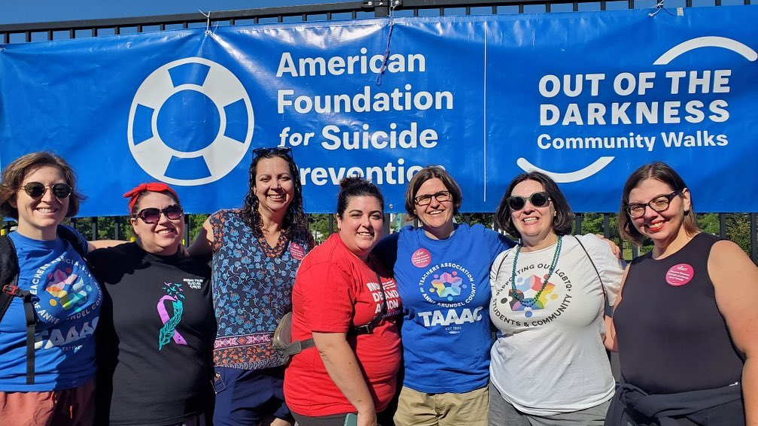
TAAAC 10 minute meeting
October 2023
Notes:
Welcome to the October 10 minute meeting. Already this month, our union has filed a class action grievance to enforce our contract for special education pay, is set to meet AACPS at the bargaining table on 10/19 and hosted a training on how to run effective FACs! Today, we’ll discuss other topics coming for the month ahead.

Slide 2
Agenda
Nominations
Government Relations Update
Hot Topic Collaborative
Member Meetings
Notes:
Those topics include negotiations, government relations, and member events!

Slide 3
Notes:
The Nominating Committee is seeking nominations for the following TAAAC Leadership positions: President, Vice President, Board of Directors, MSEA Delegate and NEA Delegate. Nominations will be open until December 15, and elections will be conducted in late January-early February 2024. NEA delegates will attend the July 2024 NEA Rep Assembly and MSEA delegates will attend the October 24 MSEA Rep Assembly. The term for President, Vice President, and Board of Directors will begin July 31, 2024.
Submit your nominations at taaaconline.org/taaac-elections or by scanning the QR code here.

Slide 4
Notes:
If we want to see future years of 6% COLAs to retain dedicated educators in the county, if we want to see more planning time and fewer nonprofessional duties, if we want to see increased compensation for class coverage, and if we want to protect our media centers from book bans, we have to elect candidates to the school board who trust educators and put our priorities first.
We do that by getting involved in the races through endorsements, door knocking, and phone banking. But if you are too busy to give your time, you can also donate through payroll to our political action committee. This is a way to financially support the elected leader who will in turn support us.
If you choose to donate, this QR code takes you to a printable document you can give to your building rep to basketmail to the TAAAC Office. You can also send one-time donations via the MSEA website: marylandeducators.org.

Slide 5
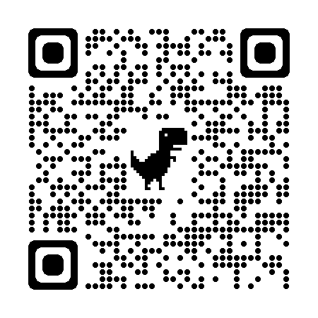
Notes:
Are you worried about writing SLOs? You’re not alone! SLOs are a part of your rating, but with support you can ensure your success and students. Learn more about the best practices for writing SLOs and refine your own at our first “Hot Topic Collaborative”. Designed for early career educators but open to all, general ed and special ed support will be available through peer-mentorship!
Join fellow members on October 25 at 4:30 p.m at the TAAAC Office. Registration is limited to the first 20 attendees. Dinner will be served.

Slide 6
Notes:
Are you a department chair who has taken on more classes because of Blueprint priorities and vacancies, and are left with no time for DC responsibilities? Are you a pre-K teacher who is told-day of that new students are coming to your class? Does your job category have unique concerns? Work with your union colleagues to determine solutions! DCs are meeting on October 16, and other groups are lobbying with AACPS for better working conditions. Reach out to Building Rep if you have concerns that can be brough to the RA so we can take coordinated action! Learn about other upcoming meetings and events at taaaconline.org/events

Slide 7
QUESTIONS?

