Slide 1
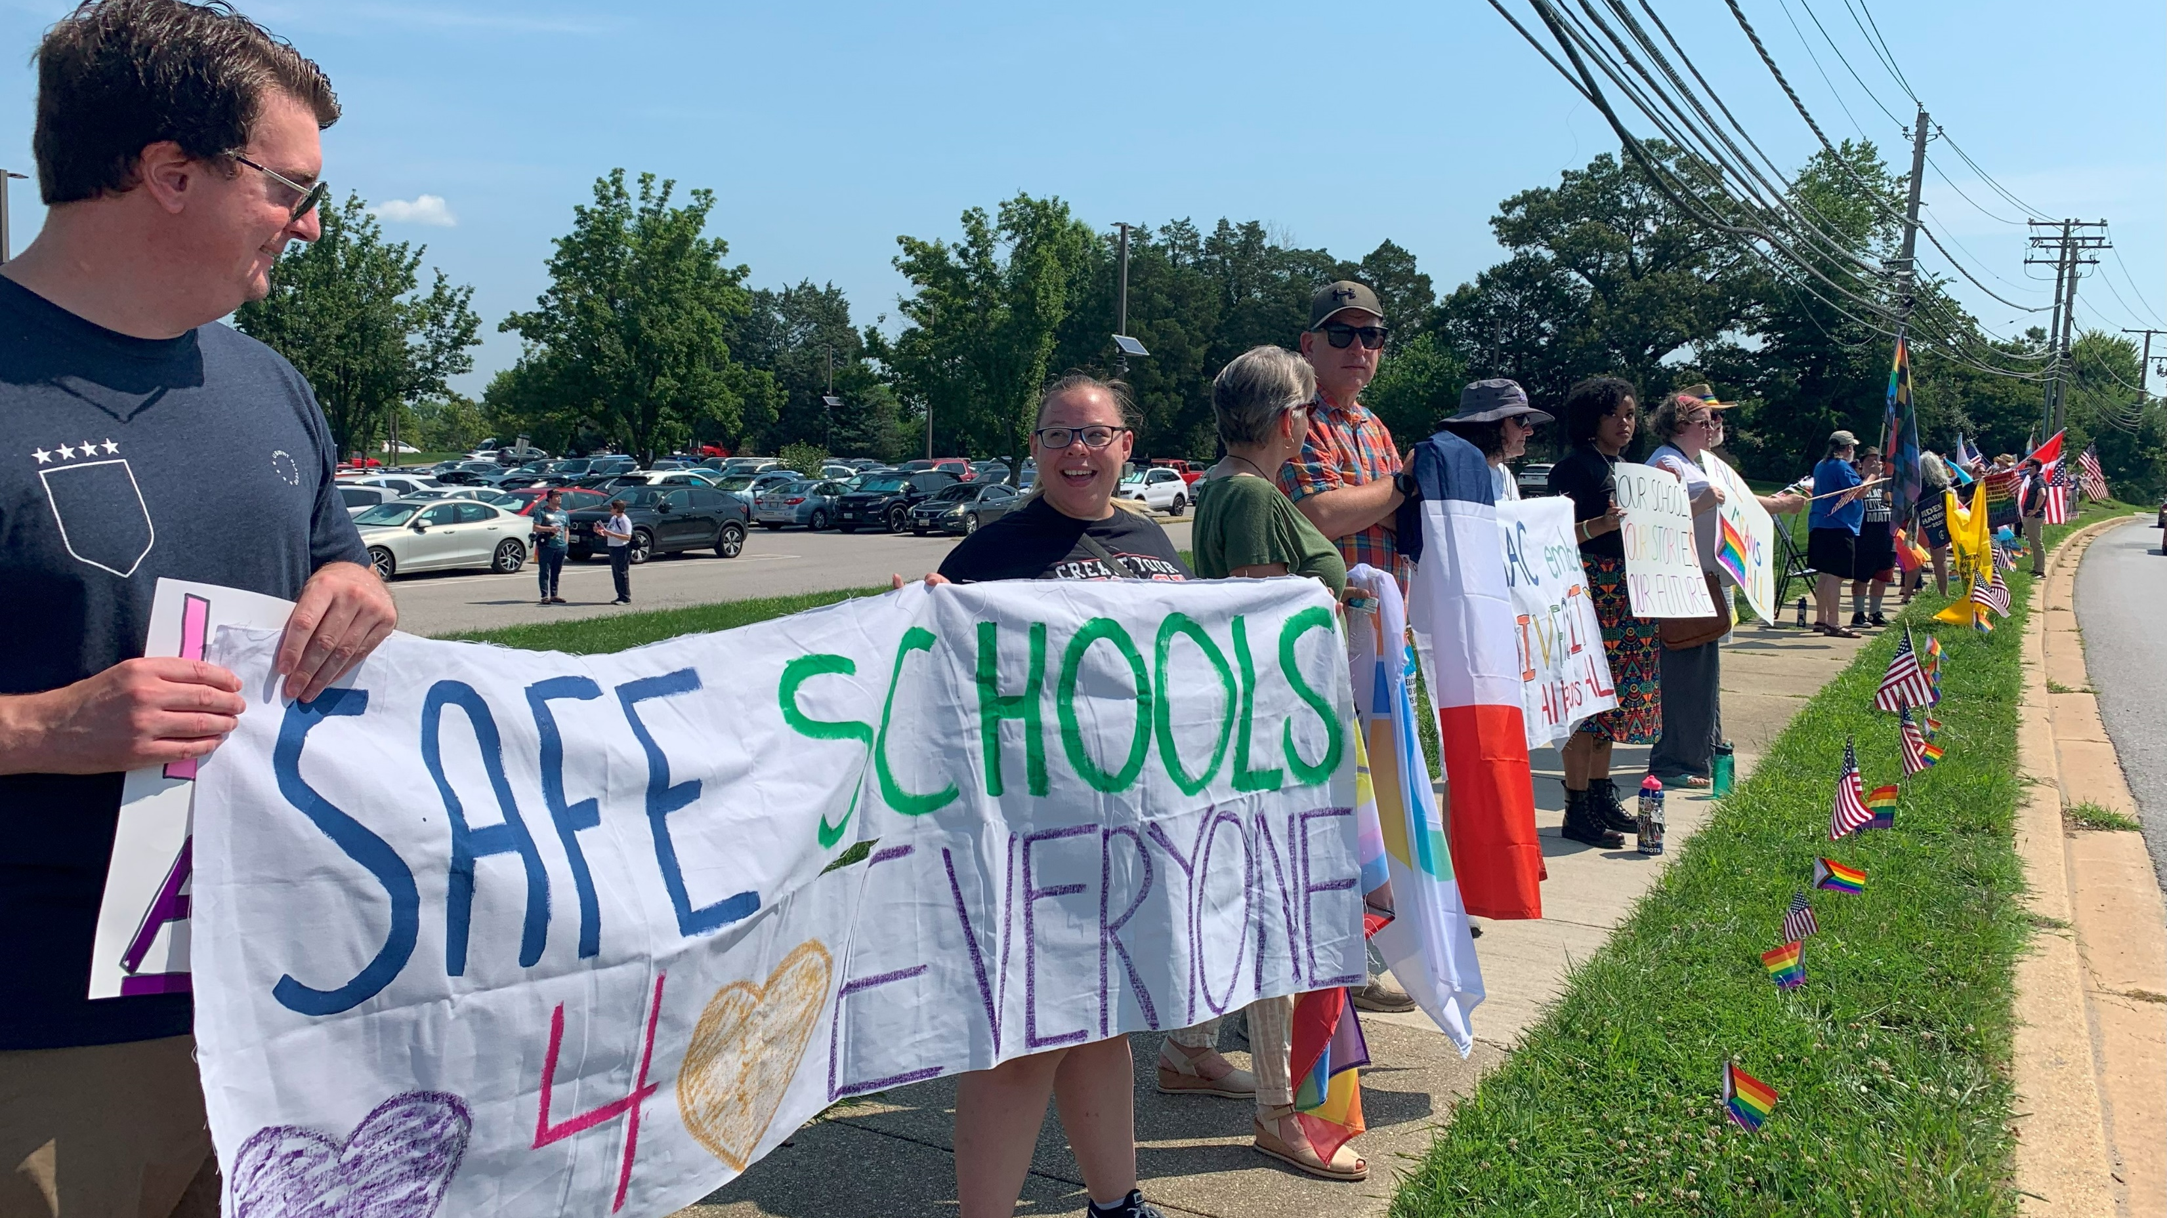
September 2023
TAAAC 10-minute Meeting
Notes:
Welcome back to the new school year! For the first time in many years, we’re kicking off with a fully ratified contract, starting the year seeing the 6% COLA we won at the bargaining table, and with protections for us as we continue to experience the effects of the educator shortage here in the county.

Slide 2
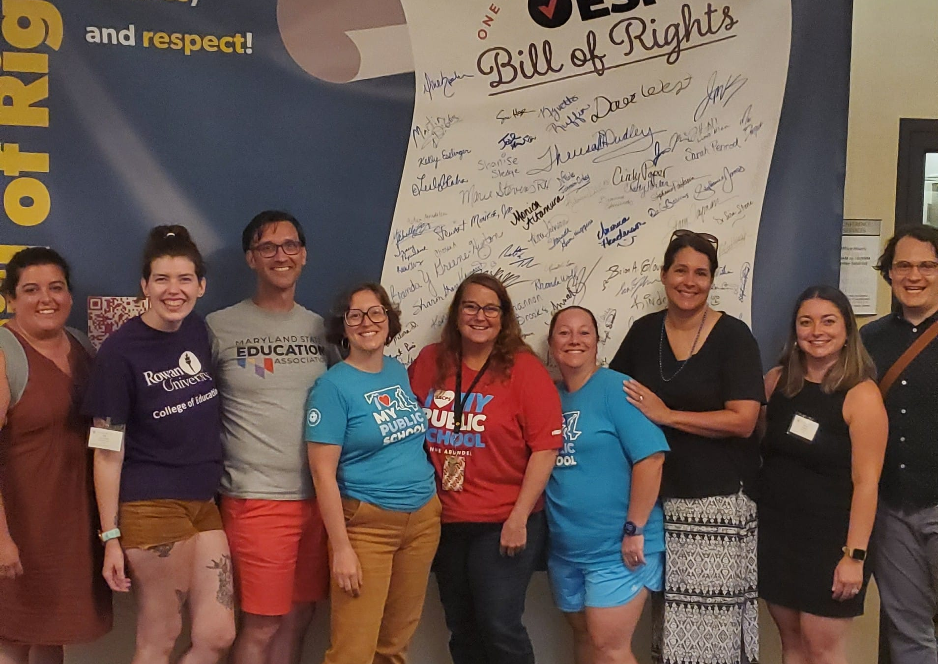
Agenda
Bargaining
Toileting
UD Update: Coverage MOU
Committees
Notes:
Today we’re talking about heading back to the bargaining table, impacts on our working conditions, some updates from our UniServ Directors, and what we can do to get involved. Sound good?

Slide 3
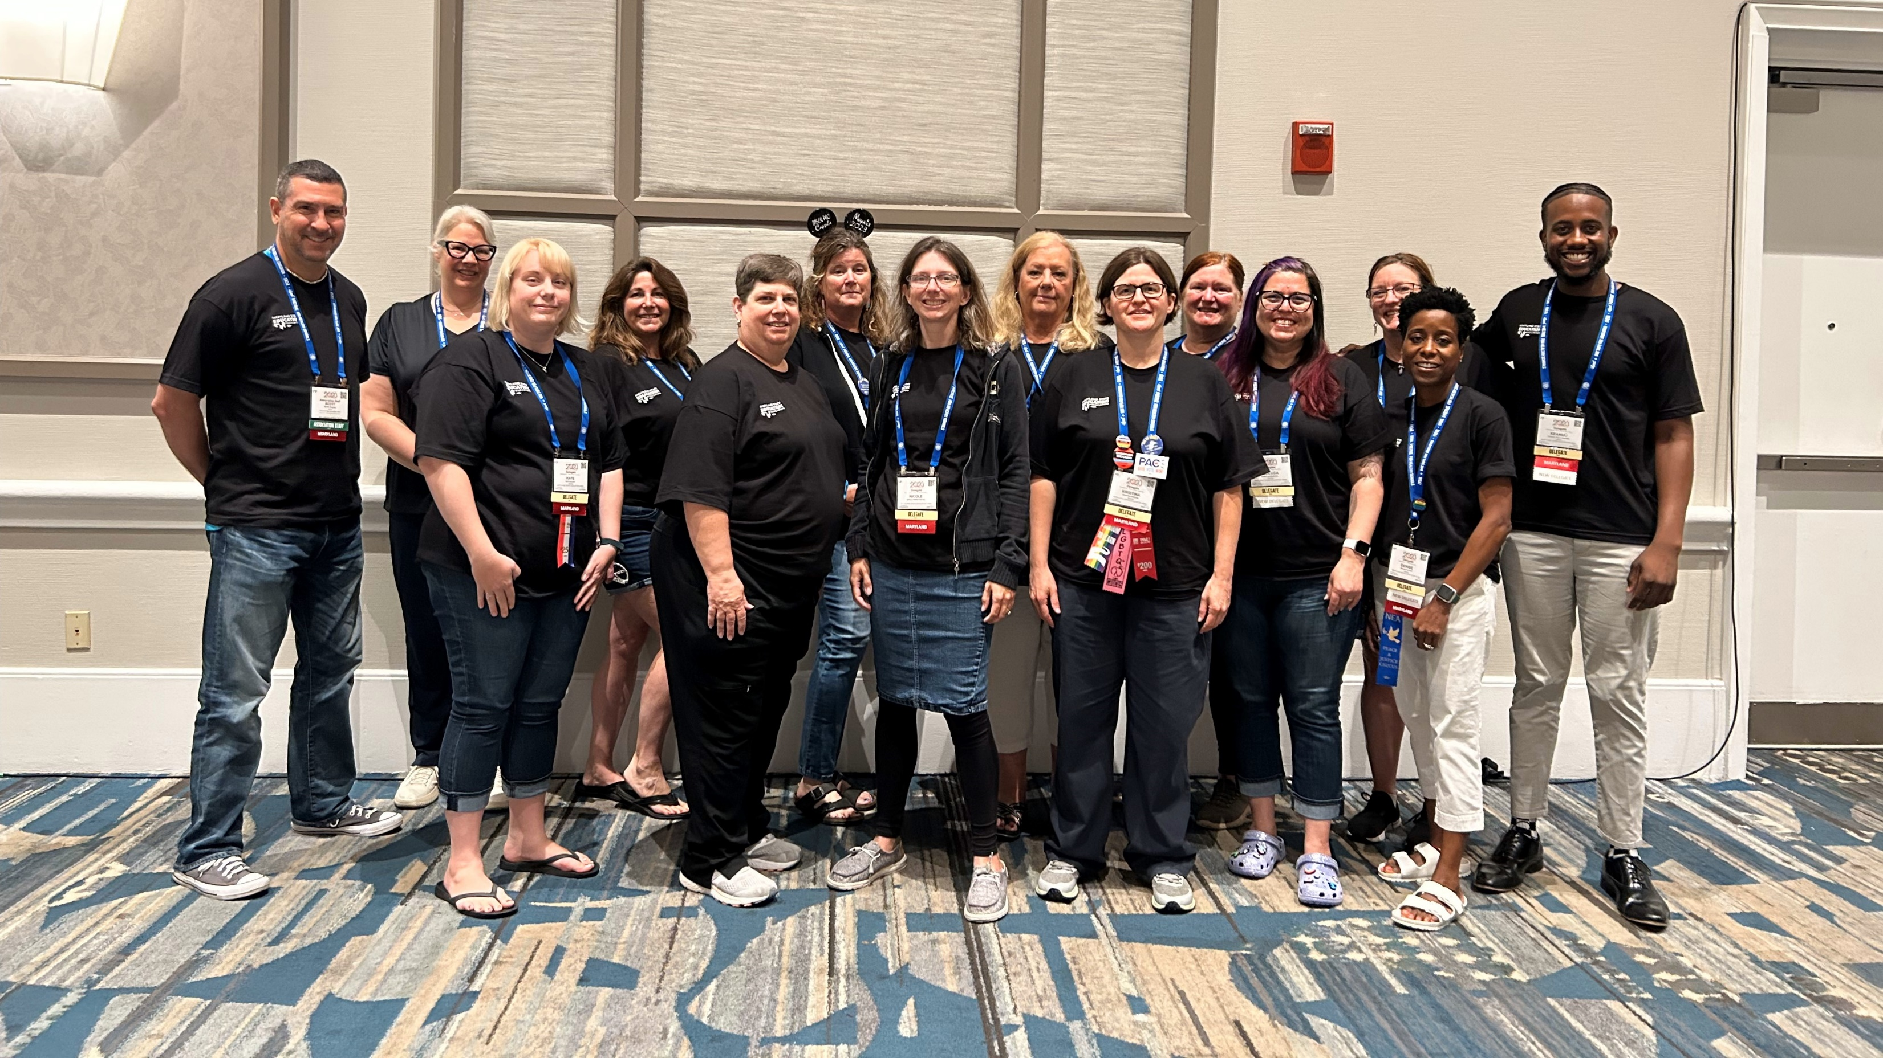
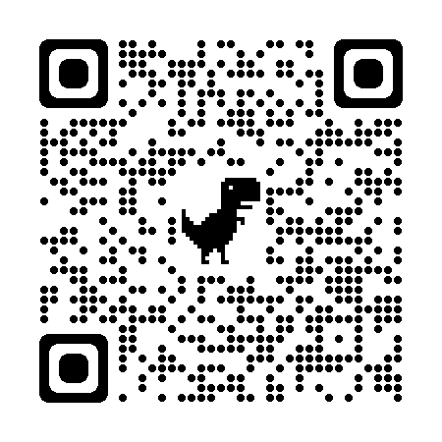
Bargaining + Kick Survey Off
Notes:
First! We’ve selected a Negotiations Team to represent us at the table with AACPS. This team of seven comes from all parts of the county, all school levels, includes related service providers and 12-month employees, and will be supported by a consulting team of folks from an even wider array of positions. But we want to make sure we hear from even more members which is why we have a bargaining survey open now. Last year we heard from over 1000 members, but we have over 6000 members in our unit, so we are asking everyone to take this survey (the QR code on the left) now and make your priorities heard. Each answer is reviewed, so please be as detailed as you want.
Additionally, we’re hosting a bargaining kick off on October 2 to review the results of the survey, meet the bargaining team, and identify the priorities for the year ahead. We’re already hearing that members want to keep seeing higher COLAs, maintain healthcare benefits and coverage pay. RSVP with the QR code on the right.
[FOR BRS: Here’s the link to the bargaining survey: https://www.surveymonkey.com/r/H9ND8HB and to the kick off: https://secure.ngpvan.com/a9KH-zALrkaNLZwDrLt9aw2]

Slide 4
Toileting
If asked to provide toileting support, you can say to your admin:
“I refuse this duty due to safety concerns for both the student and myself, and a lack of training.”
Notes:
We have been hearing concerns from early education centers and elementary schools where more students are coming into our buildings in need of toileting support. Thanks to your advocacy, AACPS has confirmed that toileting support is not the responsibility of staff, excluding special education TAs. Staff will not be disciplined for refusing to toilet students. If you are asked to toilet, please refer the student to your administration and call the TAAAC Office at 410-224-3330. While this is an ongoing issue and our students continue to need support, your advocacy has already made a difference!

Slide 5
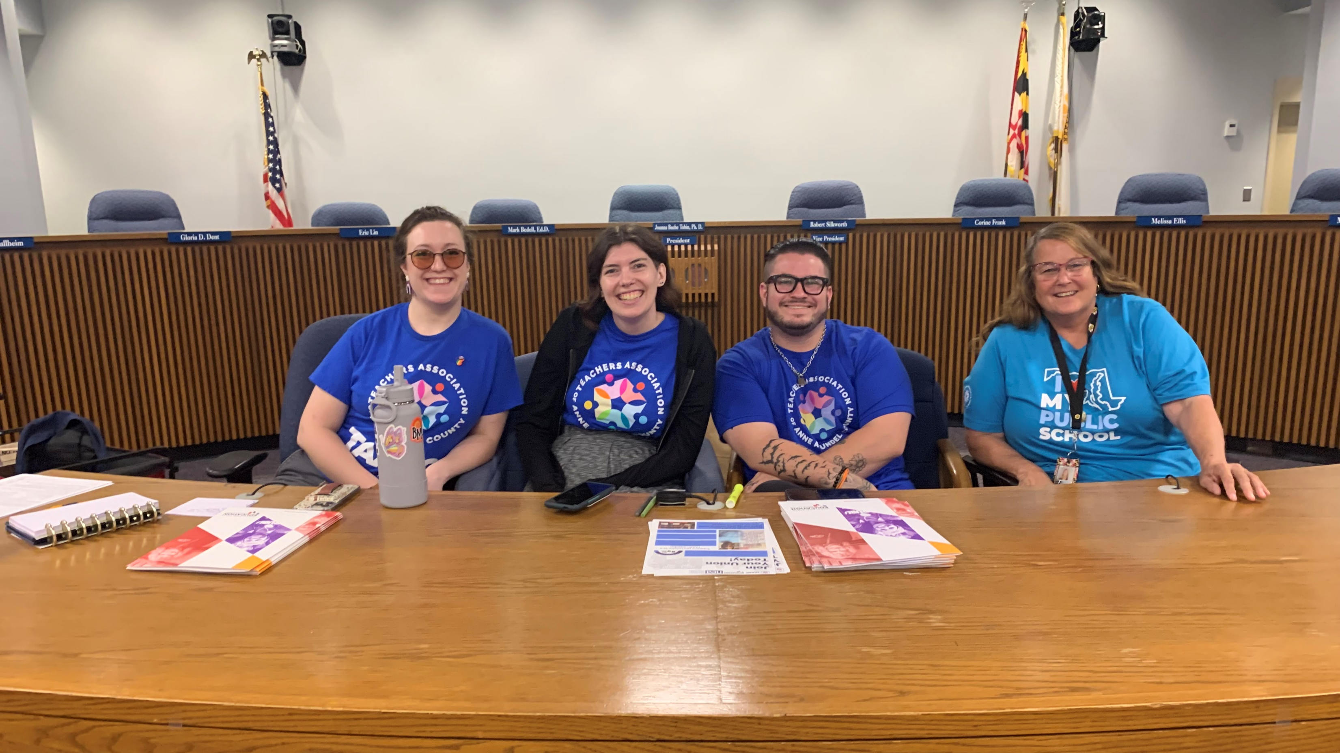
Coverage Pay
Notes:
This is an update from our UniServ Directors about the changes to the coverage pay MOU: For the 2023-2024 school year TAAAC negotiated coverage pay that can include when you cover a class during your planning period due to a staff absence and if you agree to teach an additional teacher of record to cover a vacancy. This MOU applies to some situations at elementary, middle and high schools. Read the MOU here [QR cod], for questions, call the TAAAC office.

Slide 6
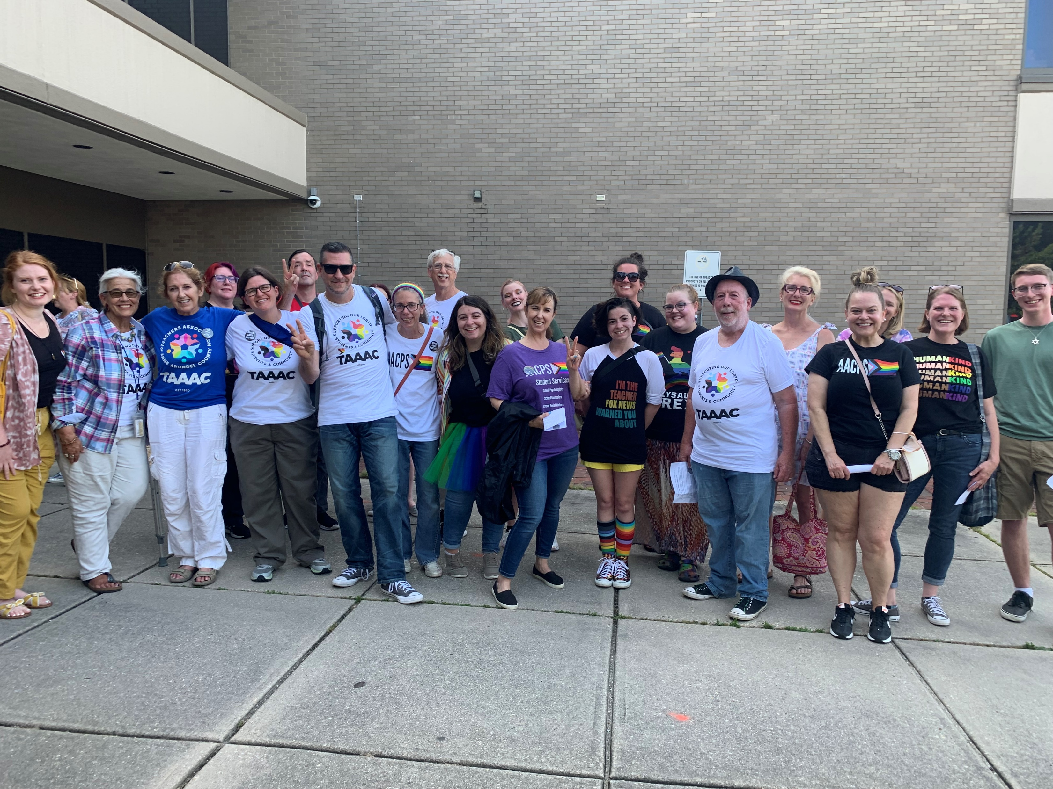
Committee Dates
September 16: Community Involvement (Out of Darkness Walk – Navy Stadium @ 9am)
September 26: Special Education/RSP (TAAAC Office @5 pm)
October 9: Government Relations (TAAAC Office @ 5pm)
Notes:
Finally, our committees are back up and running for the school year! Visit taaaconline.org/events to RSVP for anything you’re interested in. Coming up in the next month are a Special Education/RSP meeting on September 26, and a Government Relations meeting on October 9! Remember: with the upcoming Board of Education races in 2024, to have an impact on any of these areas, we need pro-public education legislators in office who will support us and our students, both in our schools and throughout our communities. Stay tuned for more information, or come to any of these meetings to get more involved!

Slide 7
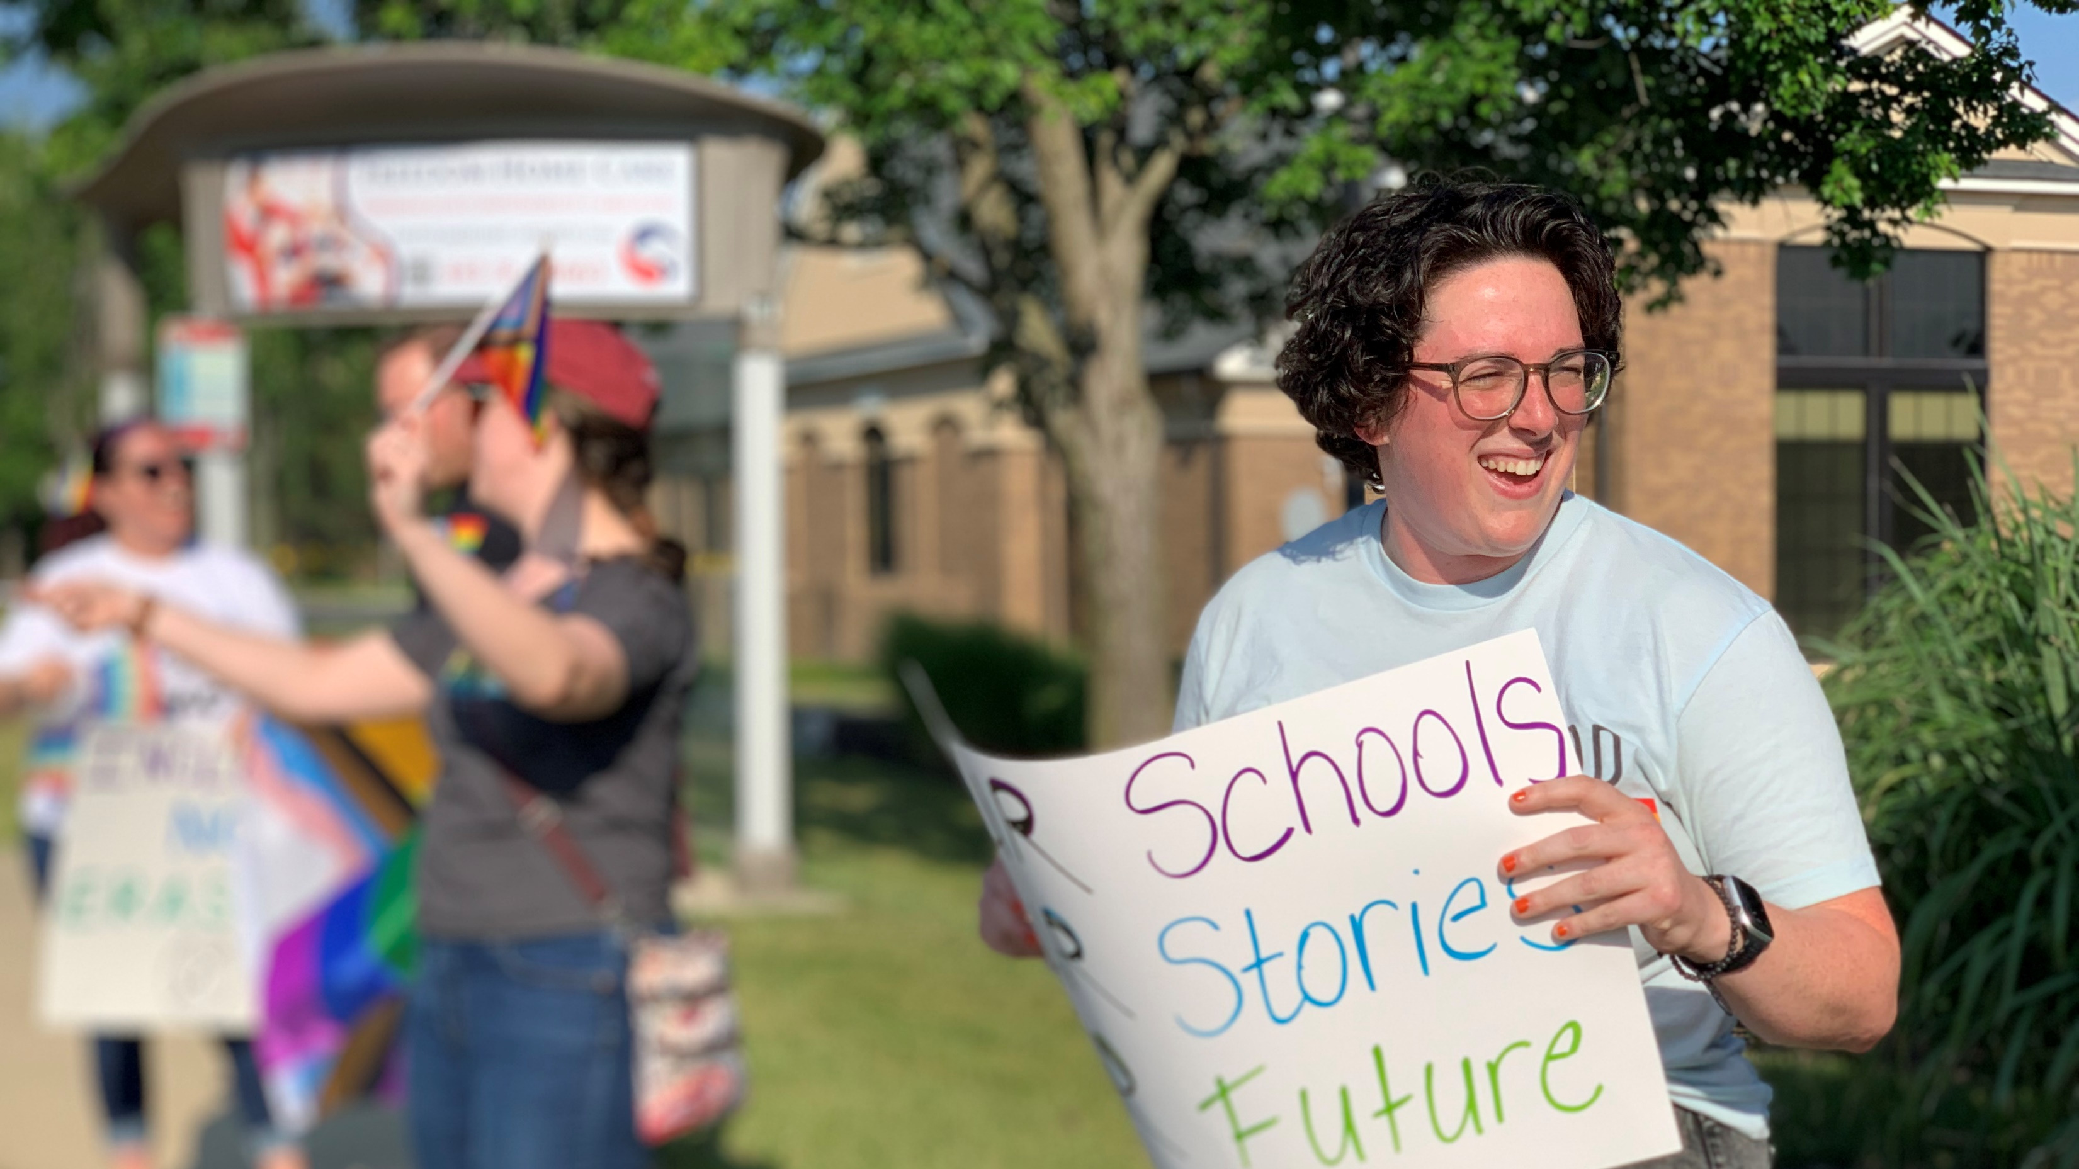
Questions?
Notes:
Any questions?

