Slide 1
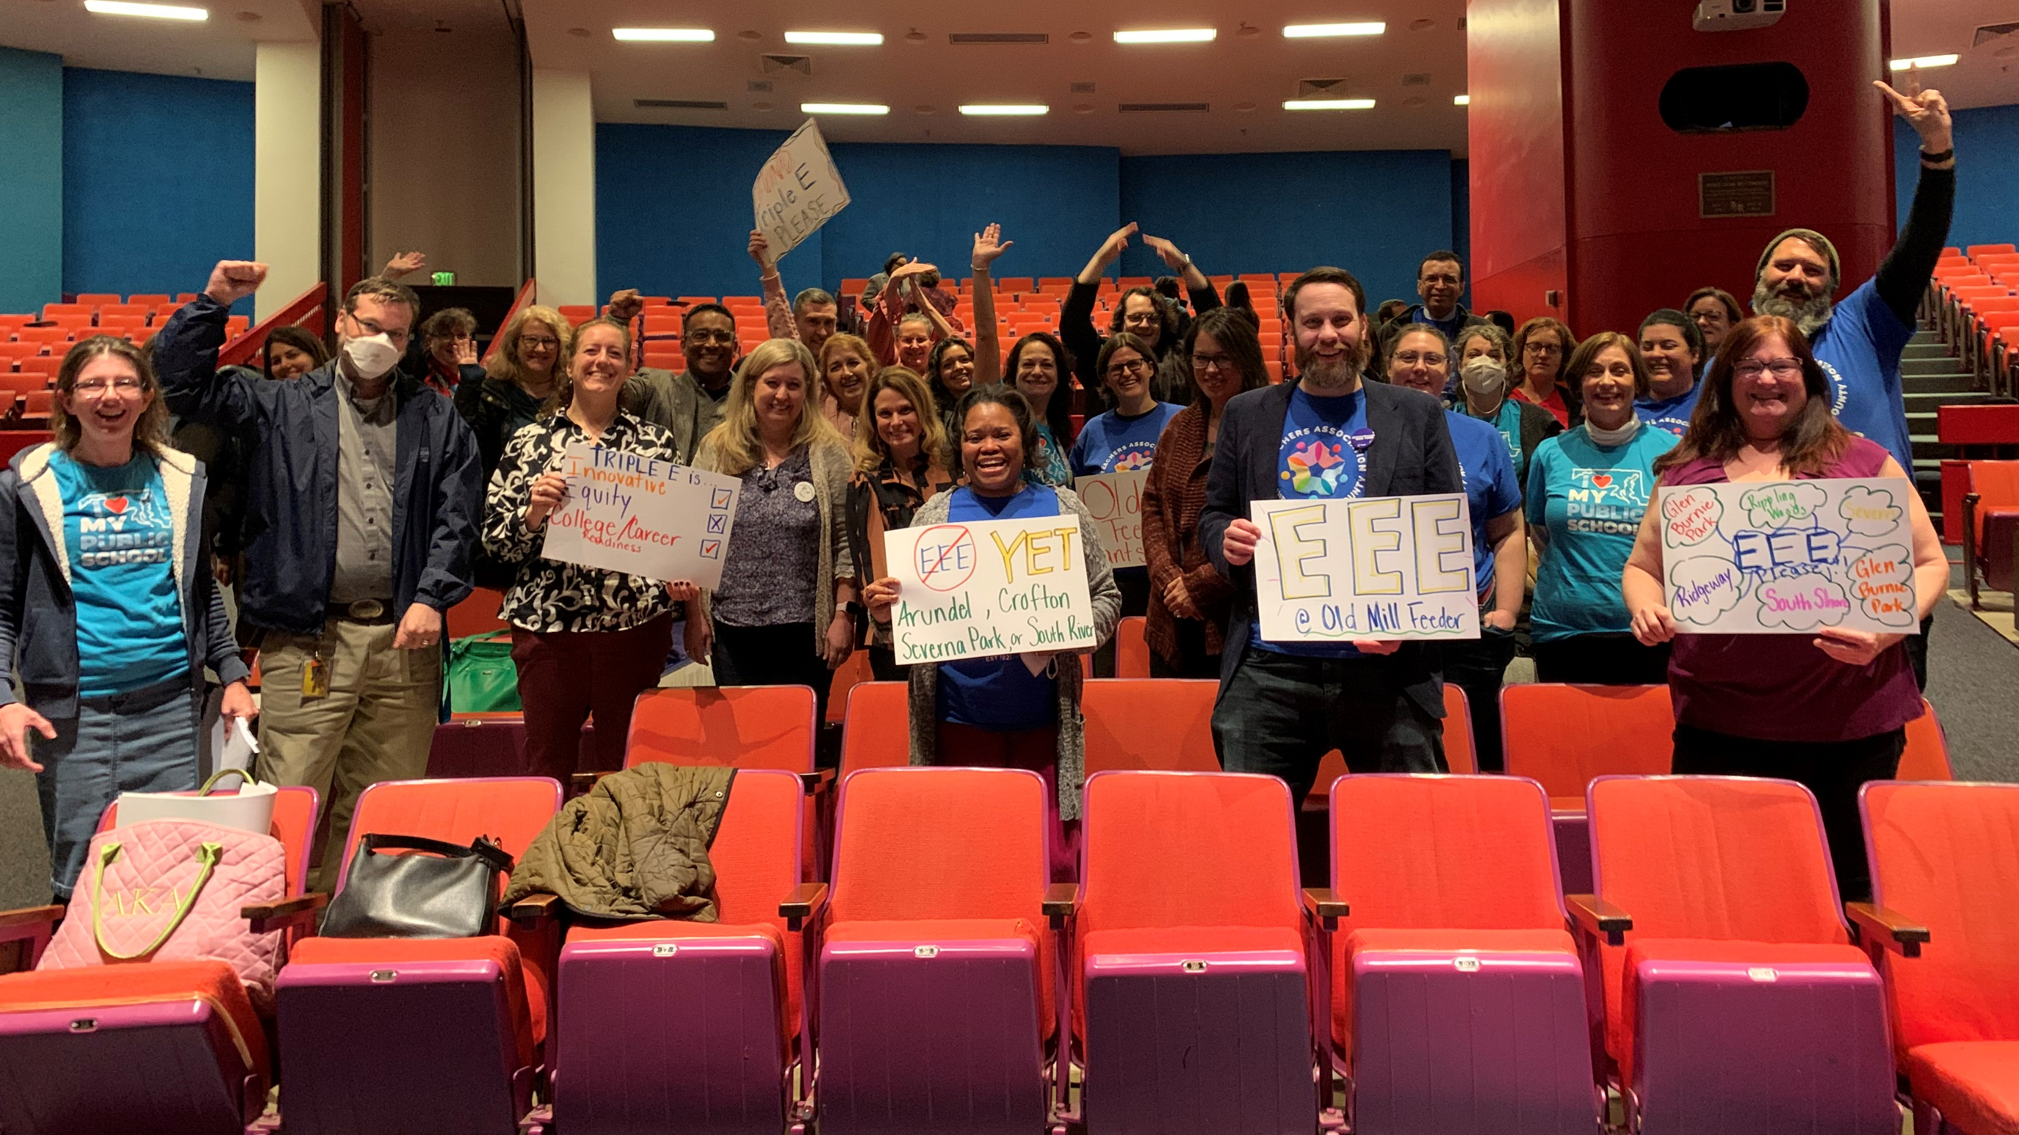
TAAAC 10 Minute Meeting
FY24 Tentative Agreement

Slide 2
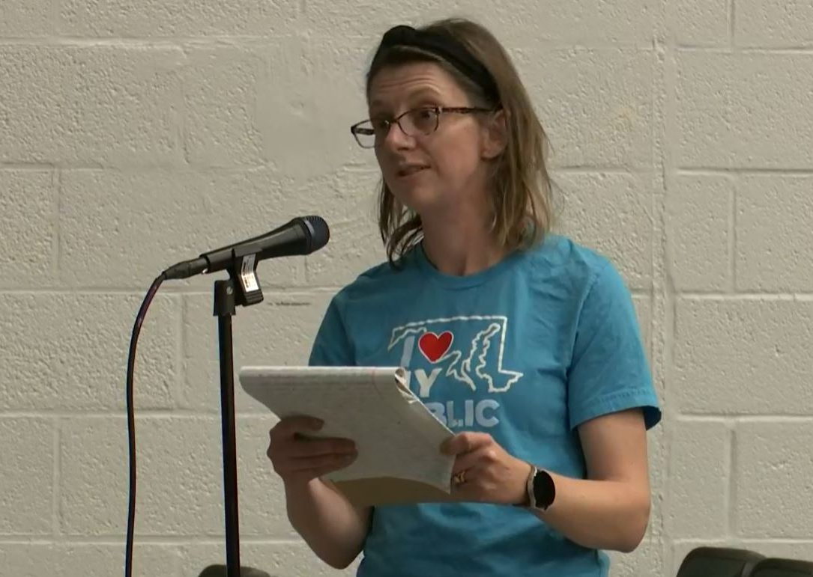
AGENDA
Review of bargaining priorities
Overview of wins
Ratification

Slide 3
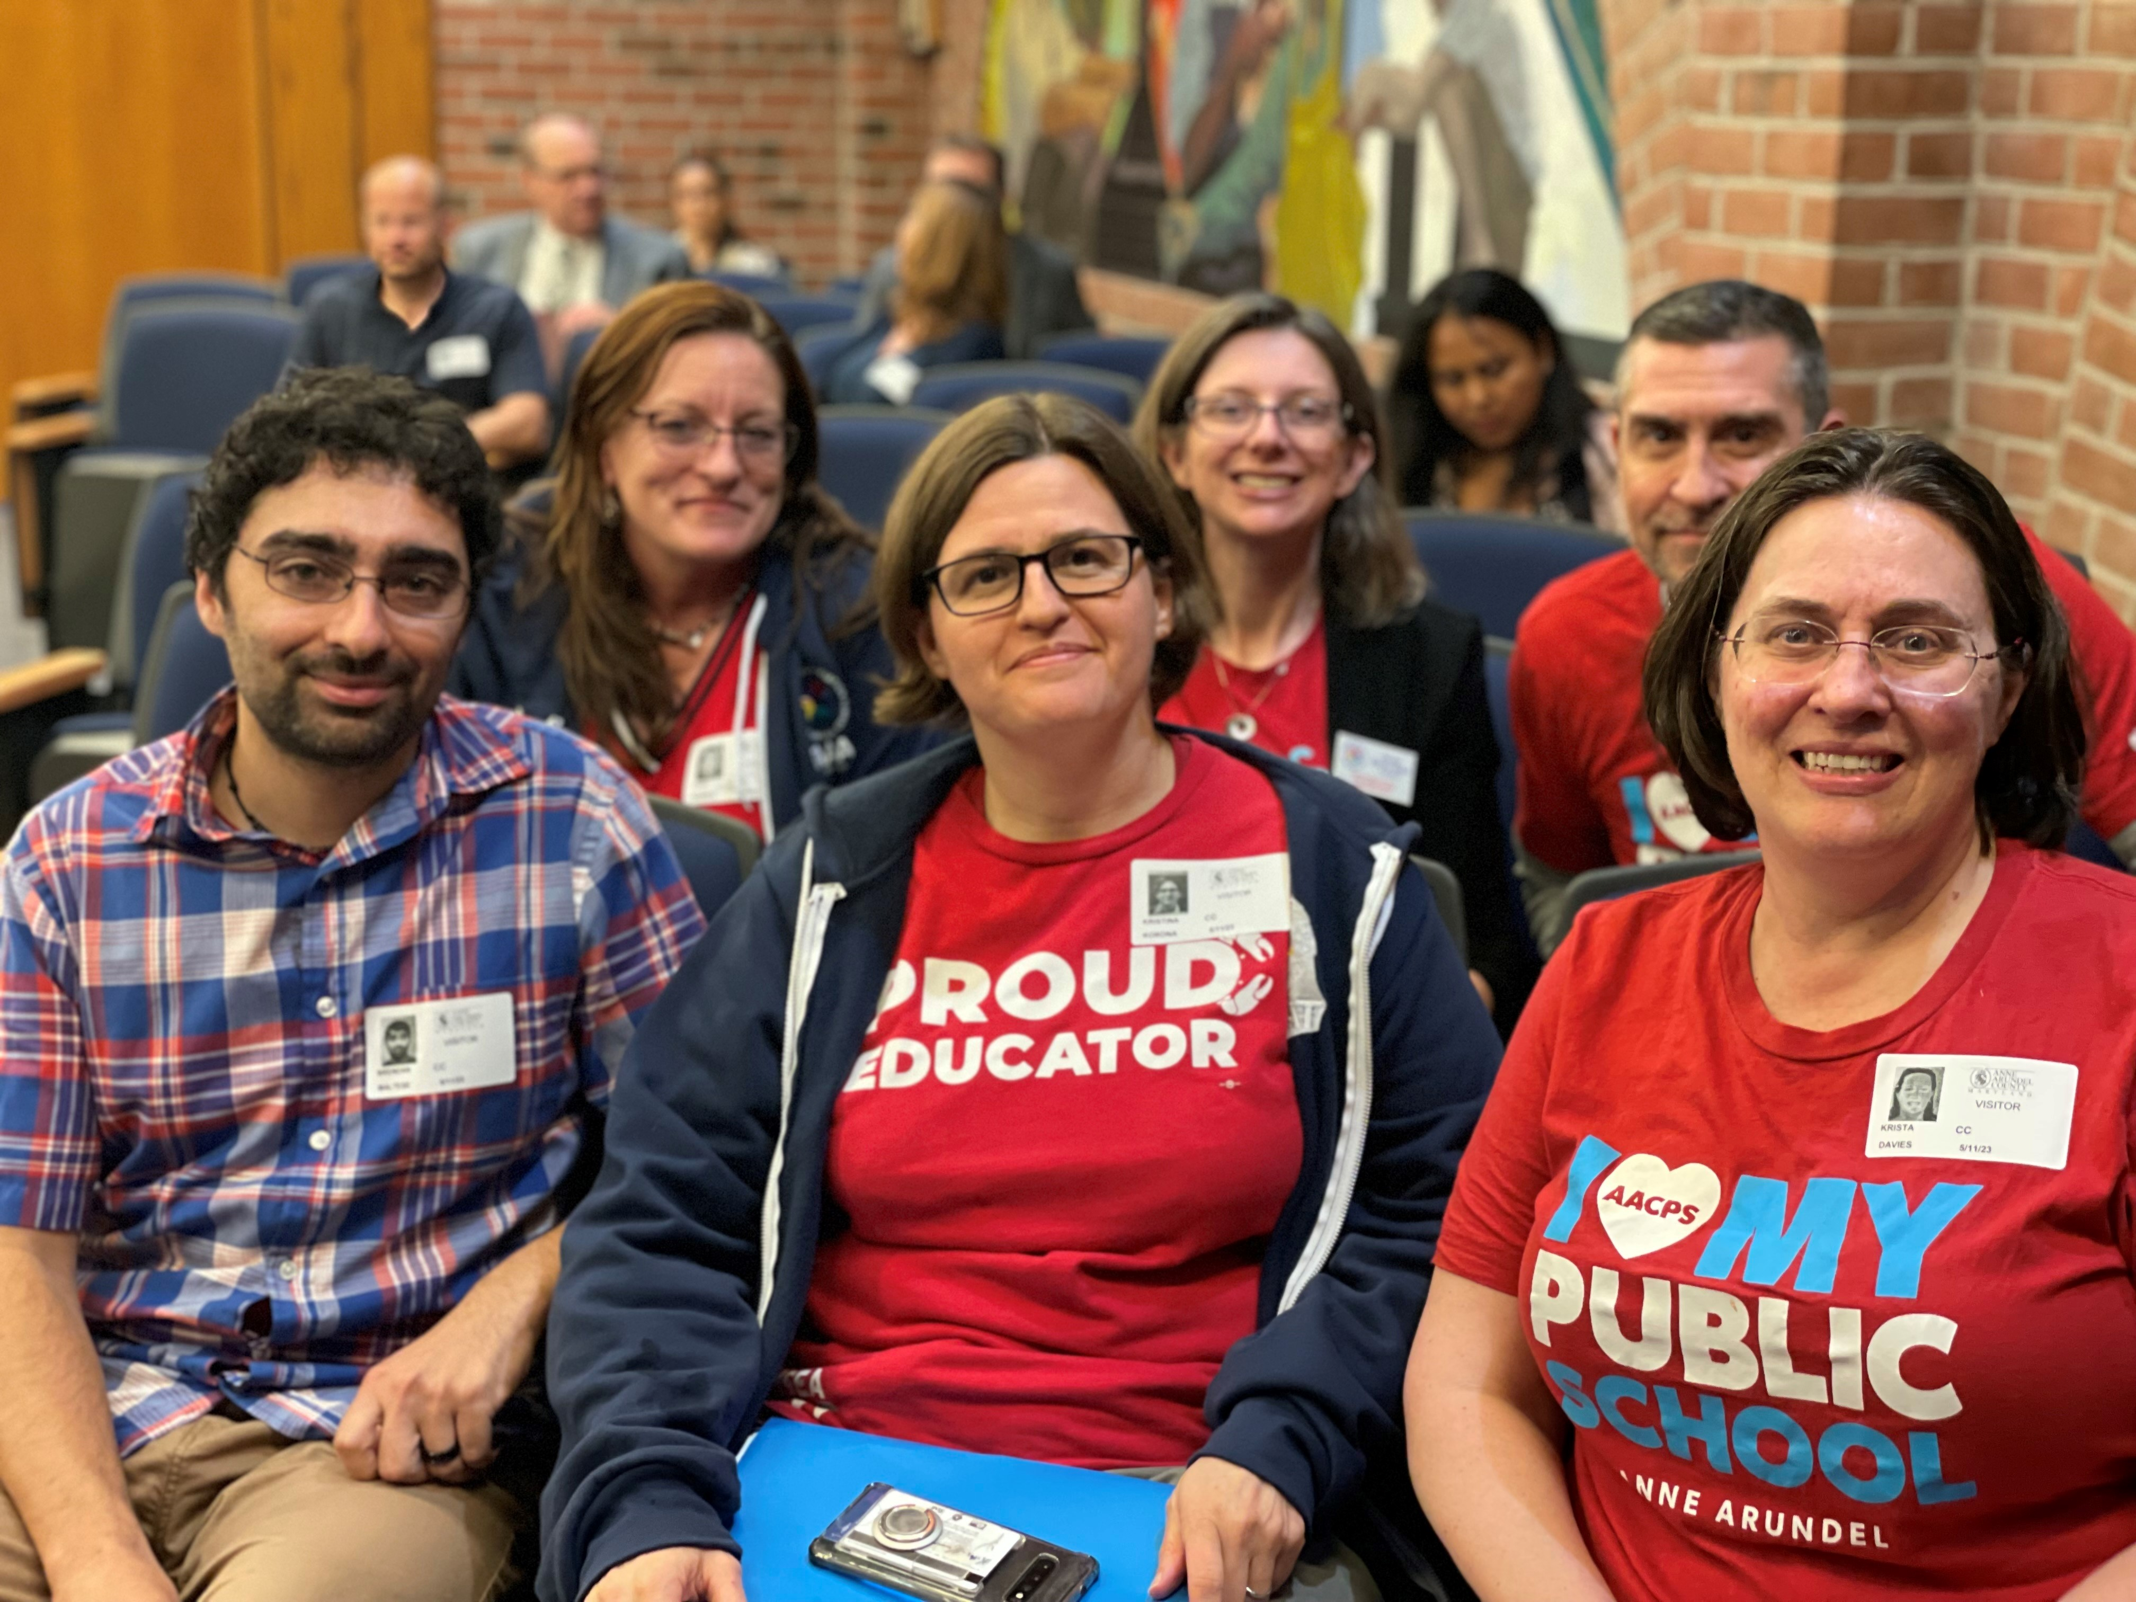
“Settle a contract that recruits and retains educators”

Slide 4
Compensation
6% COLA and Step
$2,000 stipend for SPED and RSP
Coverage Pay
Co-teachers are now BOTH eligible
MOU continues for 2023-24 school year
Permanent contract language starting 2024-25 school year
Unpaid Leave
New language in the contract allowing members to request approved unpaid leave when other forms of leave, including FMLA, are exhausted
Blueprint
Sub-group established to determine new pay scales

Slide 5
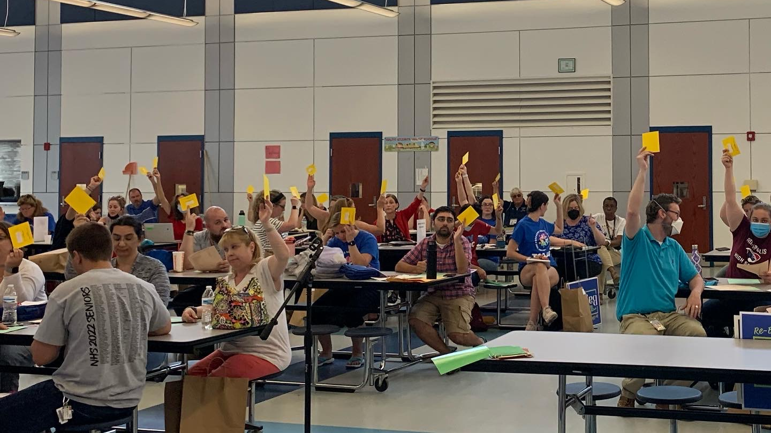
RATIFICATION
Dates: May 24-June 7, 2023
What you need: MSEA ID#
Scan to vote!

Slide 6
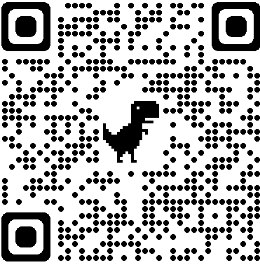
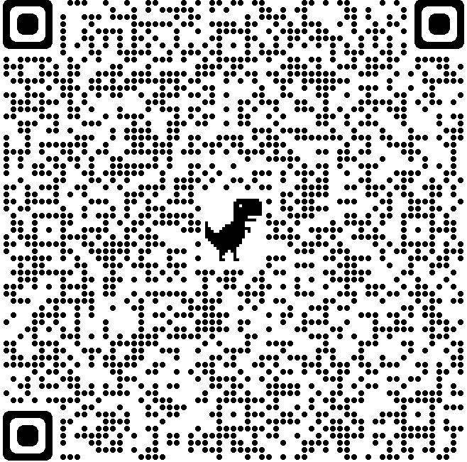
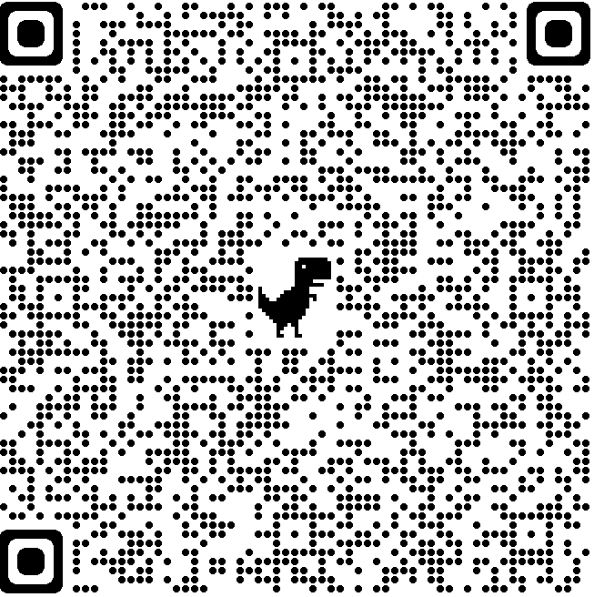
QUESTIONS
May 24
South River High
May 30
Glen Burnie High
June 2
Zoom
June 7
Severna Park High

