Slide 1
TAAAC 10-Minute Meeting
May 2023

Slide 2
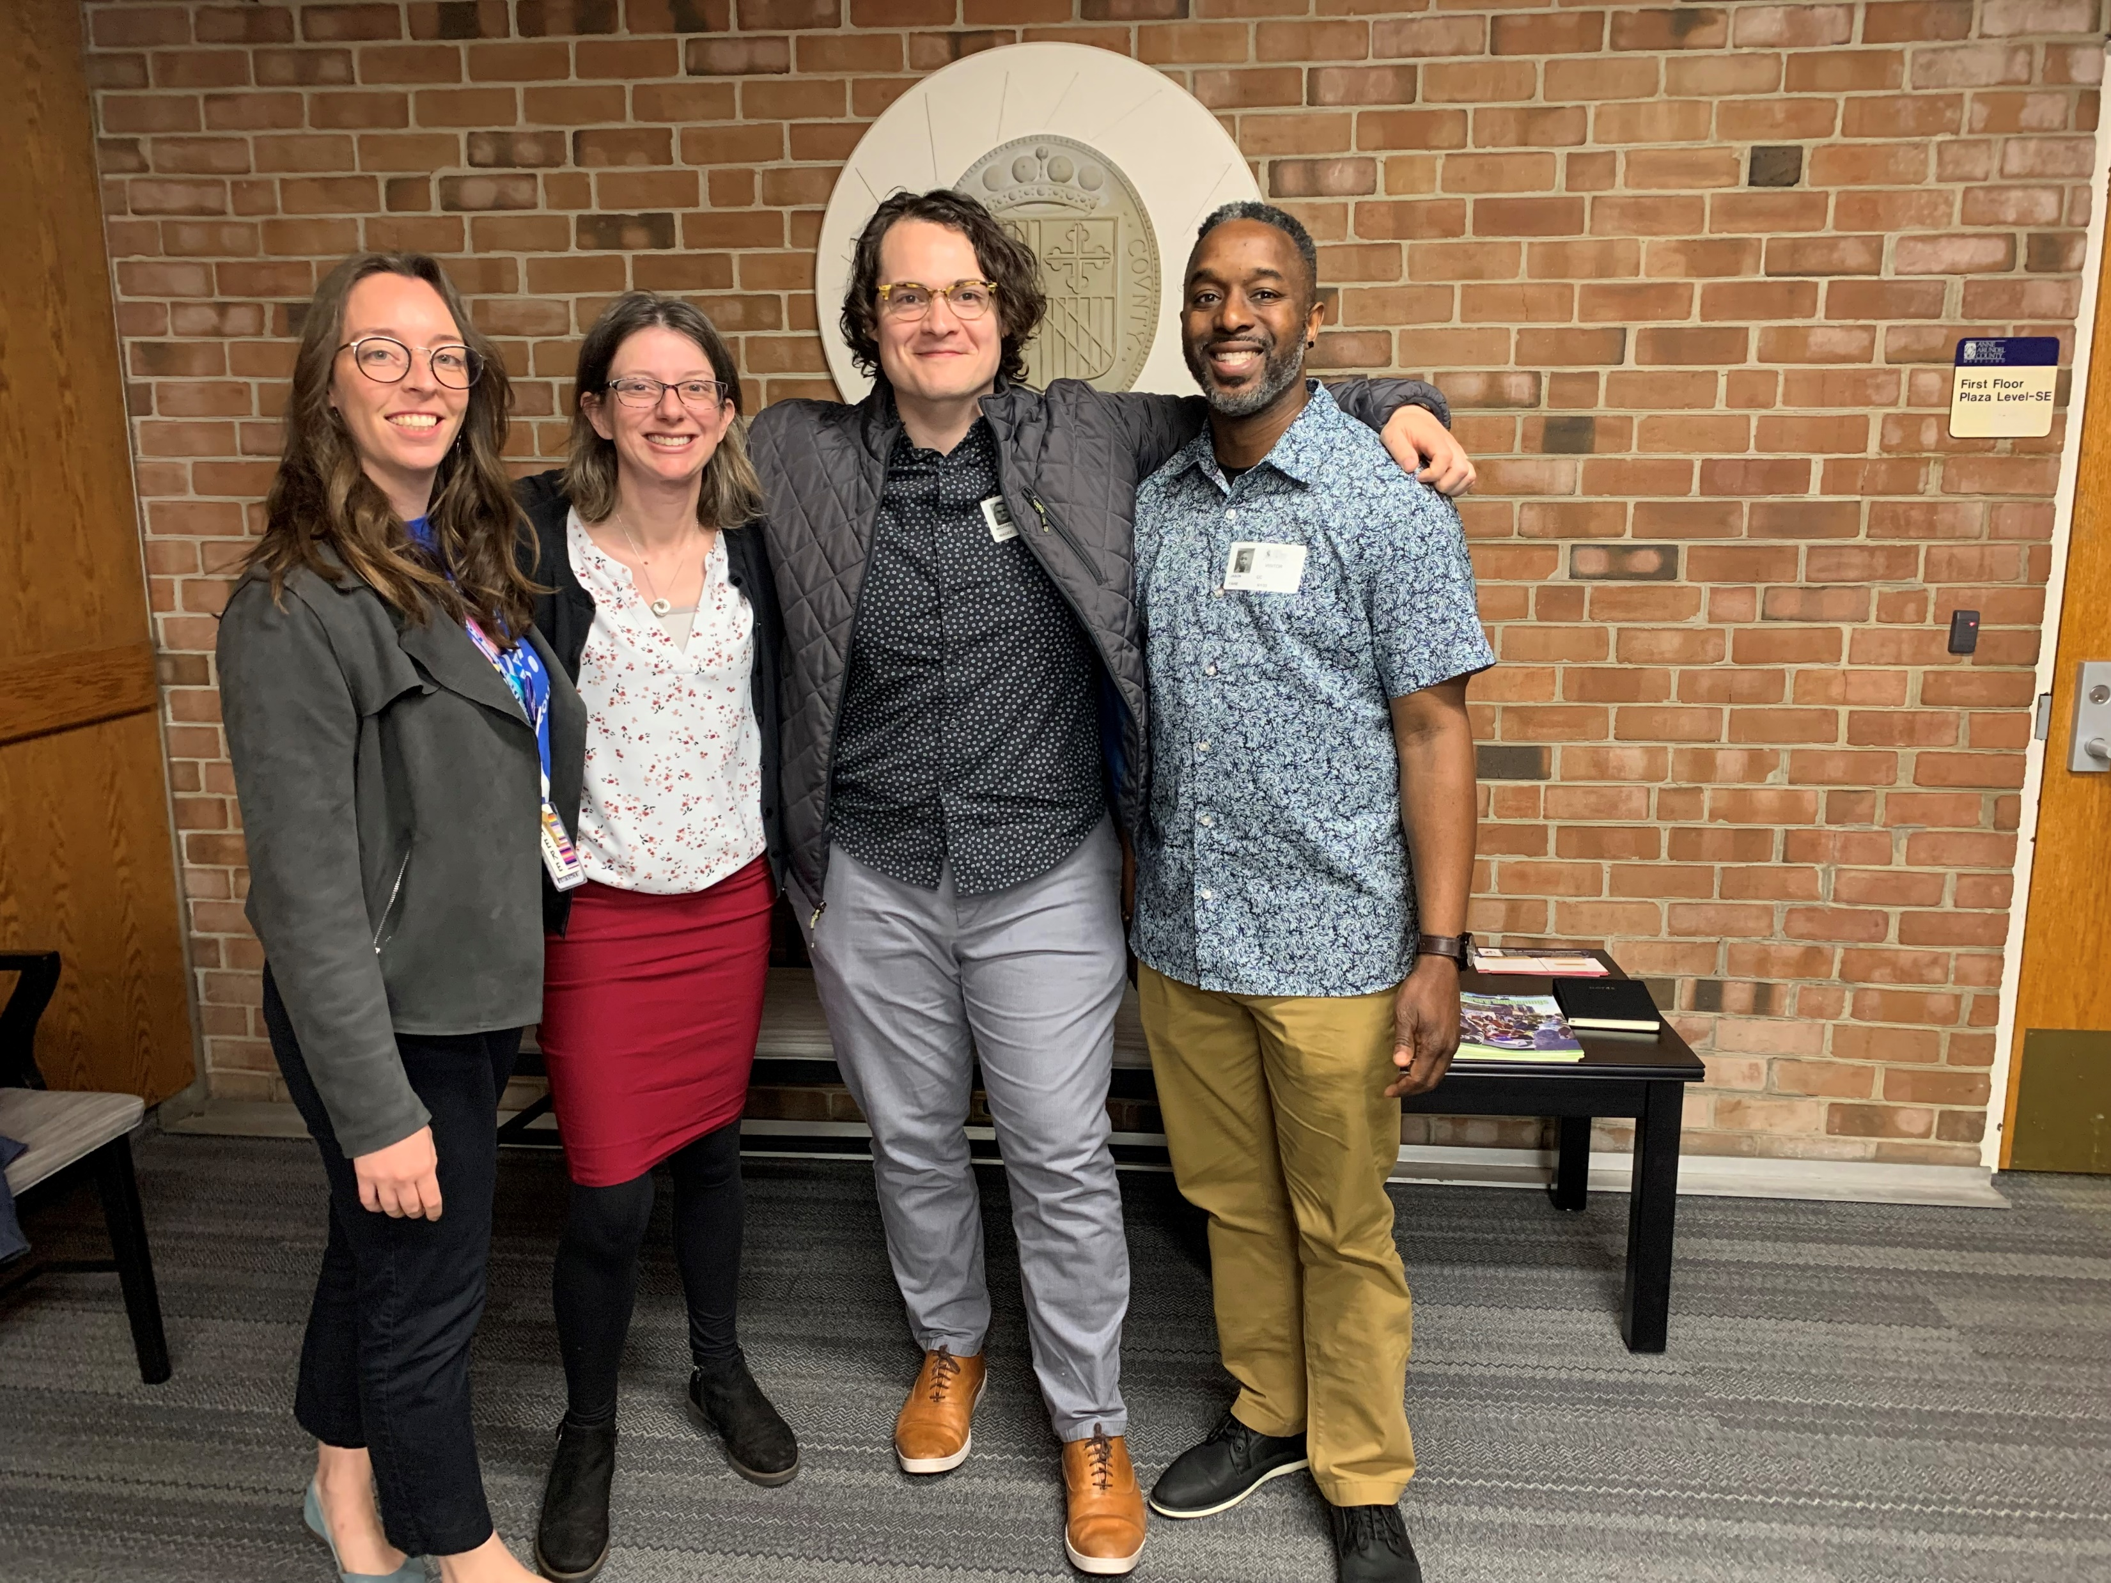
AGENDA
Funding Our Future
Work with TAAAC
Upcoming Events

Slide 6
Upcoming Committee
Finance Committee Budget Hearing: June 1

Slide 12
QUESTIONS?

