Slide 1
March 2023
TAAAC 10-Minute Meeting

Slide 2
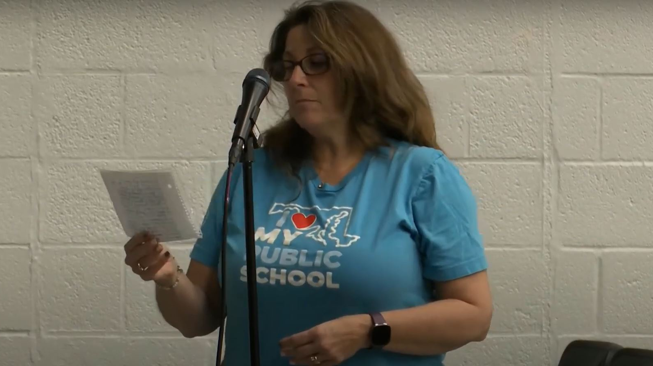
Agenda
Anne Arundel County Budget
Lobbying + Blueprint Updates
Committee updates
Bargaining
FEE Scholarships
TAAAC Budget
Union elections
Know your Rights

Slide 3
Latest on the Budget
Call and email your Council member to ask them to fully fund the public education budget!

Slide 4
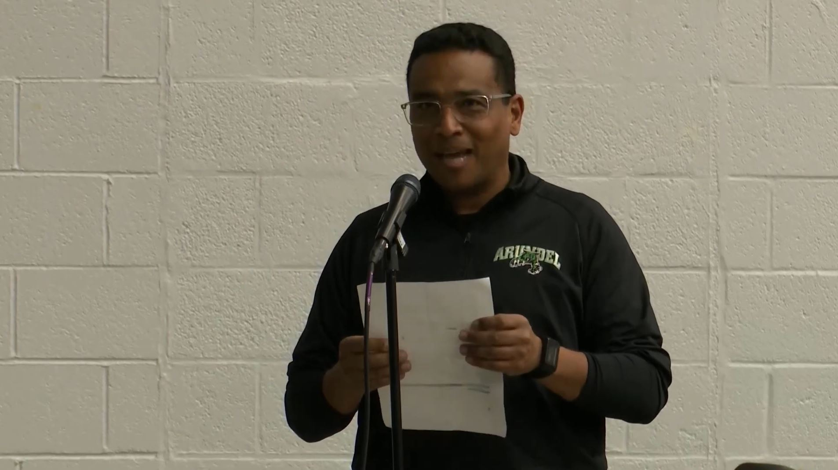
Updates from the State House
March 23
Blueprint Forum

Slide 5
COMMITTEE UPDATES
BARGAINING

Slide 6
Foundation for Educational Excellence Scholarships
COMMITTEE UPDATES

Slide 7
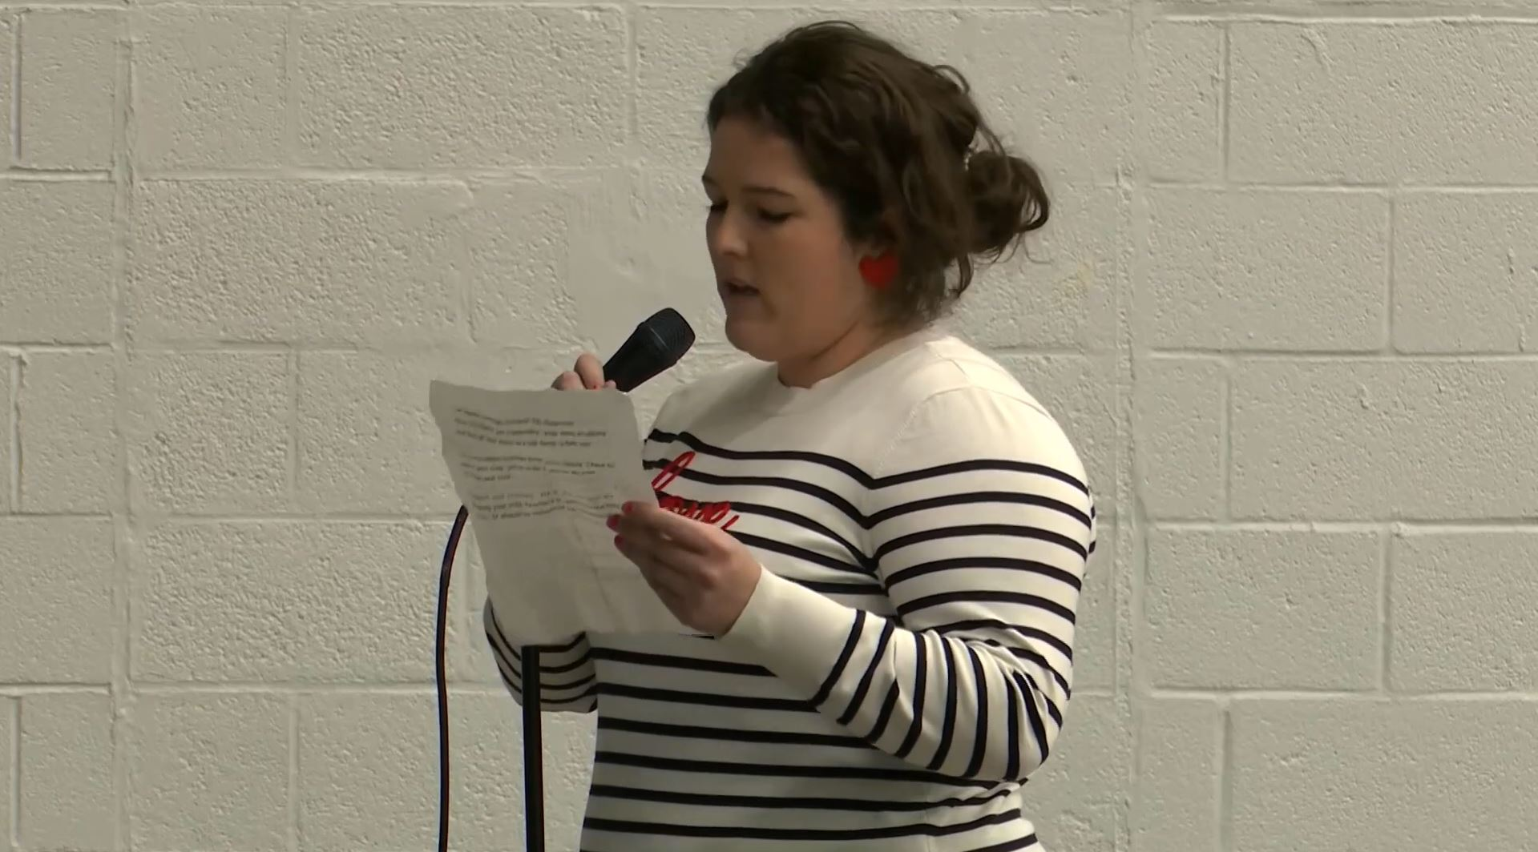
TAAAC BUDGET
COMMITTEE UPDATES

Slide 8
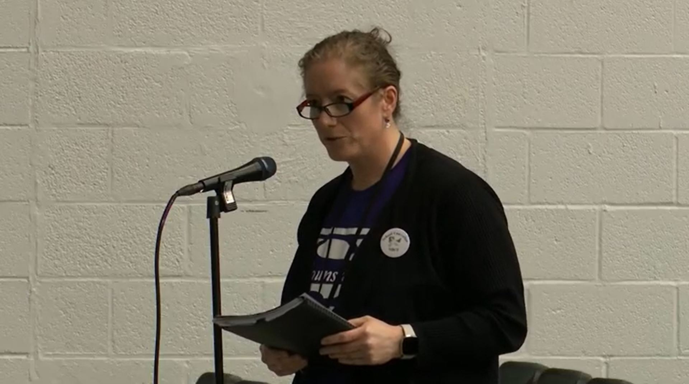
UNION ELECTIONS
COMMITTEE UPDATES

Slide 9
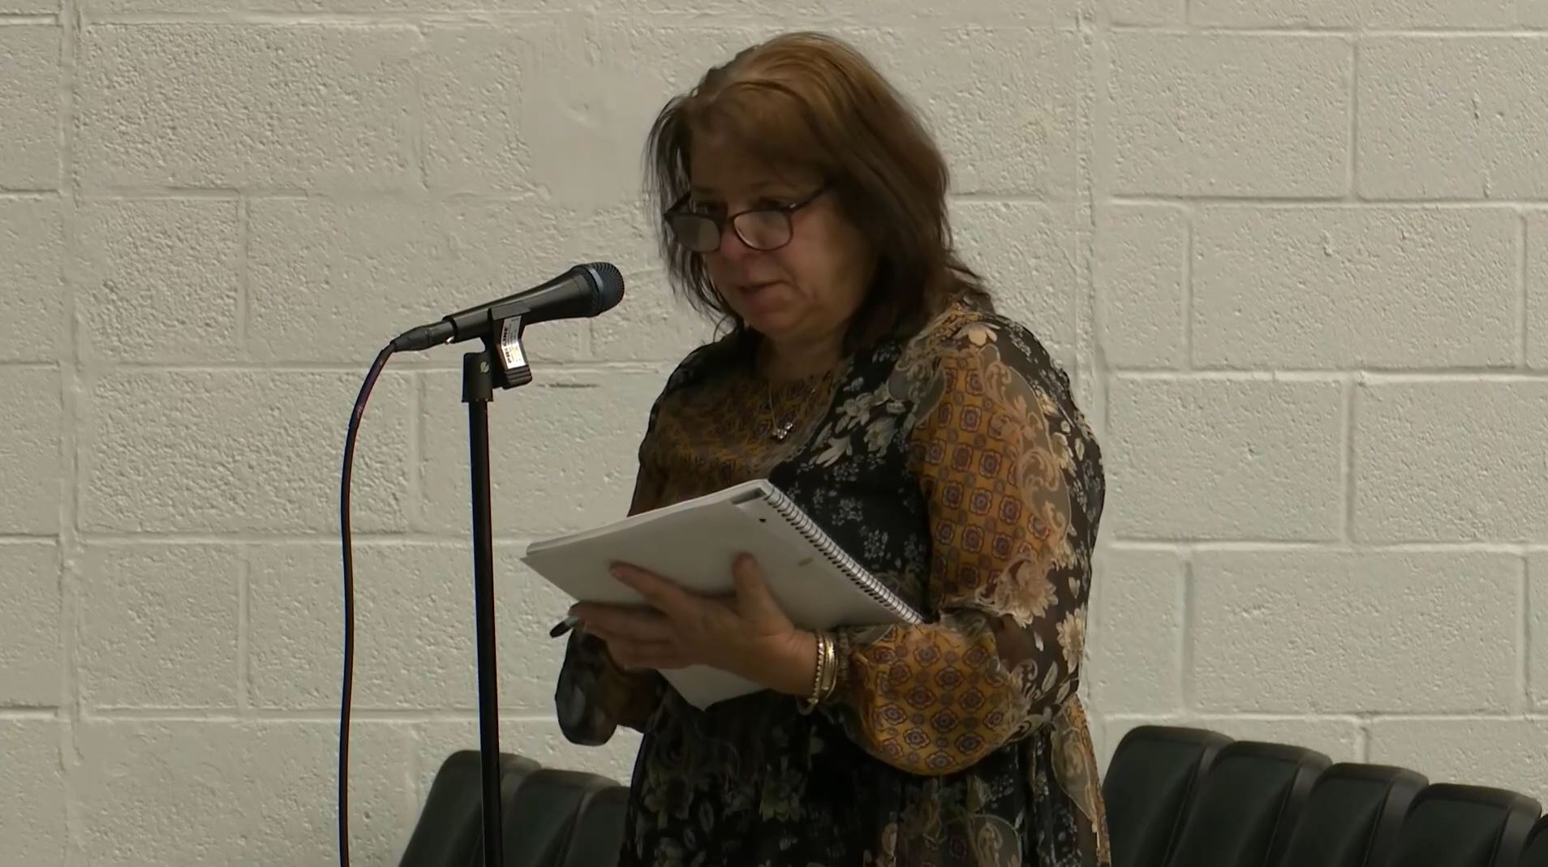
KNOW YOUR RIGHTS
Are you Tenured?
Yes
No
To receive healthcare through August, a teacher must give notice of resignation by April 15
Non tenured teachers being considered for non-renewal must be notified by April 15
To receive healthcare through August, a teacher must give notice of resignation by April 15
Tenured teachers must resign no later than July 15 for the following school year
Non tenured teachers must resign no later than May 1 for the following school year

Slide 10
QUESTIONS?

