Slide 1
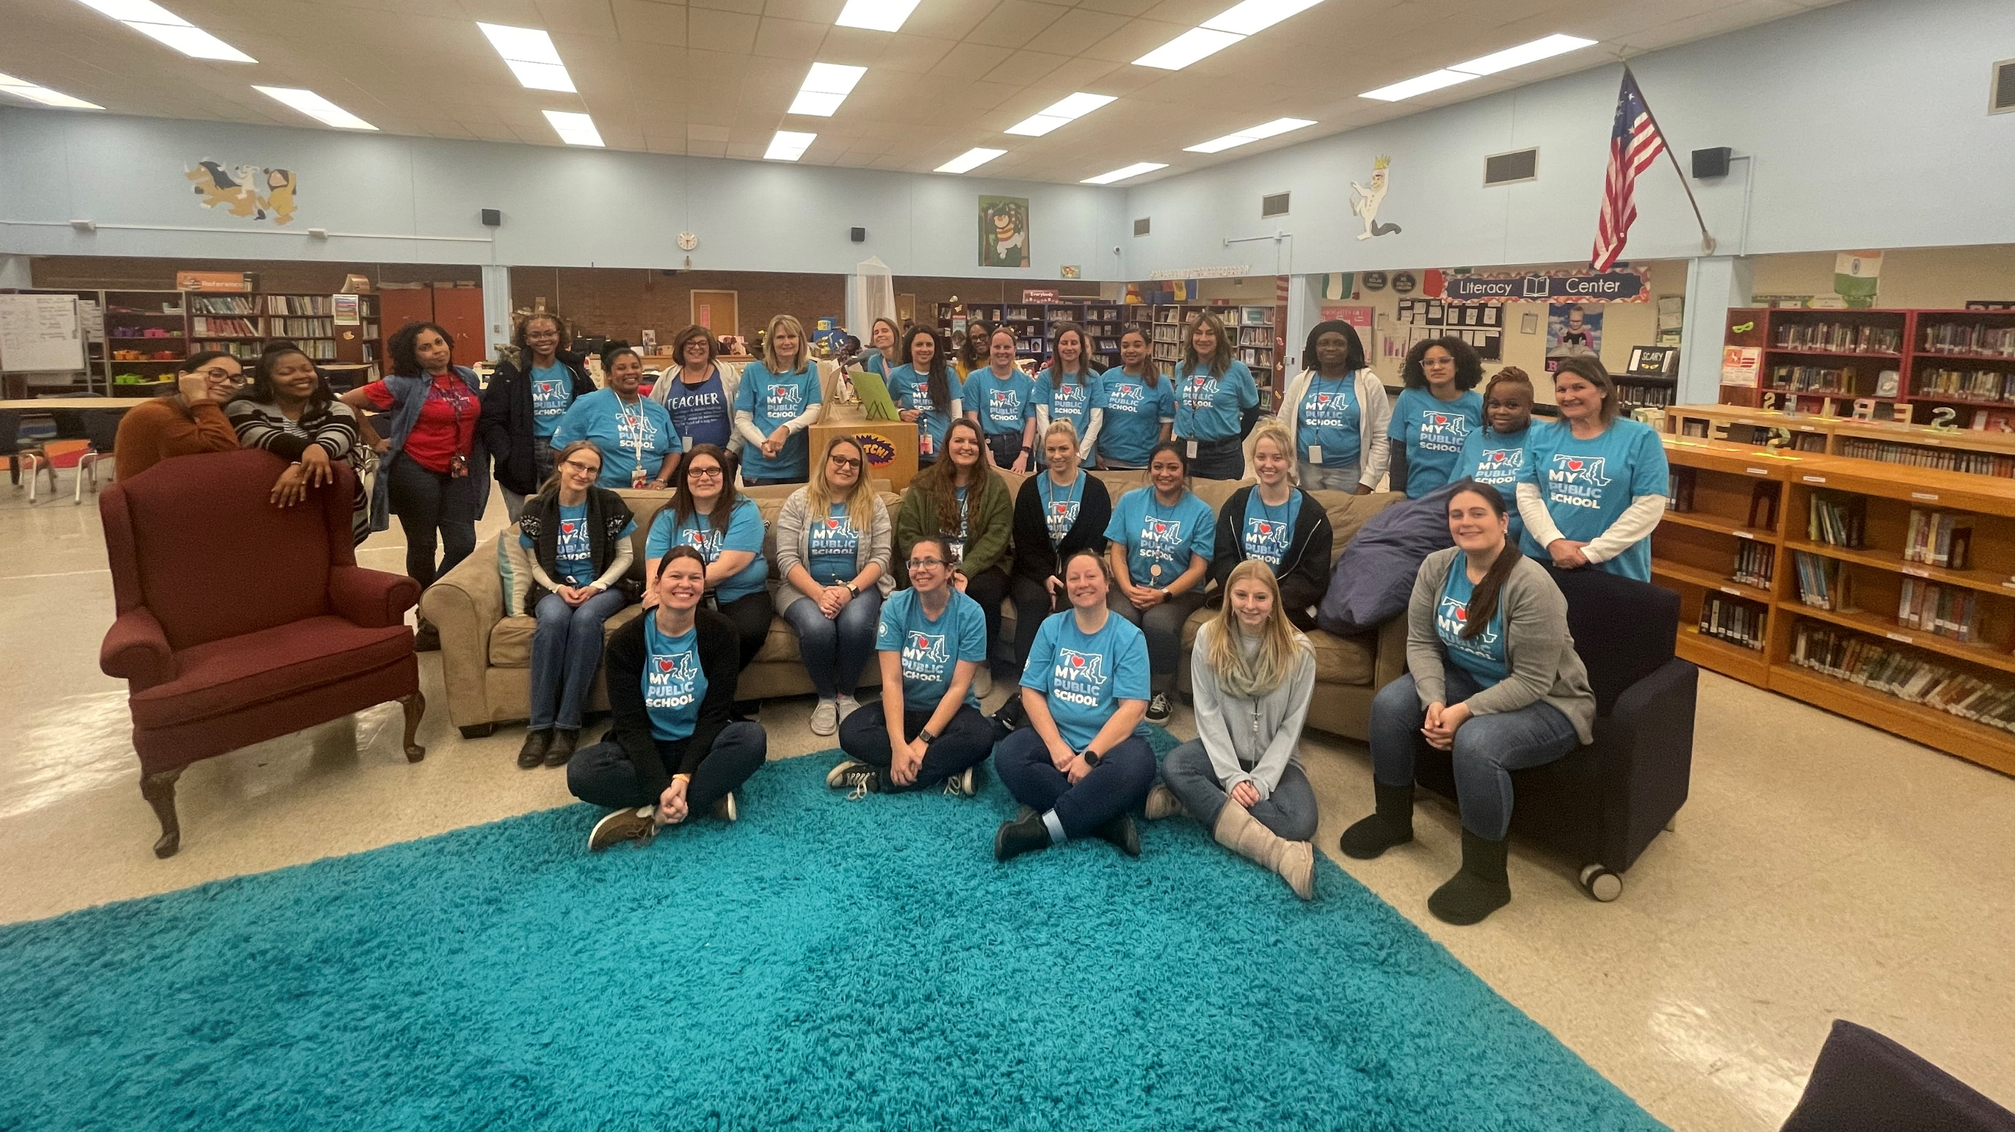
February 2023 10-minute meeting
Notes:
Welcome to the February 10-minute meeting! Over the last month, members of our union have spoken out for safe learning and working conditions at MacArthur and Lindale Middle Schools and with the help of our union called on Superintendent Bedell directly to increase adult presence in our schools with the help of our community.

Slide 2
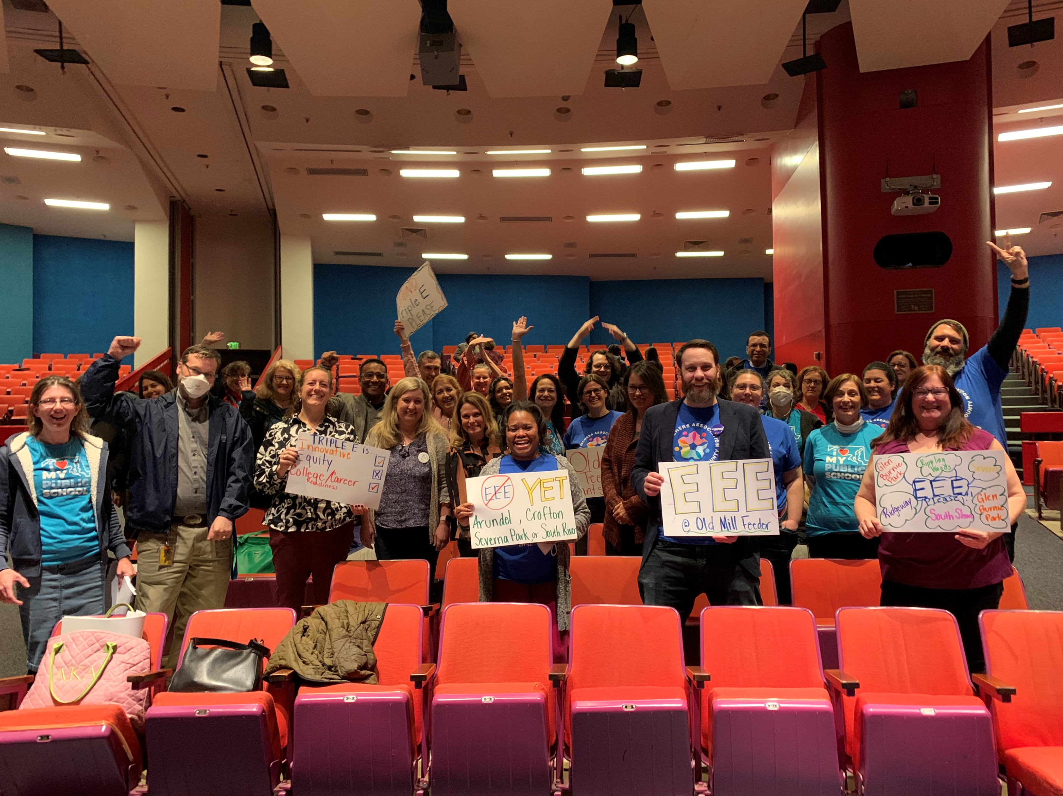
Agenda
TAAAC Elections
Budget Season
Advocating for public education
Negotiations Updates
Notes:
For the month ahead, we’ll discuss elections, the county budget including funding for our salary, lobbying at the county council and capitol, and bargaining updates from our negotiations team.

Slide 3
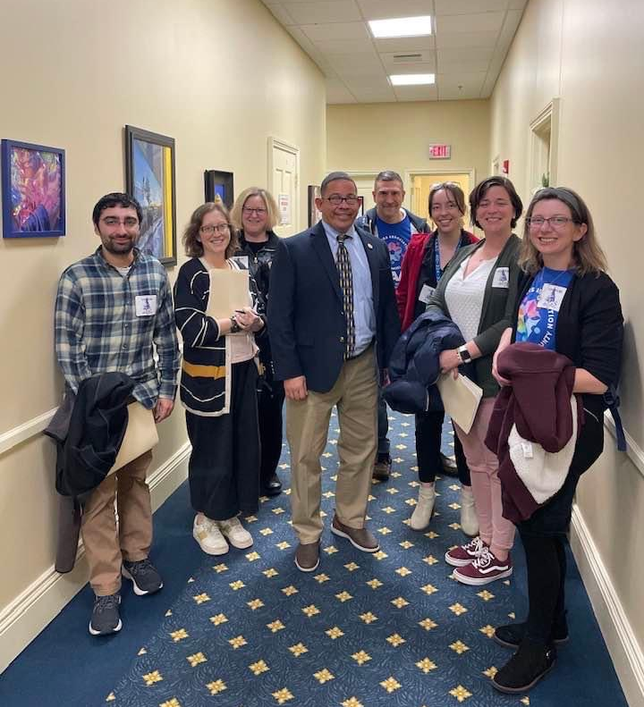
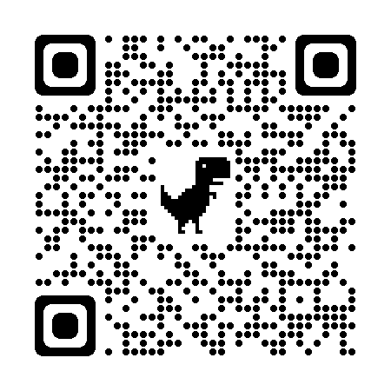
Elections
Elections open until February 17 at 5:00 p.m.
Vacant Board of Director Seat
Notes:
Elections for TAAAC, as well as our parent unions MSEA and NEA began on January 30! You can vote until February 17 at 5:00 p.m. for TAAAC Secretary-Treasurer, Board of Directors, and delegates. To vote, you need your MSEA ID, and the last four digits of your social security number. I (your building rep) have your MSEA ID, come see me if you need it or call the TAAAC Office at 410-224-3330. You can use the QR code here to vote now, or check your personal email for the link. The school (one per elementary, middle, high, and center) who has the highest percentage of members voting will win pizza on TAAAC! Vote at vote.yeselections.com/MSEA
Additionally, our Building Reps voted on February 8 to fill a vacancy for the Secretary-Treasurer seat. Congratulations to [UPDATE AFTER RA].

Slide 4
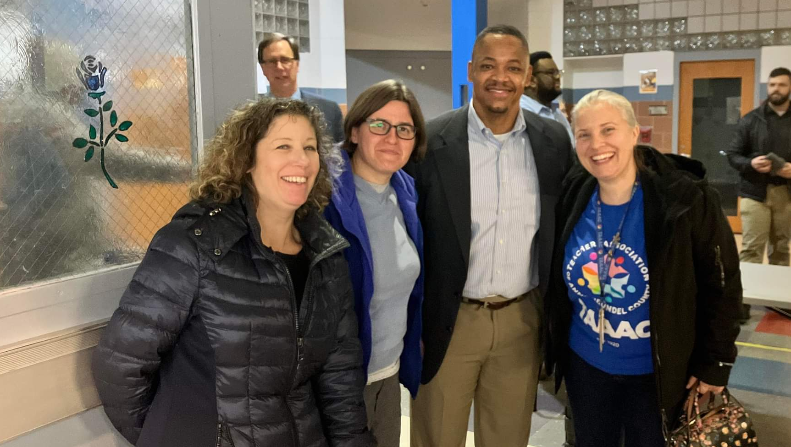
BUDGET SEASON
Notes:
As we mentioned last month, budget season for Anne Arundel County is upon us. Dr. Bedell proposed his budget which includes a 6% COLA and one step increase for our unit. Now, this budget goes to County Executive Pittman and the County Council to fund the budget, which will likely require a revenue increase. Pittman needs our help advocating for full funding of the education budget! Use this QR code to learn about how you can show support by attending one of the budget hearings until February 13. You can also submit written testimony to budget-comments@aacounty.org. We’ll share out more ways you can get involved in the coming months.

Slide 5
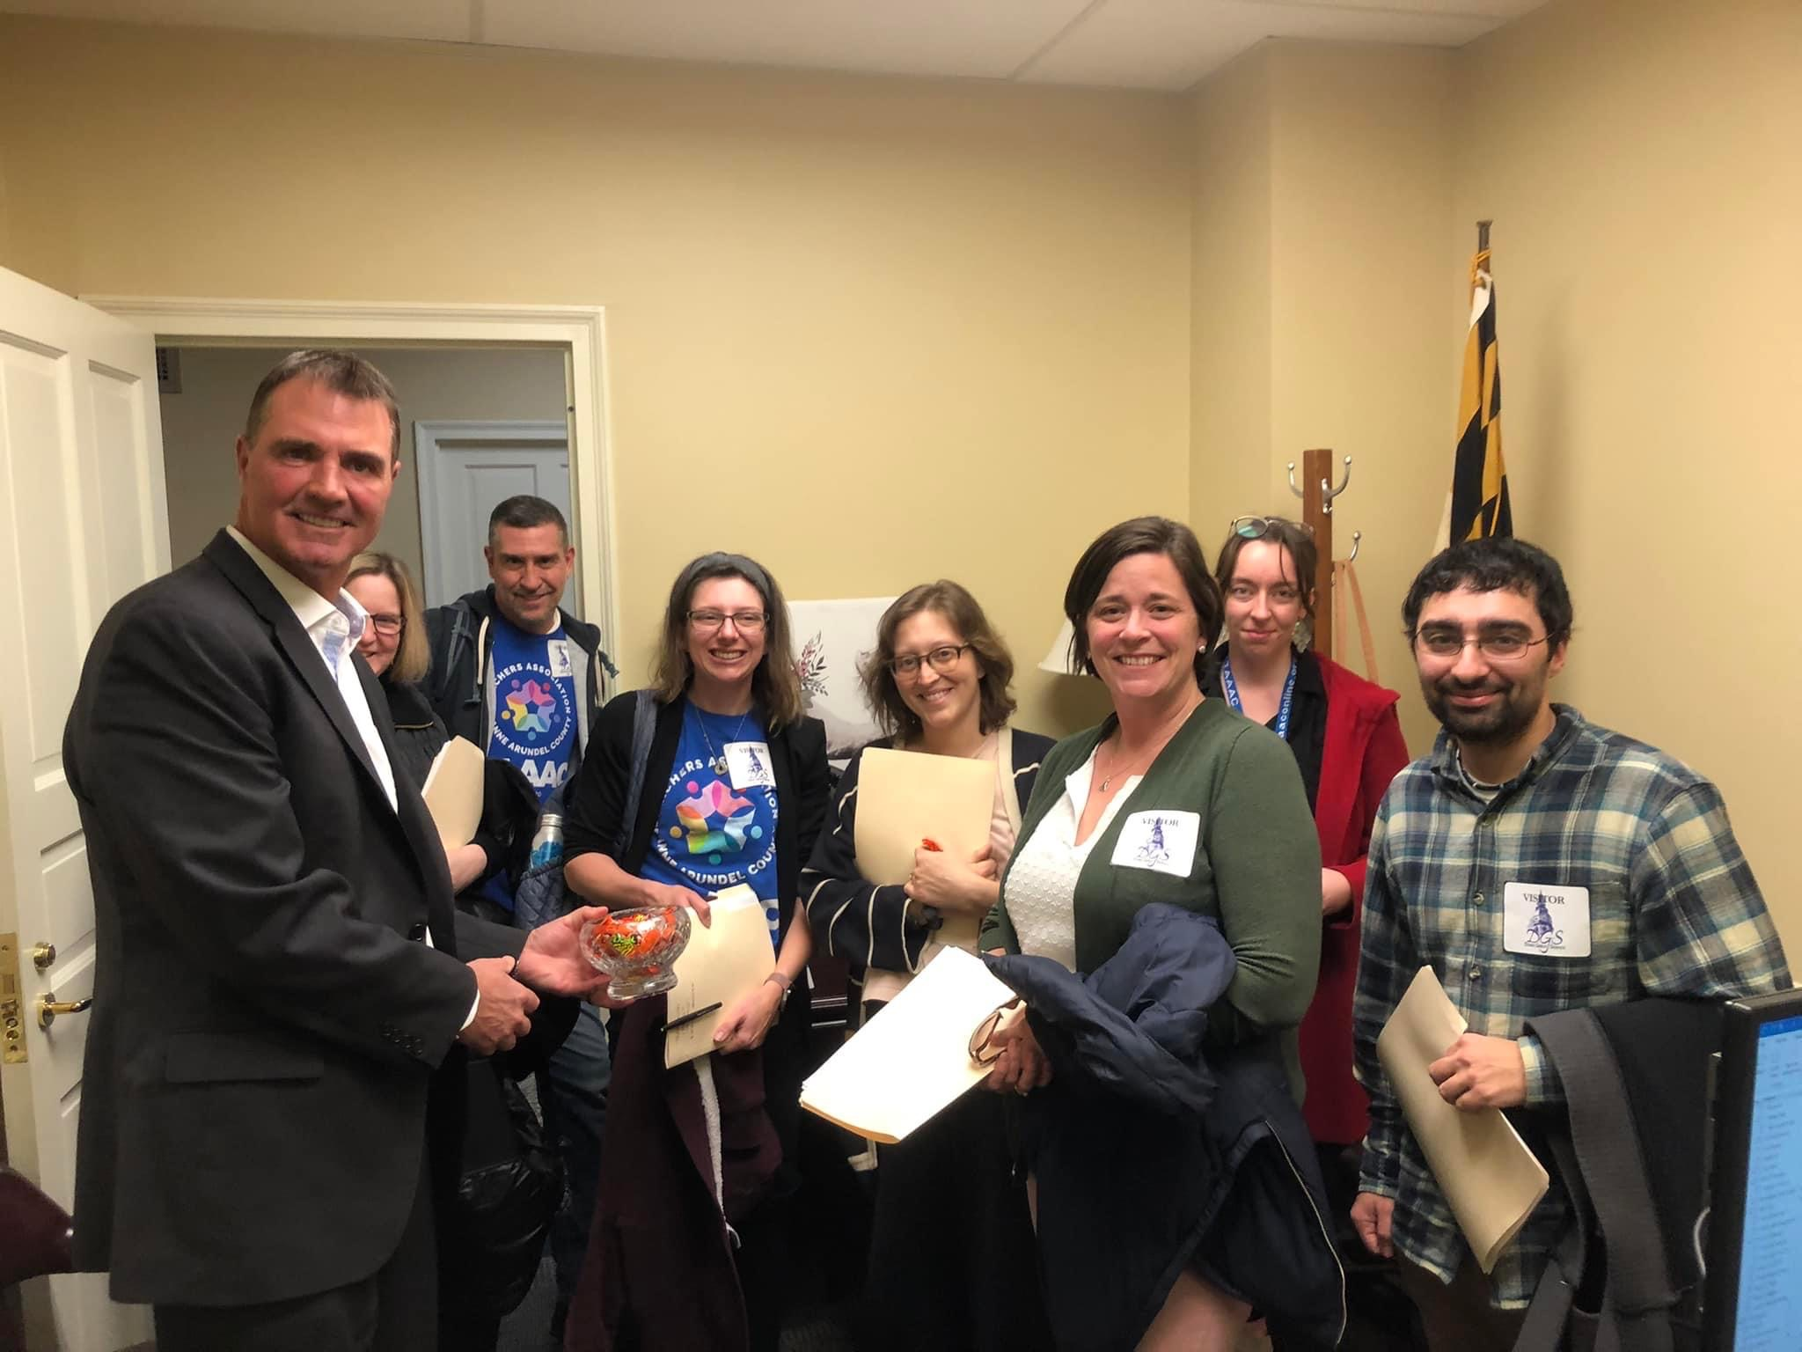
Advocating for Public Education
Feb 13
Feb 14
Feb 21
Feb 27
Notes:
Lobby sessions have restarted for our union! Throughout the legislative session, members will have the opportunity to meet with County Council member, Delegates, and Senators from both sides of the aisle to advocate for pro-public education legislation. We’re talking about everything from funding the Blueprint to the life cycle of school buses to our salaries. Here are the dates in February we’ll be meeting. Use the QR code to sign up!

Slide 6
Negotiations Updates
Notes:
Our Negotiations team met with AACPS on January 30, and plans to meet again on February 10. They report that while some useful and productive discussions occurred at the last session, there was overall disappointment after AACPS outright rejected two of our proposals without offering any alternatives our paths toward agreement. The proposals were on FMLA (which they will not back down on from trying to solve this problem), and health insurance costs (which they intend to review the data and determine next steps). AACPS plans to bring a proposal on coverage pay to the 2/10 session, and will have a full financial proposal after the Board of Education meeting on February 15. For more updates, read the At the Table on the TAAAC website.

Slide 7
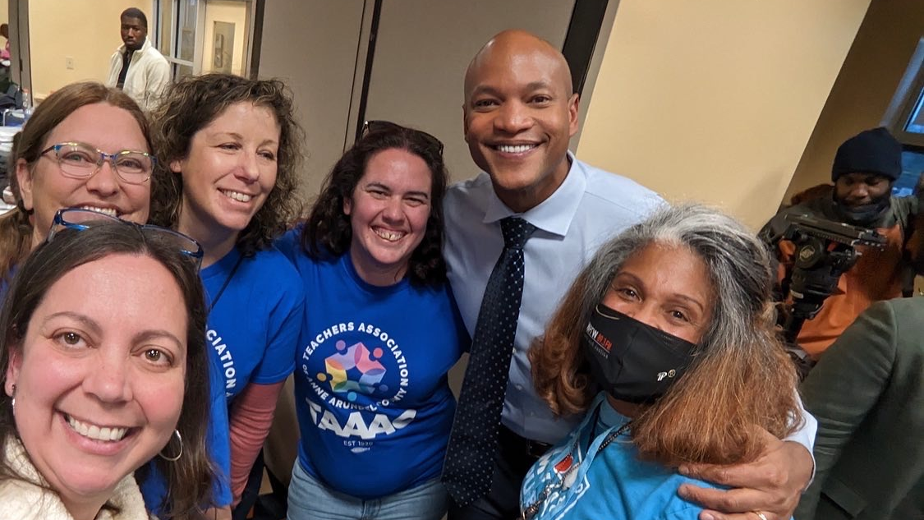
Questions?
Notes:
Questions?

