Slide 1
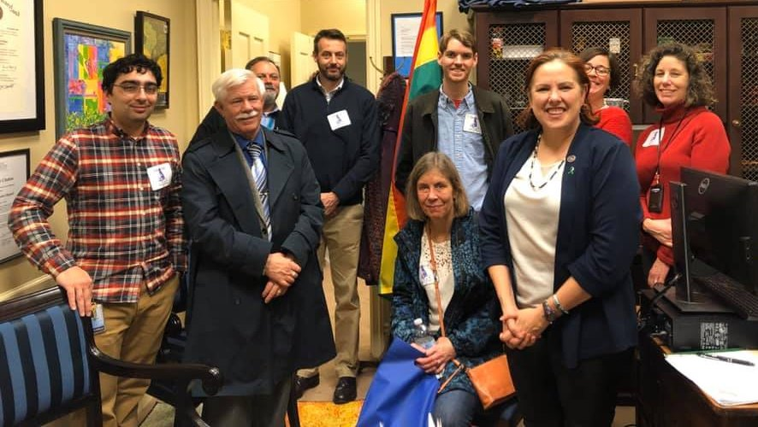
TAAAC 10-minute Meeting
January 2023
Notes:
Welcome to the January 10-minute meeting! We are focusing this month on preparing for the annual budget hearings, which might sound boring, but this is one of our best opportunities to advocate for better wages and working conditions!

Slide 2
AGENDA
Budget Hearing
TAAAC Election
ESP Bill of Rights
Upcoming Events
Notes:
Today we’ll discuss various opportunities to make our voices heard: at the annual budget hearings, in our union elections, by supporting our ESP colleagues, and during our committee events!

Slide 3
BUDGET HEARING
SAVE THE DATE: January 24 at Old Mill High
Notes:
First up are the budget hearings. Dr. Bedell’s proposal of a 6% COLA and one step is a great start, and now we can ask for funding to be allocated to other priorities! Do you want EEE in your school? Should there be more OTs? What support do your classrooms, students, and schools need to be successful? Join us for the Board of Ed budget hearing on January 24 to either speak or attend in solidarity with our priorities.
If you can’t make it, there are opportunities throughout January and February to share your thoughts with the County Council and County Executive Steuart Pittman as well. The County Executive has specifically asked us to help get educators to these hearings because we need full support to fund the education budget. Check out the TAAAC website for information on the dates for each district’s meeting.

Slide 4
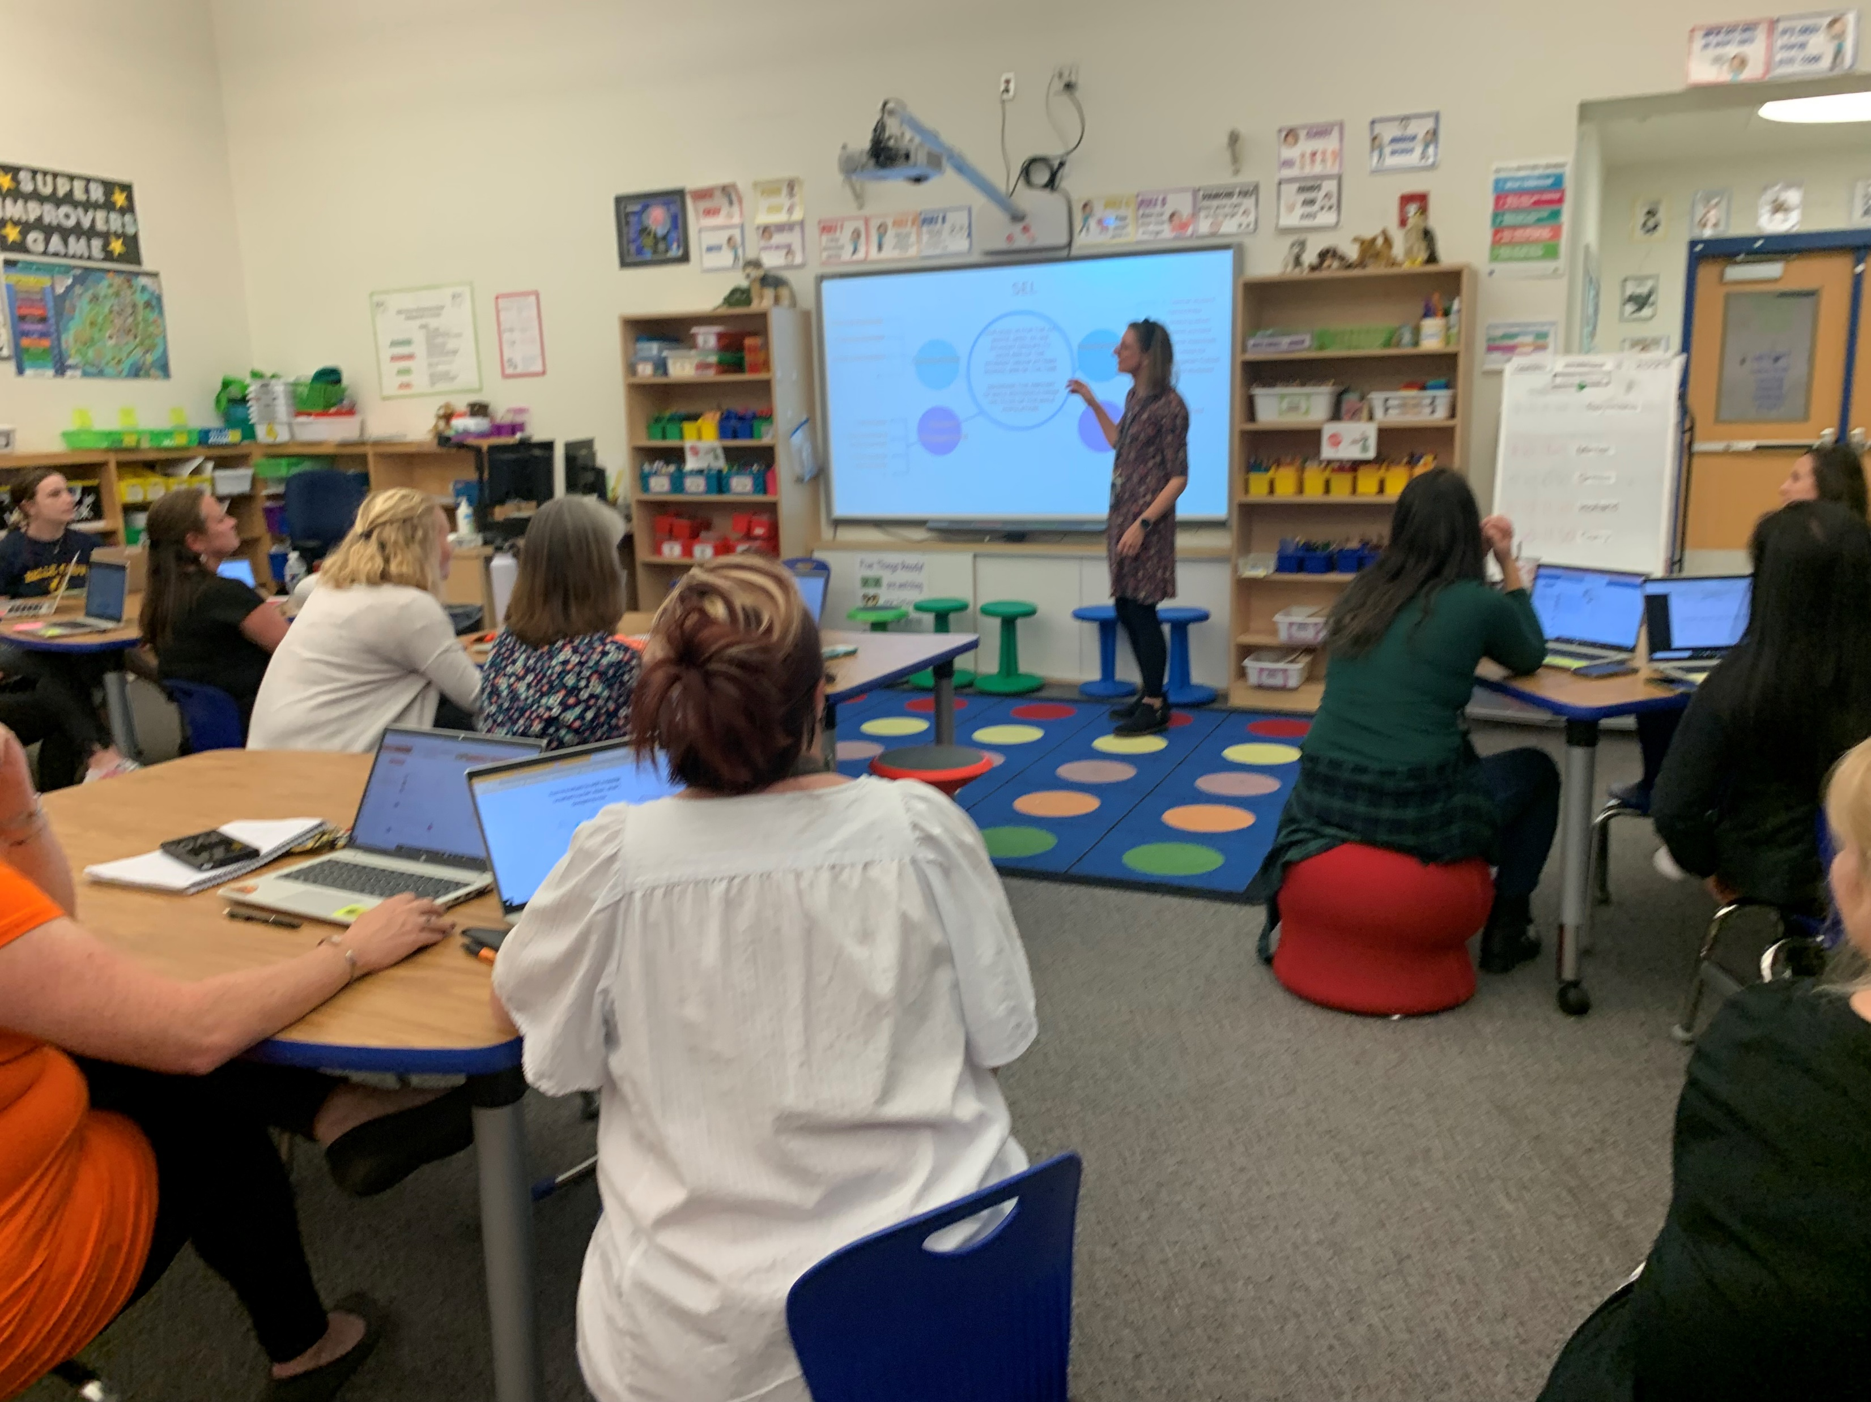
TAAAC ELECTIONS
Welcome new Board of Director member
Nominations open for Secretary-Treasurer
Elections start January 30, 2023
Notes:
This month, we elected a TAAAC member to fill a vacant Board of Director seat. Welcome to Chris Lerch who will join the Board of Directors through the term ending July 31, 2024. Additionally, we have a newly vacant seat for our Secretary-Treasurer. Nominations will be accepted until February 8 and the position will finish the term ending July 31, 2023.
Our regular union elections for Secretary-Treasurer, five Board of Director seats, and MSEA/NEA delegates will start at 9:00 a.m. on January 30, 2023 and close at 5:00 p.m. on February 17, 2023.. These positions will be voted on by all TAAAC members electronically. You will receive information about voting via your personal email.

Slide 5
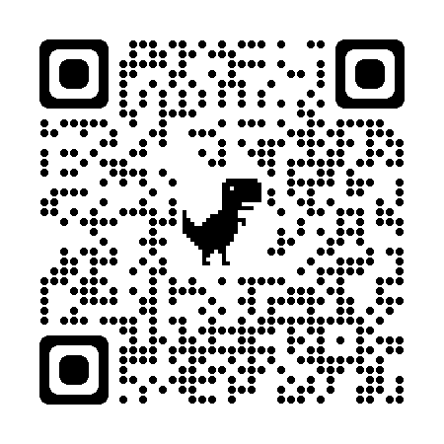
Notes:
Another priority for educators across the state is lifing up our Education Support Professional colleagues. Our parent union MSEA has developed an ESP Bill of Rights, and member leaders are asking staff In every building to sign in solidarity! Use this QR code to download the reach app, then search the campaign code GW4Z6J to add your name.

Slide 6
TAAAC Events
17 Jan.
Contract Action Team
23 Jan.
IPD Committee
23 Jan.
Early Career Educator Committee
30 Jan.
Contract Action Team
2 Feb.
Community Involvement/ Racial Social Justice Committees
Notes:
Finally, we have a few events to kick off the year!
Our Contract Action Team is meeting twice this month to help recruit for the budget hearings, and then plan next steps to help our negotiations team win a strong contract.
On January 23 we have two events: a training on Trauma-informed education by the president of the teachers union in Prince George’s County, and a happy hour for our early career educators!
Then next month, our Community Involvement Committee and Racial Social Justice Committee are hosting a joint meeting to plan volunteer activities for the rest of the school year.
If you’re interested in joining any of these meetings, visit the TAAAC website to RSVP!

Slide 7
QUESTIONS?

