Slide 1
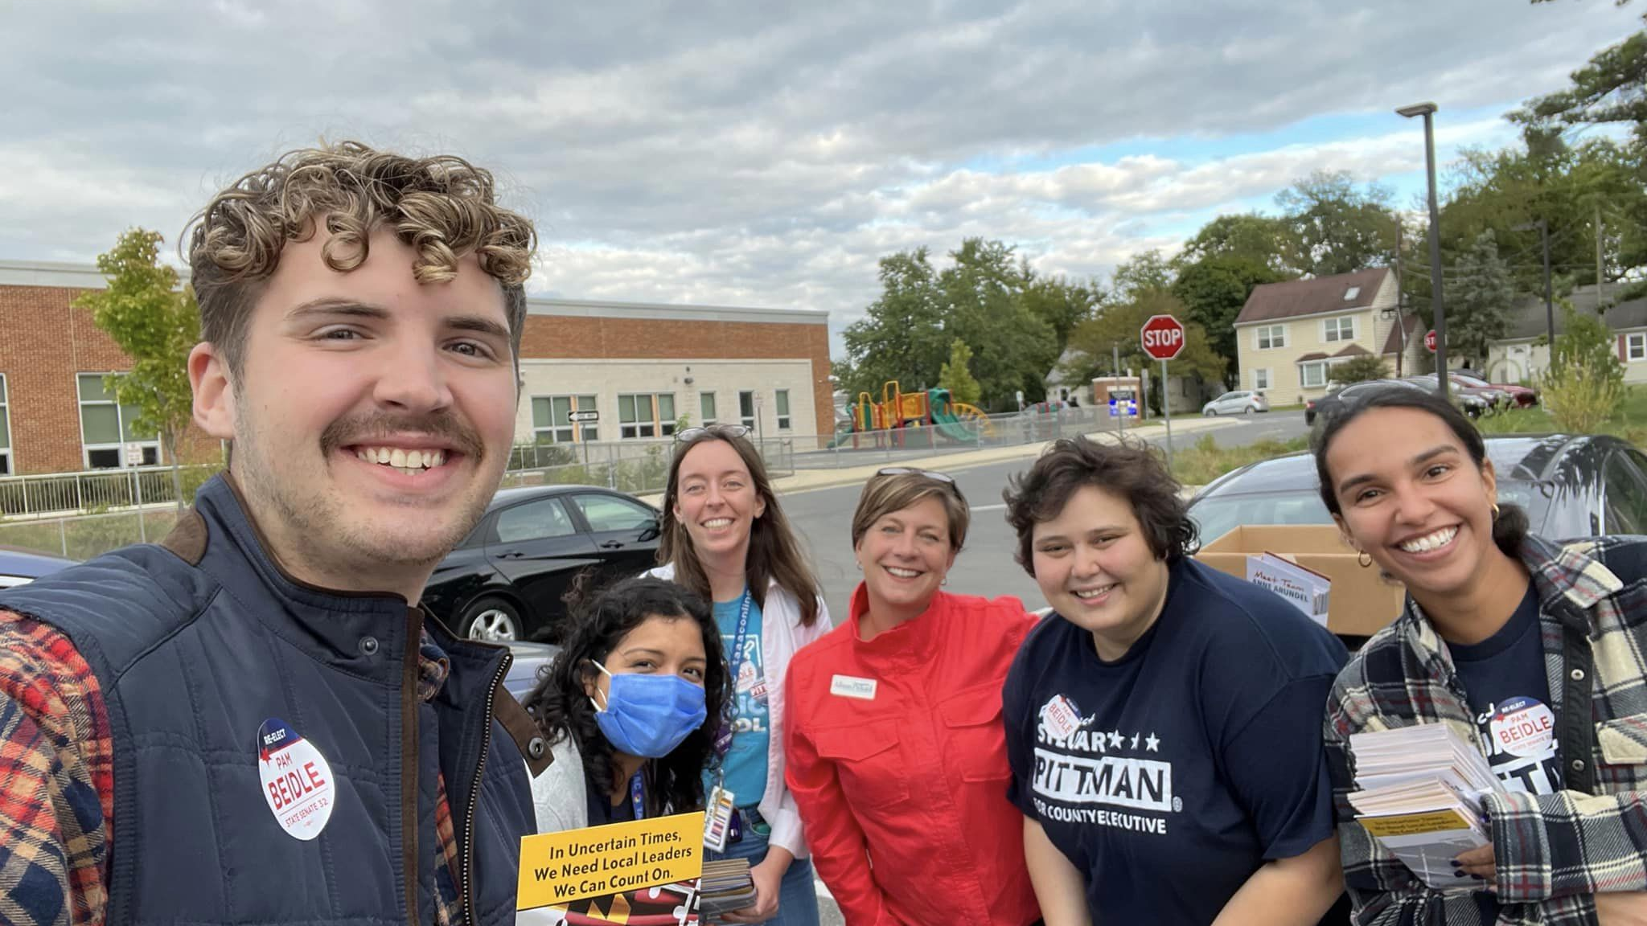
10-MINIUTE MEETING
October 2022
Notes:
Welcome to our October 10-minute meeting! Since last month, we’ve made huge strides on lowering Brightspace expectations, increasing pay for educators who are taking on additional work, and developing a partnership with Dr. Bedell. None of this is possible without the work of TAAAC members, so congratulations. We have a lot of work to do still but it’s a good start to a tough year.

Slide 2
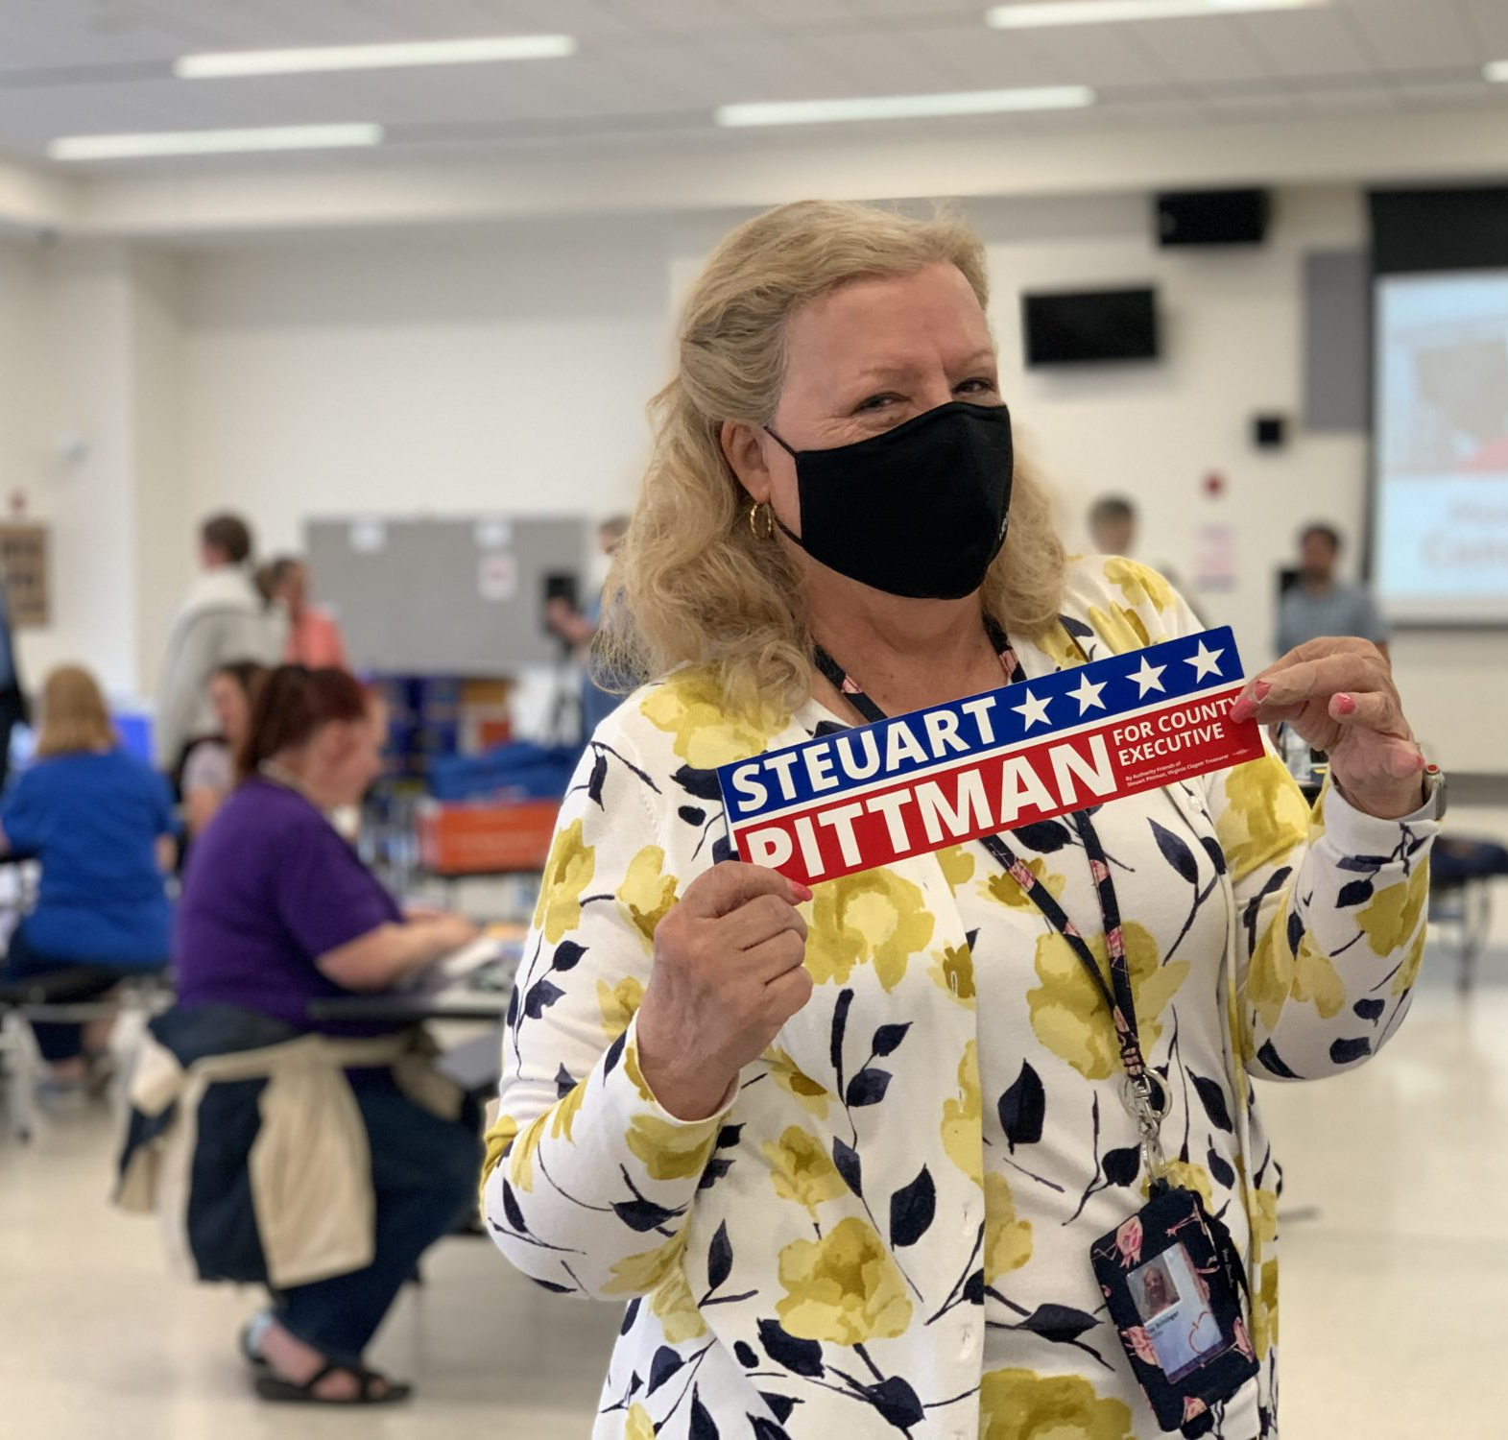
AGENDA
Get out the Vote
Blueprint
Bargaining
Elections
Notes:
Quick agenda review: we’re less than one month away from the midterm election to we have updates on our get-out-the-vote efforts, as well as other advocacy including around Brightspace, the Blueprint, Bargaining, and finally our own union elections.

Slide 3
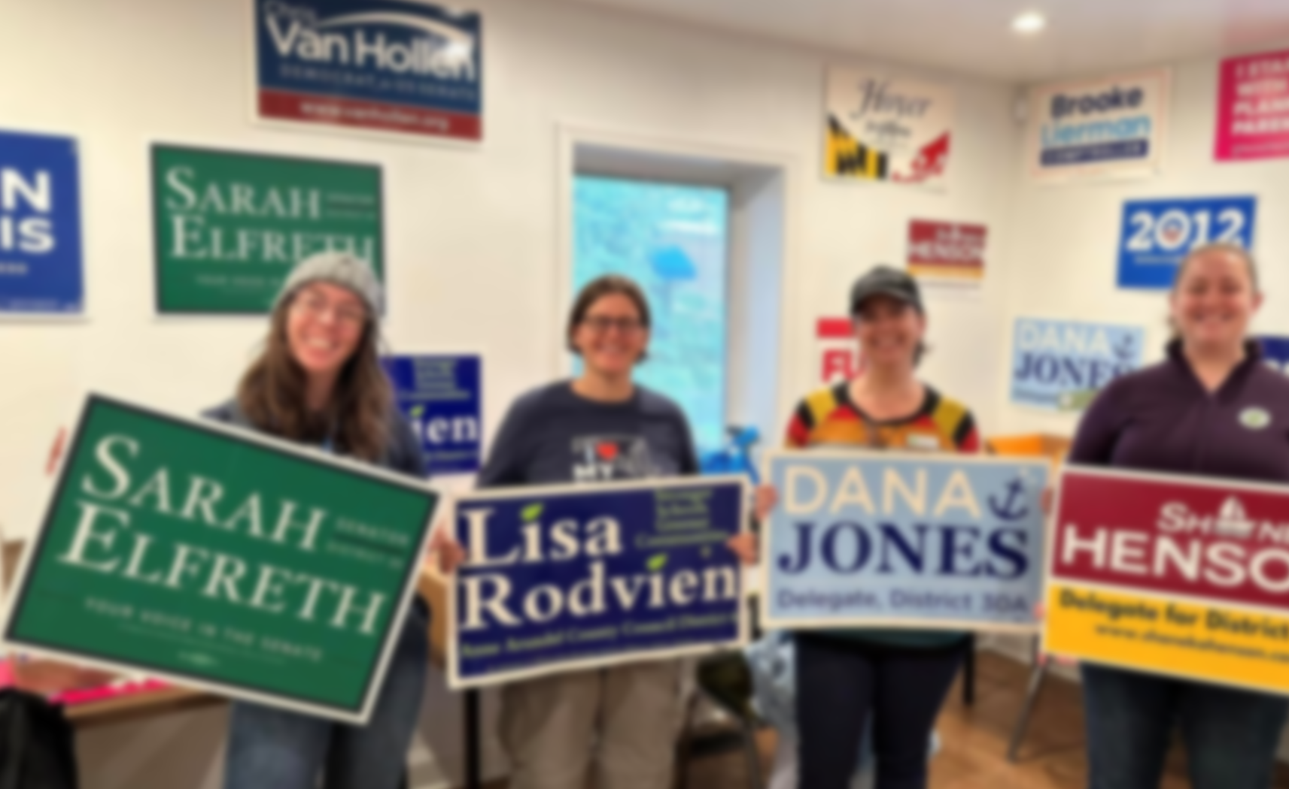
VOTE PLEDGE
Notes:
First up: We all know that decisions are made and elections are won by the people who show up. The people in this room, educators, are the people most likely to show up, because we show up for our students every day and we know that they are not able to advocate for themselves so it’s our job to do it for them.
By taking the vote pledge, you’re letting our union know if you plan to vote early, by mail, or on election day. This will help us all get the best information we need to make a decision on Election Day. AND WE GET FREE T-SHIRTS! Use the QR code to take the pledge.

Slide 4
MAKE A PLAN TO VOTE
Notes:
Once you’ve taken the pledge, we need information about how to vote! If you’ve moved or need to update your registration, if you need to request a mail-in ballot or check transportation to your polling place, use the QR code here to make sure you’re ready to cast your ballot.

Slide 5
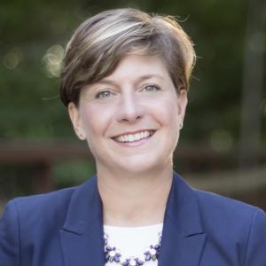
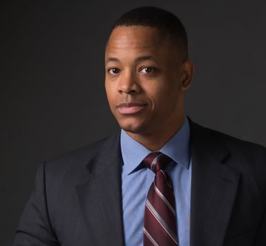
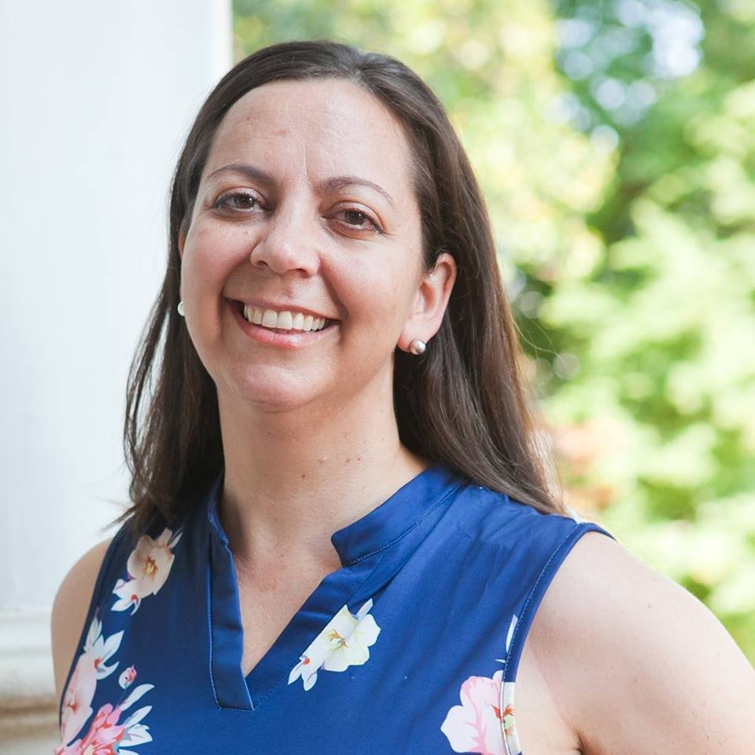
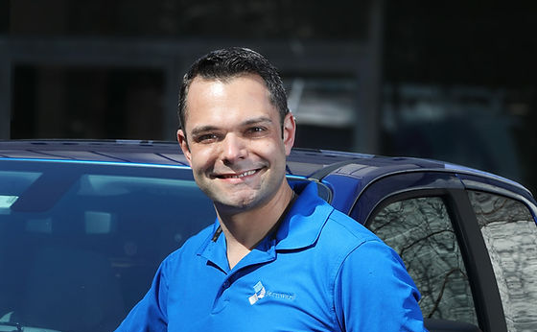
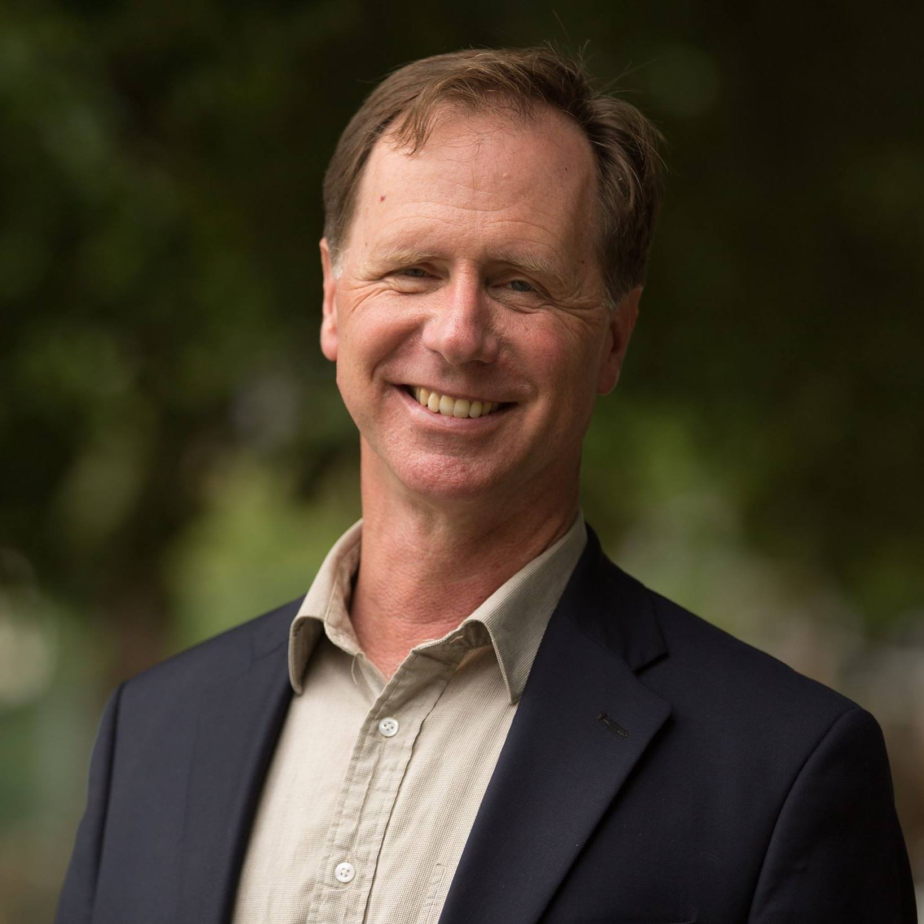
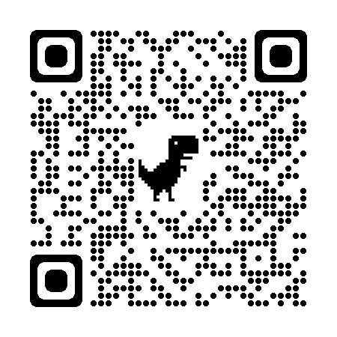
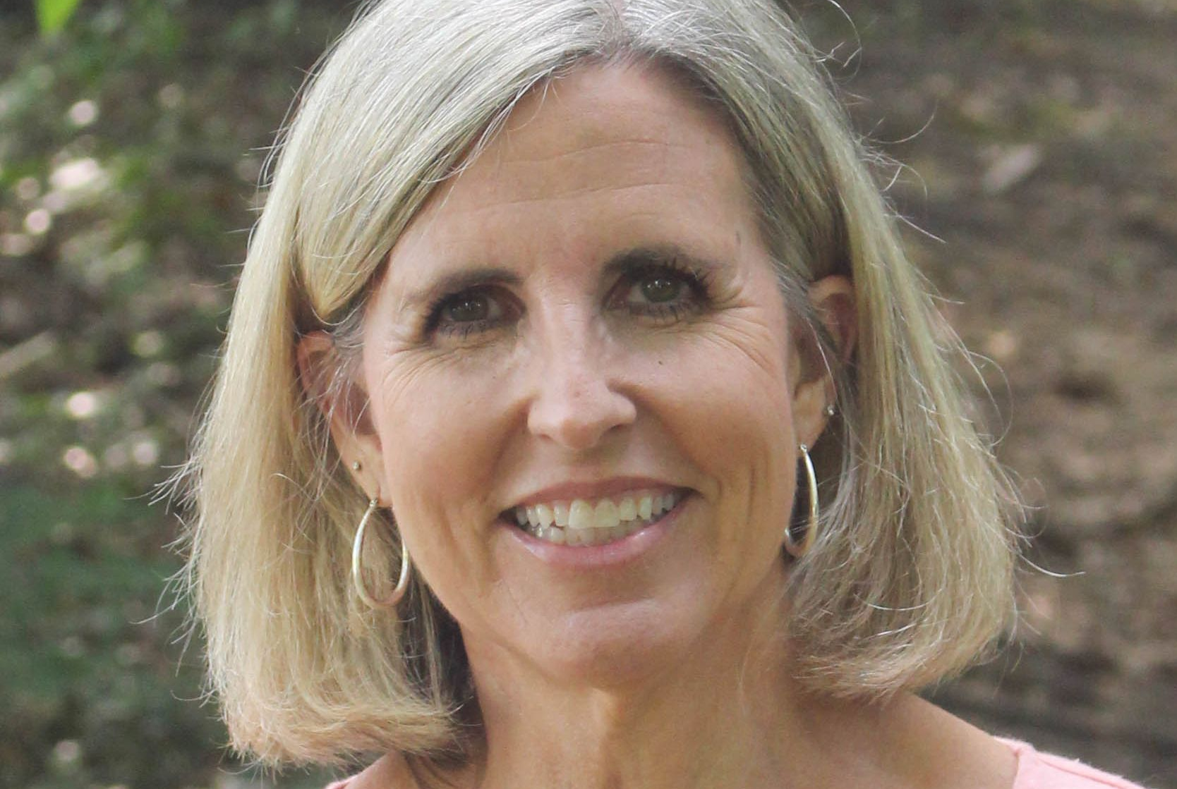
MEET EDUCATOR-ENDORSED CANDIDATES
Notes:
Our union has interviewed and collected information from all the candidates in the county executive, council, and state-wide races to recommend or endorse the best pro-public education candidates. The link from the previous slide will take you to meet candidates specific to Anne Arundel County, whereas this slide will take you to mdappleballot.org to ensure you are receiving information about educator-recommended candidates if you live and vote in other counties.

Slide 6
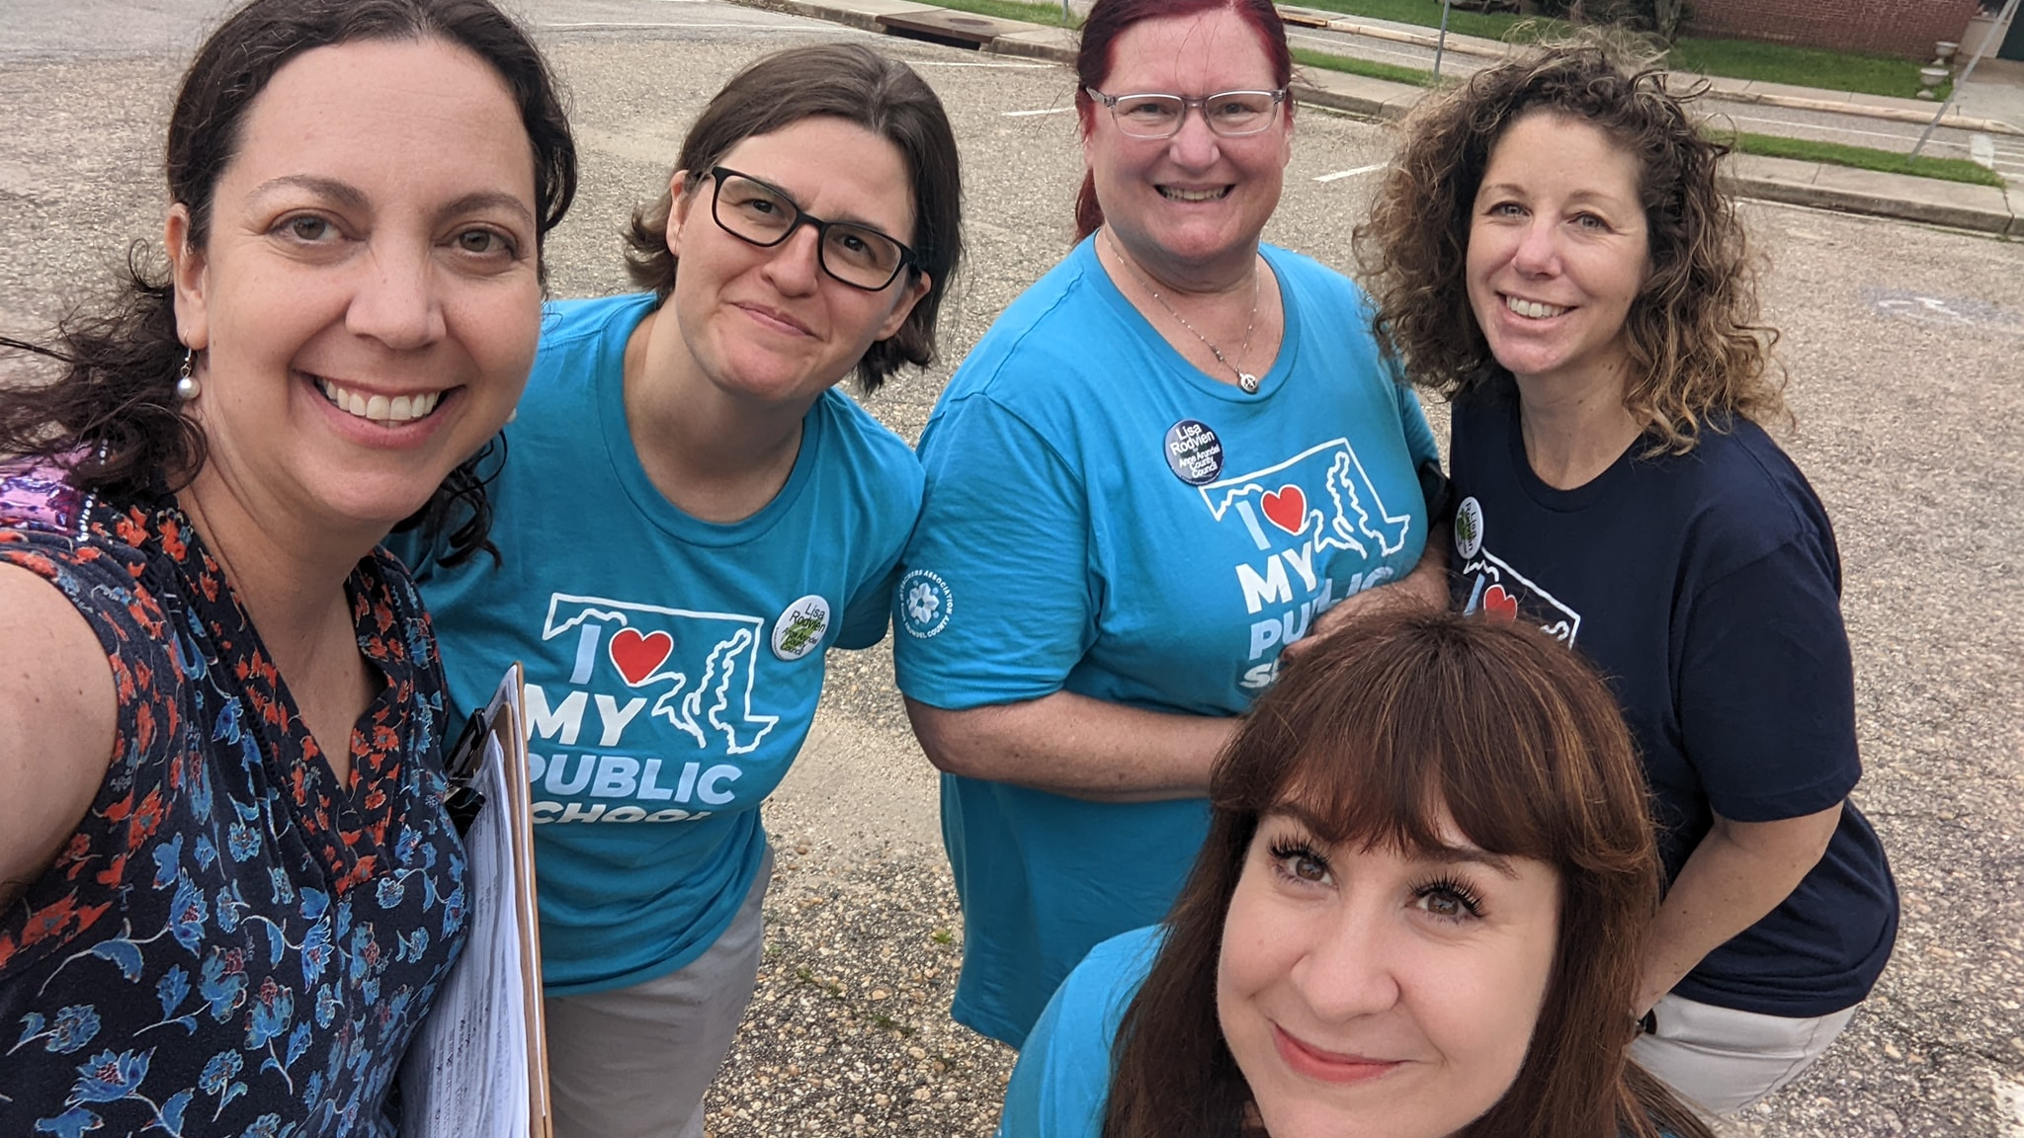
GET OUT THE VOTE
TAAACTuesdays
Phone bank
Door Knock
Voter-cade
Notes:
After you have a plan and know the candidates, we can do our part to help others know who supports our public schools, students, and profession. There are opportunities every week to help get out the vote! First, we want everyone to wear your new I <3 My Public School shirts on Tuesdays through election day. On Tuesdays we also have phone banking to support County Council Candidates. Every weekend there are door knocking activities as well!
If you are meeting before Friday, October 14 also mention: This Friday, TAAAC members will also be supporting a “voter-cade” to get out the vote in predominantly Black and Brown communities. We want to help make voting accessible as possible for as many people as possible!

Slide 7
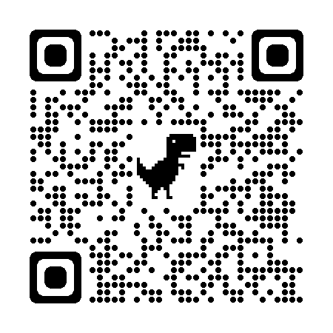
SIGN UP TO APPLE BALLOT
Notes:
Finally for our election round up, are apple ballots. Educators are some of the most trusted members of any community, and apple ballots are our tool to help voters make decisions on election day. We pass out lists of educator-recommended candidates at polling places on Tuesday, November 8.

Slide 8
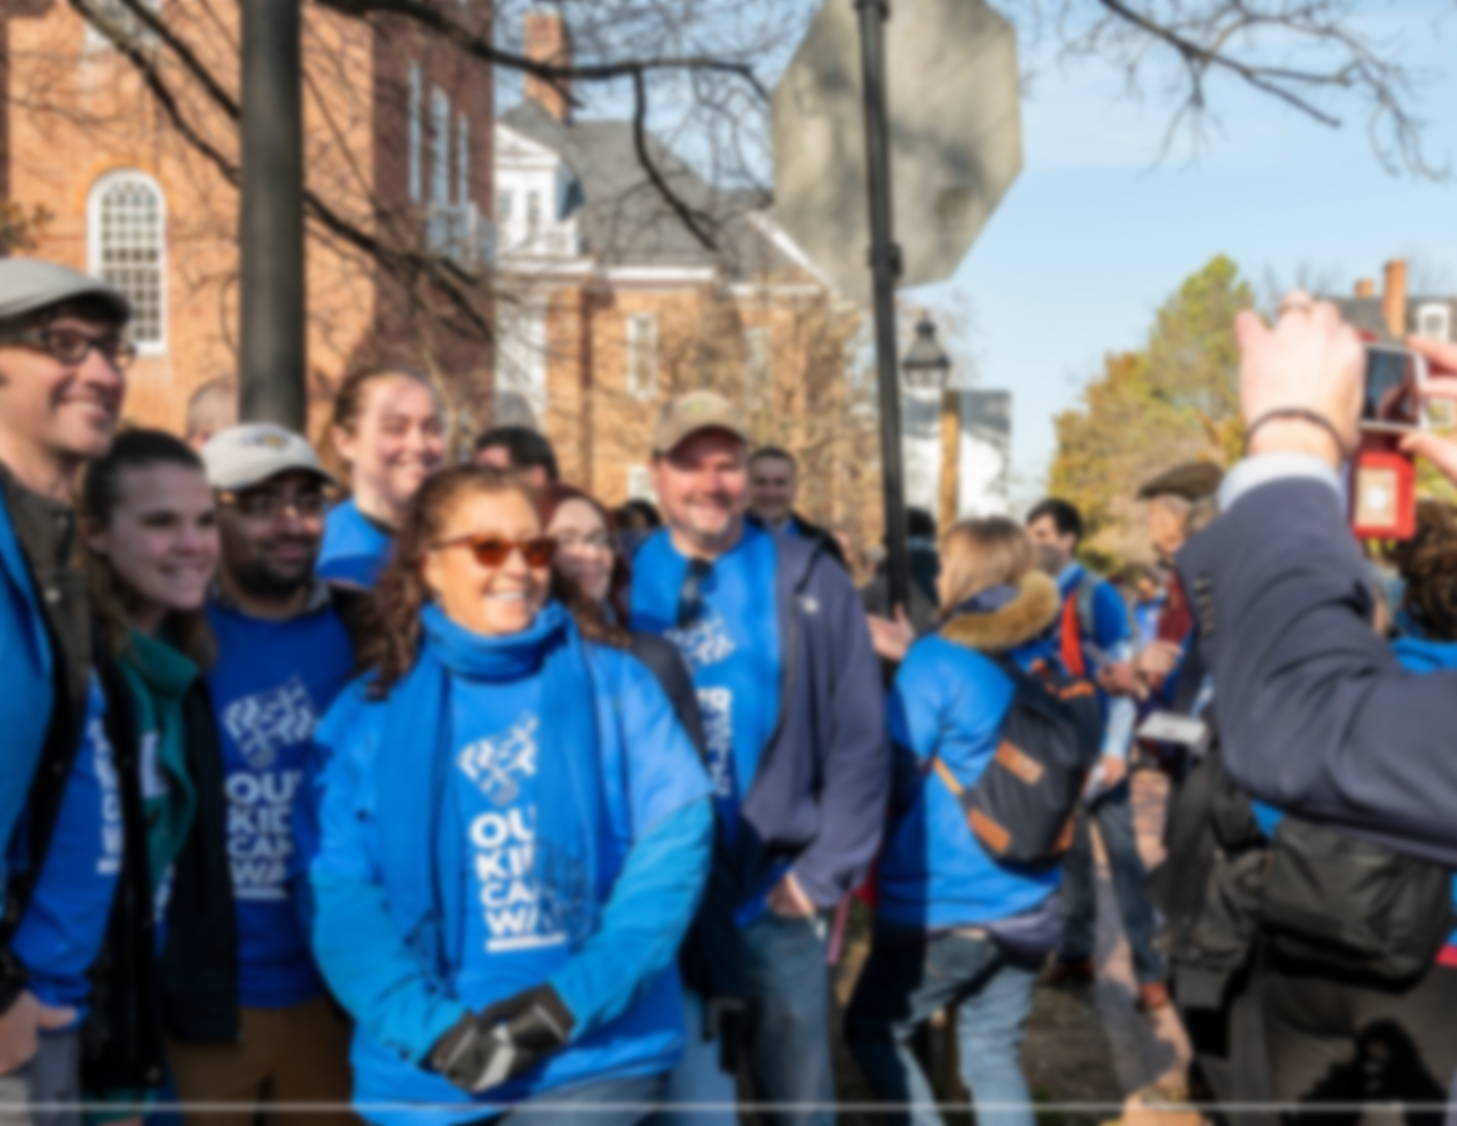
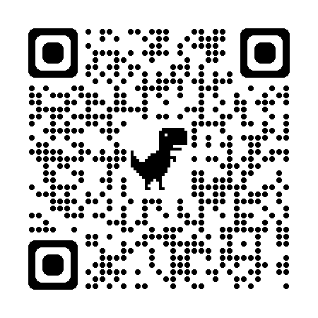
BLUEPRINT TRAINING
When: Thursday, October 27
@ 5:00 p.m.
Where: Zoom
Notes:
Moving on from election work, we’re also continuing our advocacy in Anne Arundel and across the state to ensure the Blueprint is implemented equitably and effectively. To learn more, we’re hosting an overview training on Thursday, October 27 as a refresher on the legislation. Use the QR code to RSVP.

Slide 9
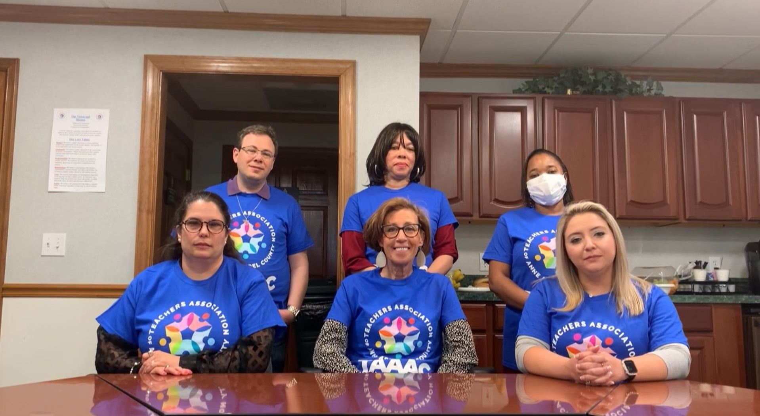
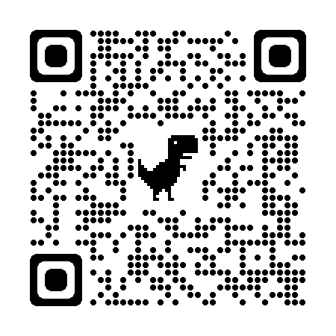
BARGAINING UPDATES
Notes:
Over the last month, we submit our feedback to our bargaining team about what is most important to us as they head back to the table this year. New members applied to the team and you can see both our representatives as well as our union’s top priorities in the bargaining survey with the QR code here. As a reminder, there are limited reopeners to our contract this year which means we will only be negotiating: Salary, healthcare, Blueprint implementation through FY24, the MOU for substitute coverage, and one additional reopener per party. Stay tuned for more information.

Slide 10
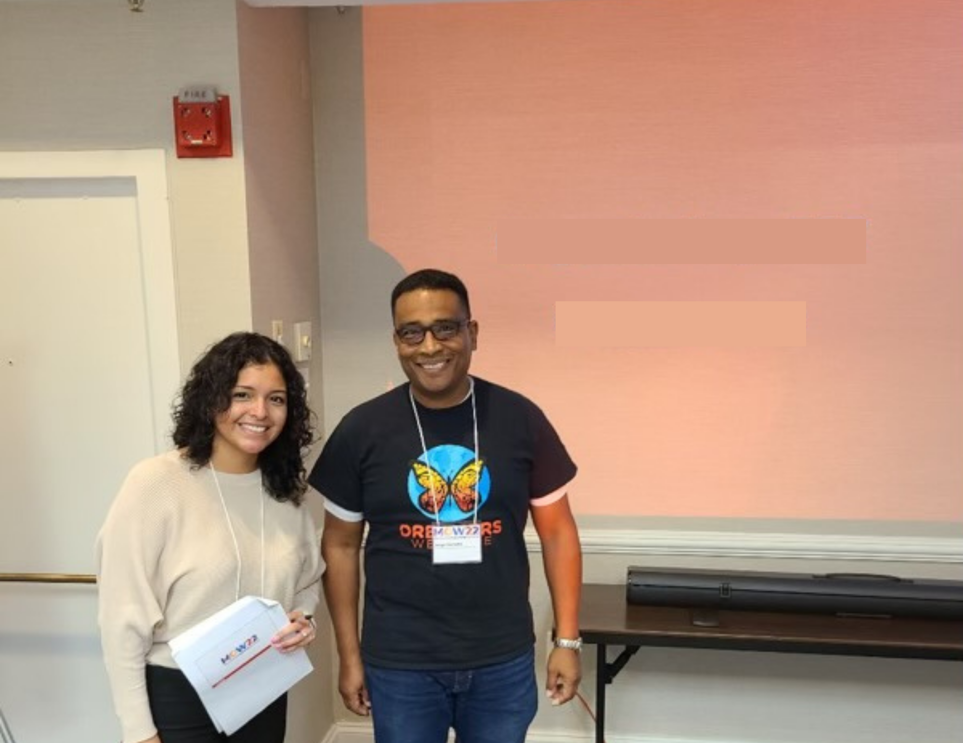
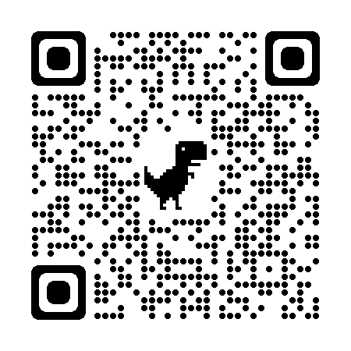
TAAAC ELECTIONS
Secretary Treasurer
Board of Directors
MSEA Delegate
NEA Delegate
Deadline:
December 10, 2022
Notes:
Ending our meeting today with a reminder that if you are interested in taking on an additional leadership role, there are opportunities starting now! Positions are available for Secretary Treasurer, Board of Directors, MSEA and NEA Delegates. Nominations are open until December 10!

Slide 11
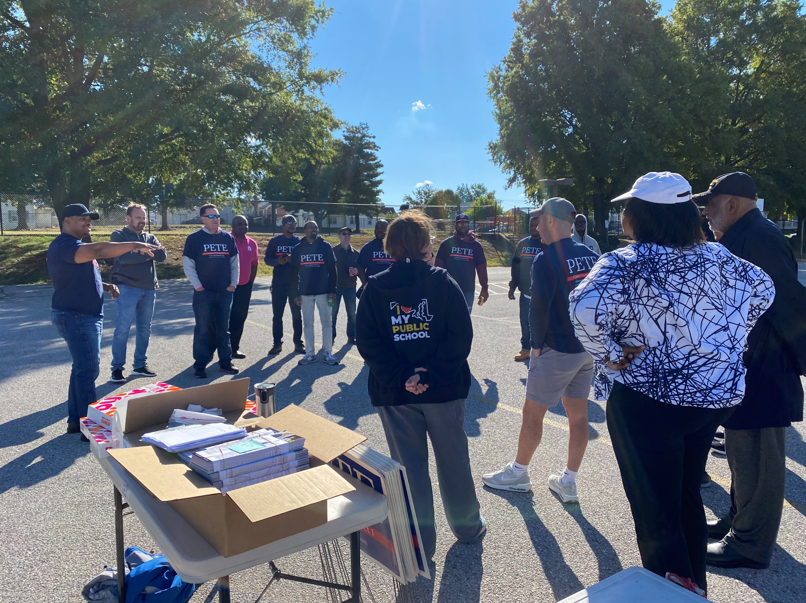
QUESTIONS?

