Slide 1
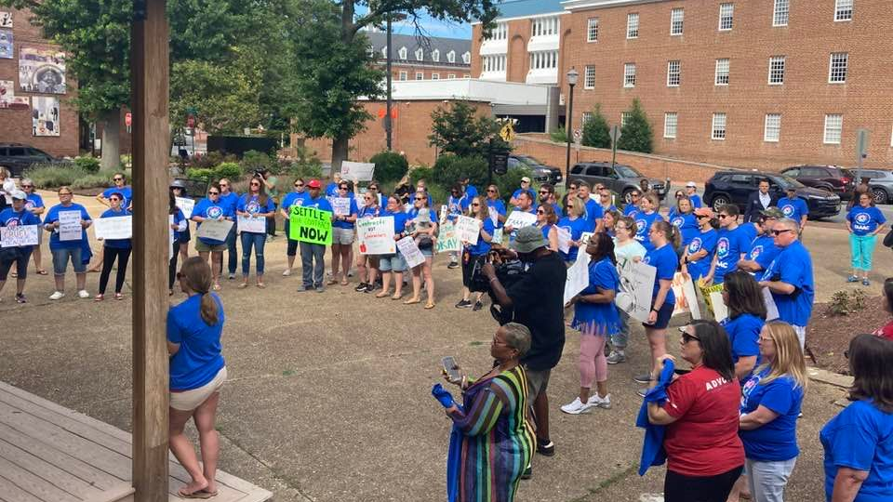
September 2022 10-minute meeting
Agenda:
Our new contract
Brightspace
Contractors
Get out the Vote
TAAAC Updates
Notes:
We are solidly into our 2022-23 school year now. As always, we are grateful for the 12-month members who worked through the summer to support our district, and those who supported students in a variety of other avenues. We have many things we’re facing this month as a union from Brightspace to involuntary transfers, to the contractors. If we can stay united, we can continue to advocate for ourselves and our students.

Slide 2
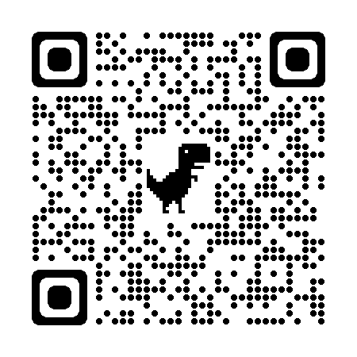
Notes:
First, we have a new contract!
While there are wins in here, it is far from everything we wanted. We originally advocated for a 5% COLA and step increase, but ended at 4%. AACPS originally wanted to increase our non-professional duties to 35 minutes per day. After lobbying and testifying and rallying, our bargaining team took it as far as legally possible to the public school labor relations board to fight against that, and we were given a contract that now includes 30 minutes of non professional duty time per day.
This time does not come out of your individual planning time or duty-free lunch. If that is the case, contact your uniserv director right away.
Use the QR Code here to learn more!

Slide 3
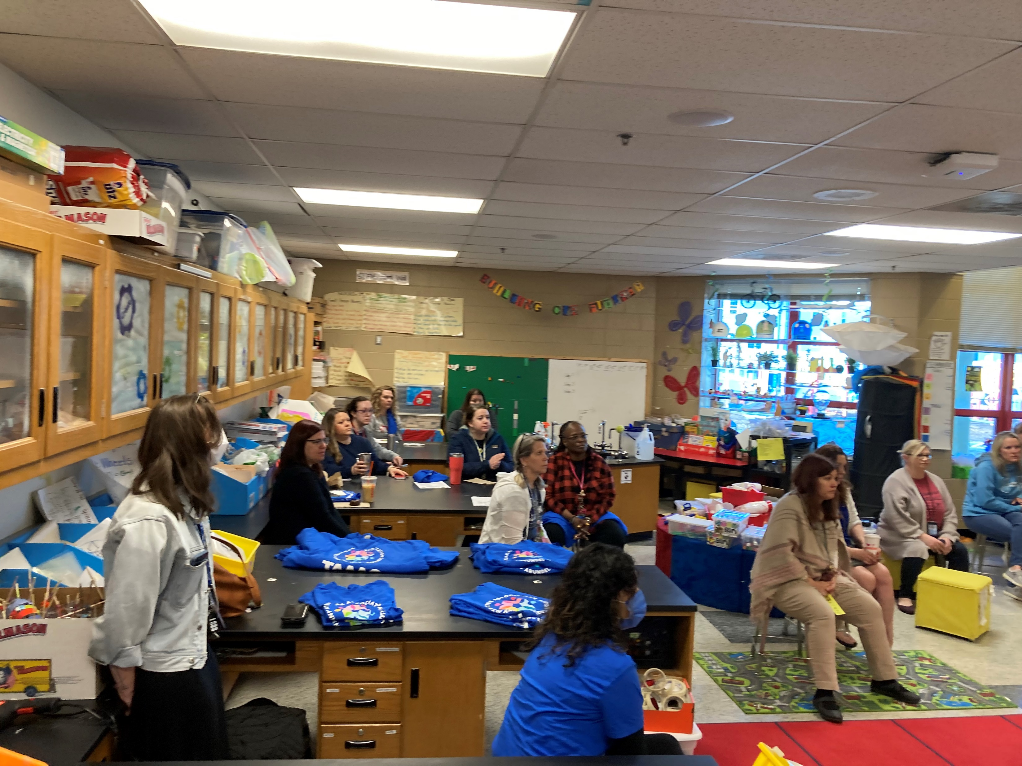
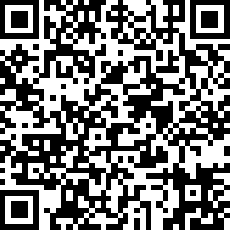
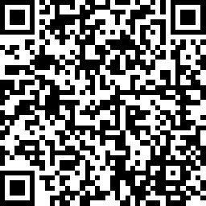
FY24 Bargaining Survey & Team Application
Notes:
We’re heading back to the table to advocate for our working conditions and pay for virtual teaching, and starting to negotiate our FY24 contract.
While our contract is not perfect, we fought hard for everything we did win. Nothing was given to us, it was because members fought hard!
Use the QR codes here to let our bargaining team know about your priorities this year, and if you are interested in joining the bargaining team, submit an application by September 16!

Slide 4
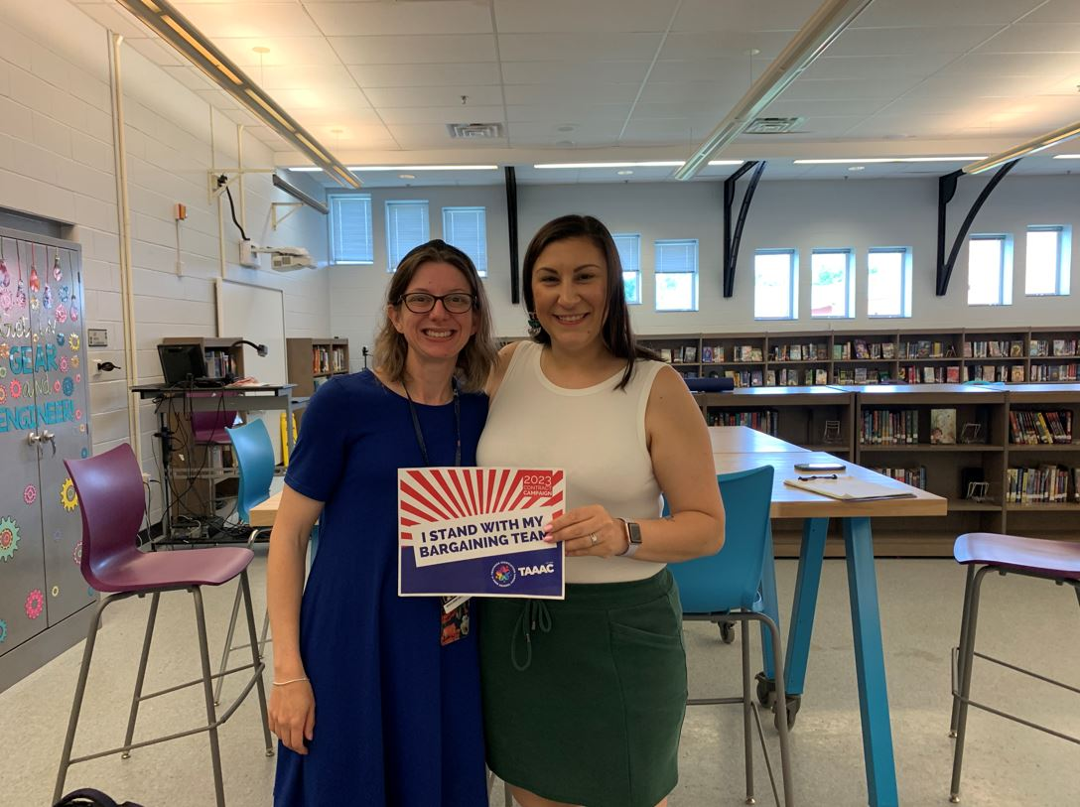
3 STEPS TO ADDRESS BRIGHTSPACE IN YOUR SCHOOL
Track your Hours
Bring your data to the FAC
Advocate with AACPS leaders
Notes:
The changes to the Brightspace expectations are unreasonable and often detrimental to our ability to actually support our students in person. But we can work together to show AACPS leaders – especially our new superintendent Dr. Bedell – that Brightspace is not the best way to us to educate our students.
What we’re asking everyone to do is for the next two weeks [update this with your own FAC date] until our FAC meeting, track your hours. If you go beyond your 7.5 hours per day or 37.5 hours per week, track that time. If you don’t get to updating Brightspace in those hours, we will all take our timesheets to the FAC and our principal and ask them to support us in reprioritizing our work so we can accomplish all our required tasks. If they are unable to help on that front, we can ask for them to work with us to advocate on higher levels to make changes to these expectations. We’re looking to submit testimony to the Board of Education for their September 21 Board meeting – so if every school can commit to tracking time until then, we can change Brightspace expectations within the month for our whole union.

Slide 5
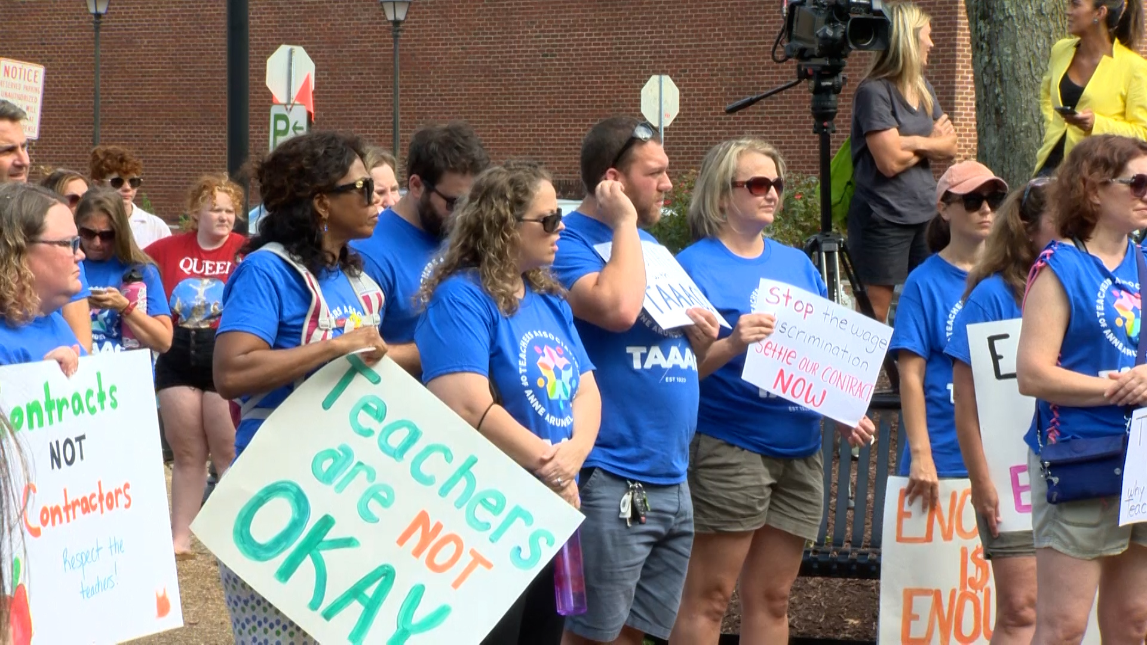
100 Special Educators Sign Grievance!
Notes:
With AACPS’ choice to hire outside contractors to address the teacher shortage, they are conducting an unfair labor practice. It is a change to our bargaining unit, which is why 100 special educators signed a grievance to take action. Our uniserv directors will provide an update when we take the next step so we can work to support each other!

Slide 6
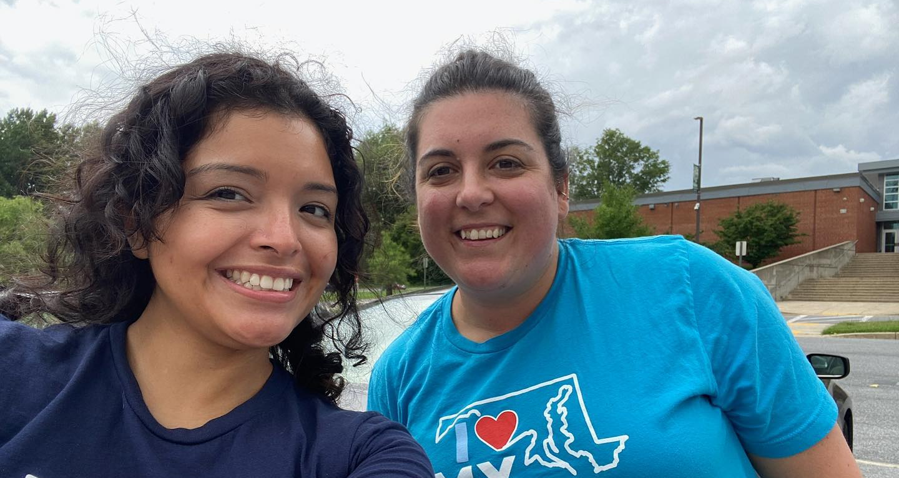
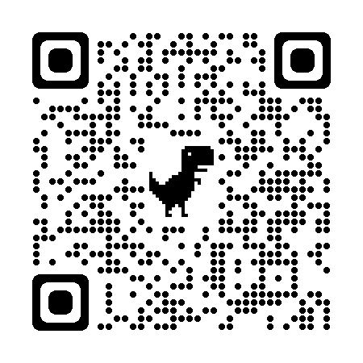
Notes:
The 2022 elections are quickly approaching, and educators make up a huge voting block! There are races in every district in Anne Arundel County that can shape what our jobs look like next year – from how much money we earn to how many students we should be responsible for in our classes or caseloads. Use the QR code here to check out upcoming phone banks, canvassing opportunities, and more ways to get involved! Sign up and get the new “I love my public school” shirts!

Slide 7
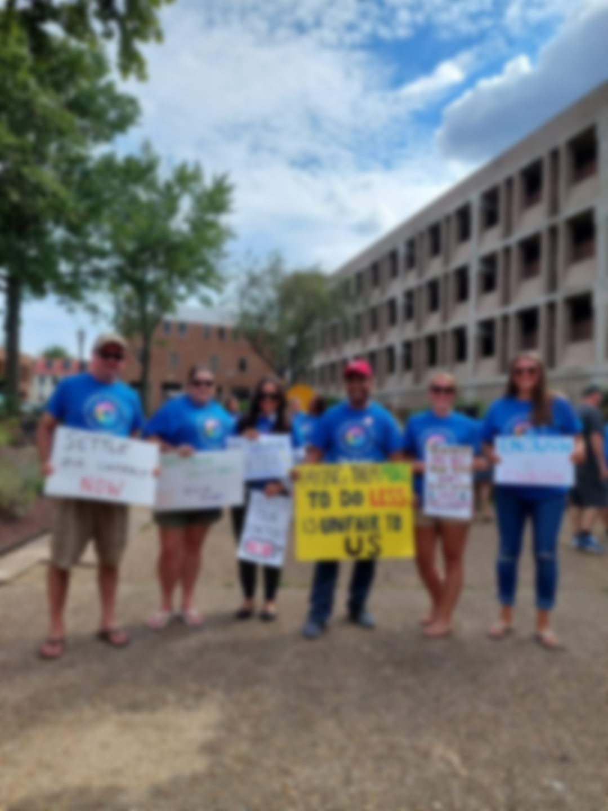
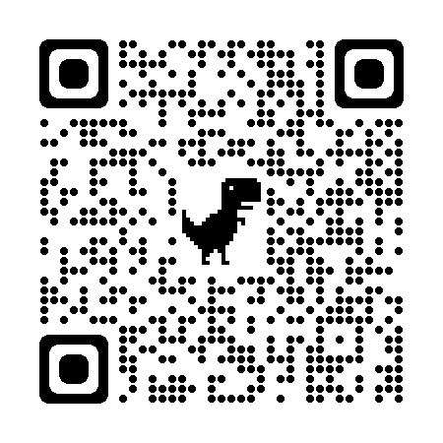
UNION UPDATES
Tutor pool
Sick Leave Bank
Member Committees
FOLLOW US!
Notes:
Some other important information to wrap up our meeting:
Our union accepts names for the tutor pool through the fall and shares with schools and libraries to support our students. Open enrollment for the sick Leave bank ends September 30. Committees are accepting new members so if you’re intertsed in joining – or learning more about any of these, visit our website taaaconline.org, or follow us on Facebook @TAAACOnline!

Slide 8
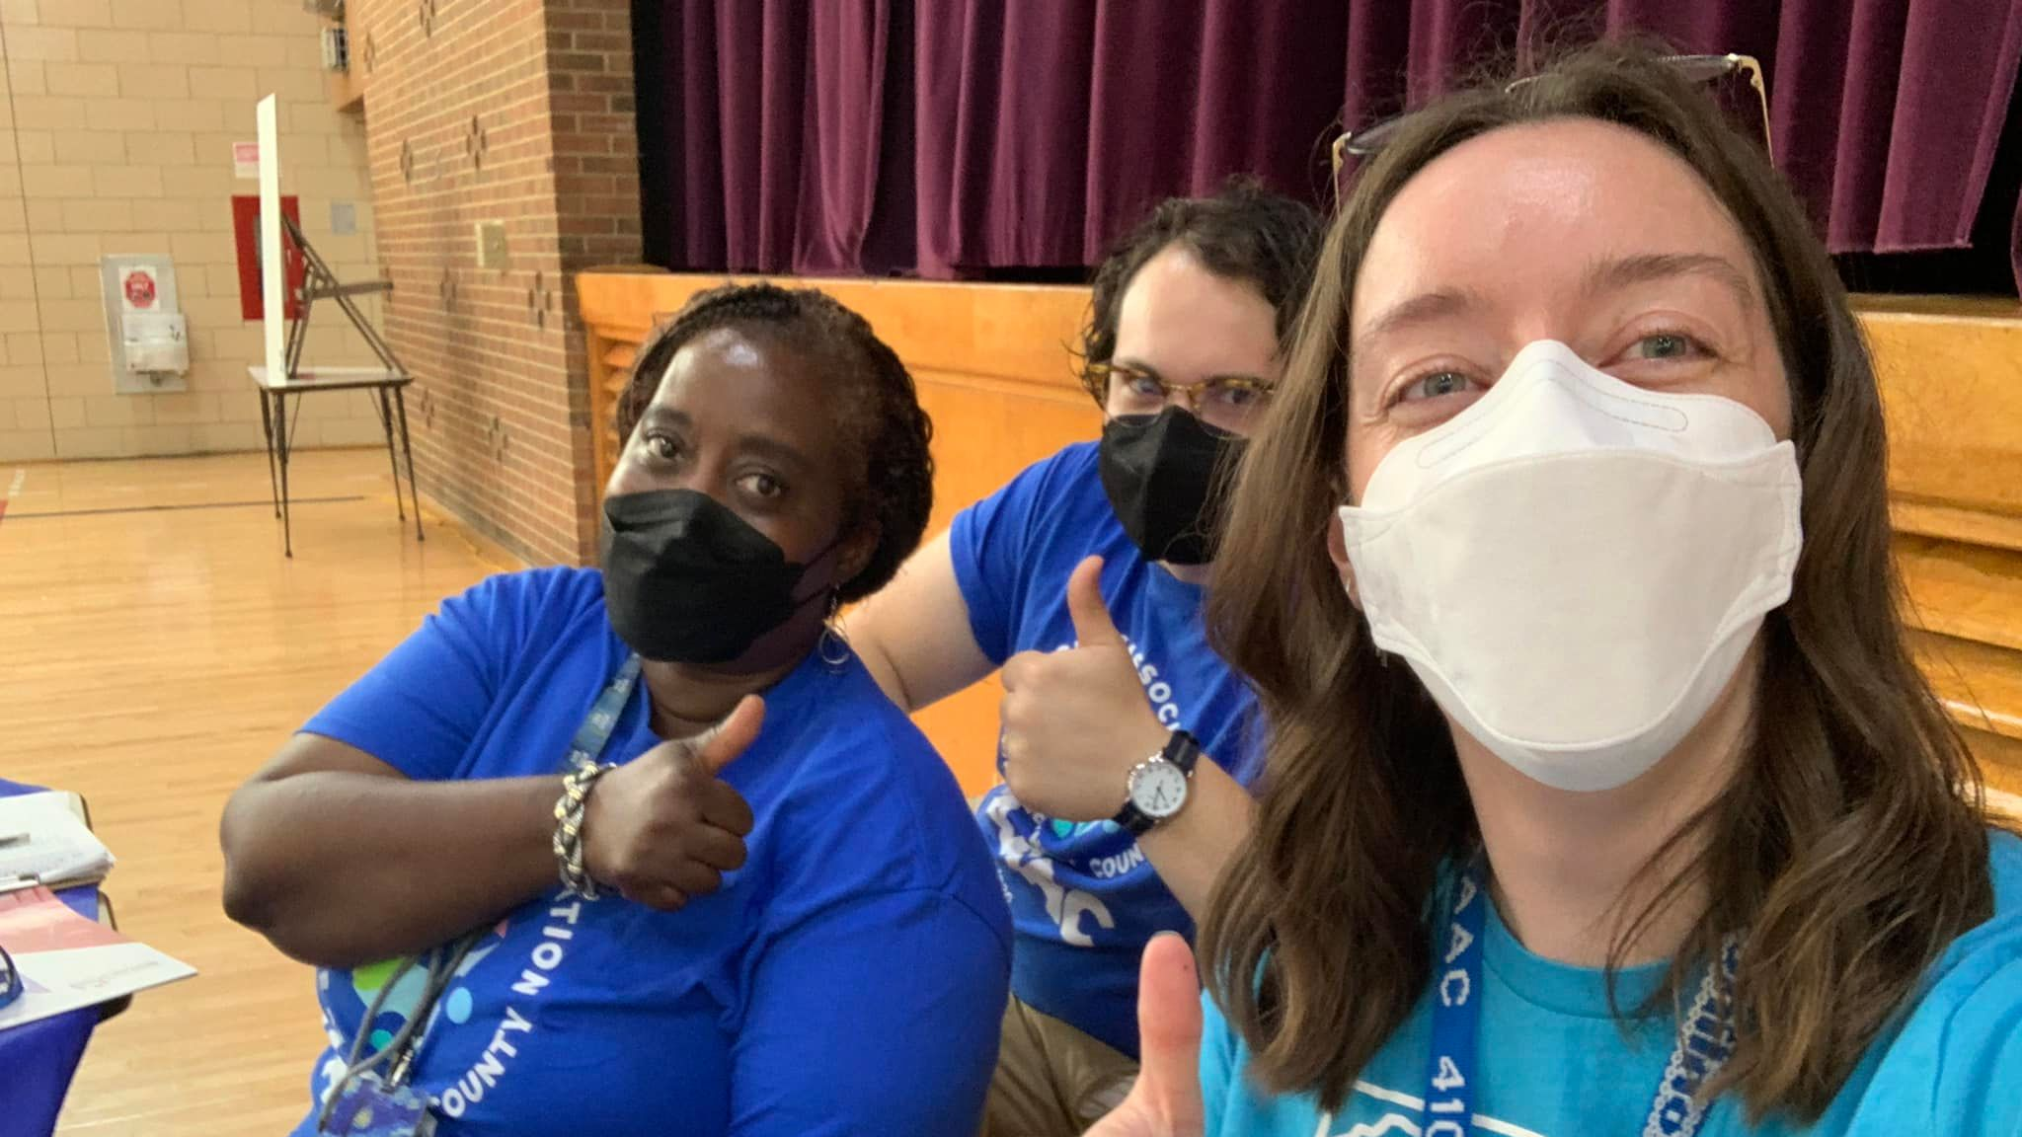
QUESTIONS?

