Slide 1
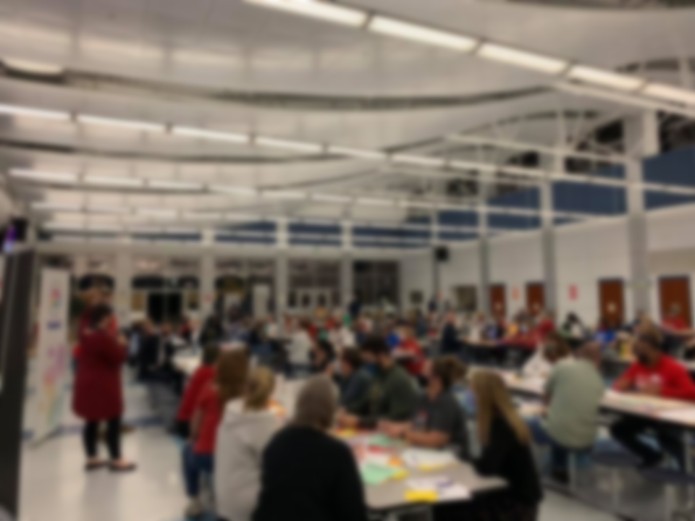
January 2022
10-minute Meeting
Notes:
First things first: CONGRATULATIONS! We finally have a new contract and our hard work has paid off. We worked collectively to bring over 3,000 of our members who have been behind for up to a decade to their correct experience credit step. Now, as the Blueprint works to increase pay for new hires, we can ensure we are all moving up and paid appropriately for our service to our school community. We can take this time to celebrate our victories!

Slide 2
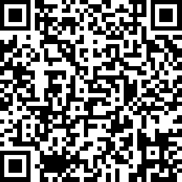
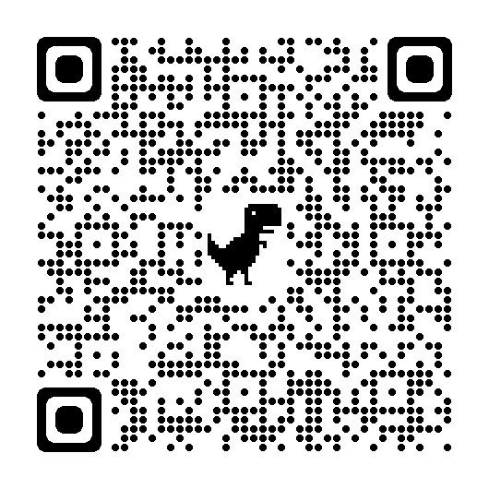
UPCOMING IN JANUARY
FY 23 Bargaining Survey
County Council
Budget Hearings
Notes:
Coming up, there are important dates to save:
Member Survey: TAAAC leadership wants to hear your concerns and your priorities for the next round of negotiations. What are you willing to do here in our school or out if our community to resolve these problems or advocate for solutions? Will you post on social media? Talk to our principal about safety and bullying concerns? Bring a friend to a rally? Testify at a hearing? IT’s up to us to make the changes we deserve to better our working conditions.
Budget season is upon us. The Board of Ed hearing is/was on January 13, and the County Council is hosting virtual forums in each district this month. Make sure you speak up to advocate for things like better tuition reimbursement, more PPE, or a longer-term contract that lets us plan for our futures better.

Slide 3
Notes:
The Blueprint for Maryland's Future will impact collective bargaining throughout the state and inform many of our options and decisions. To best prepare for the next cycle of bargaining, training around the substance of the Blueprint will be critical.
We’ll be hosting a training the week of February 23. Stay tuned for more information.

Slide 4
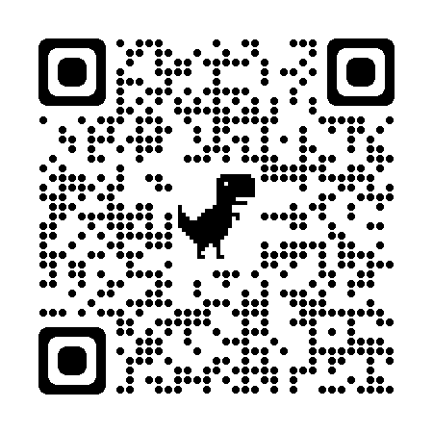
TAAAC Elections
Notes:
TAAAC elections are here! The Nominating Committee is hosting a virtual candidate forum to ask questions on January 20 at 6:30 p.m. Scan the QR Code to register.
Elections will be open from 9:00 AM on January 31 through 5:00 p.m. on February 18. You can learn about the candidates at taaaconline.org/2022-taaac-elections

Slide 5
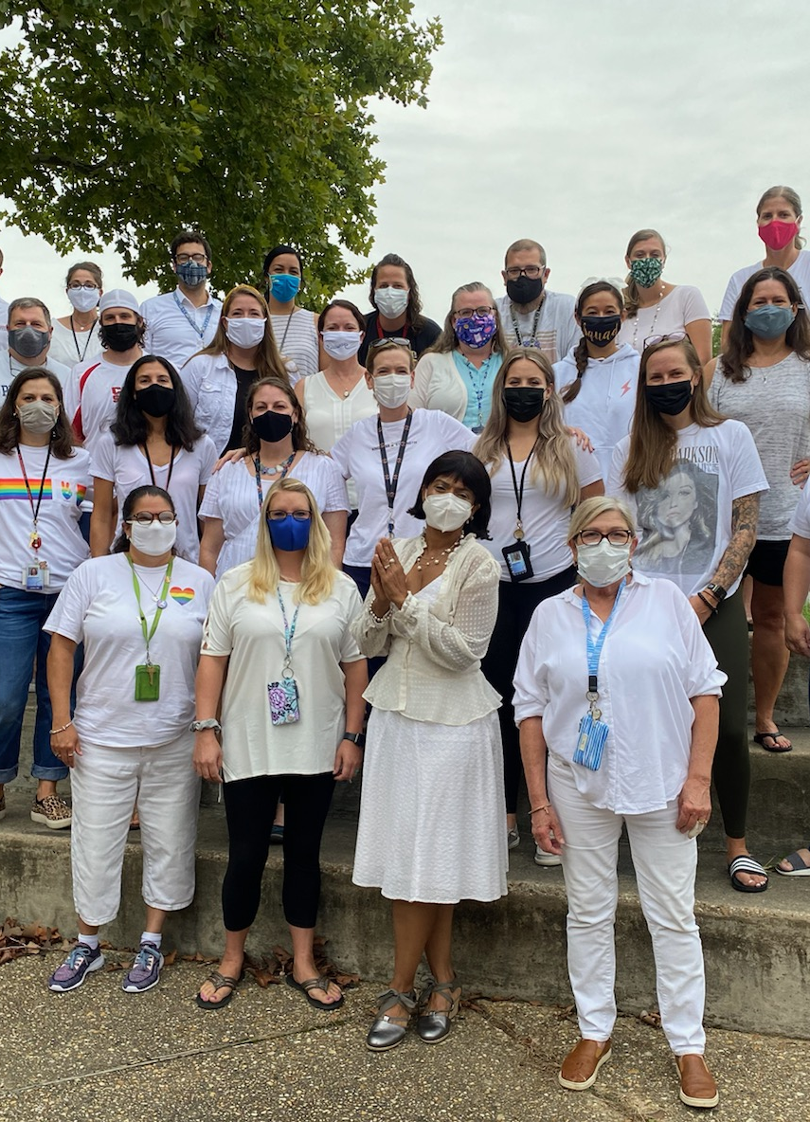
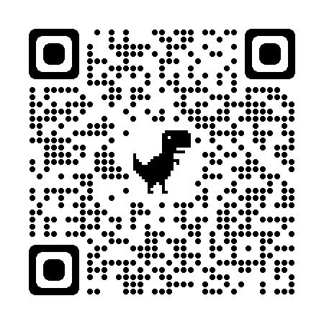
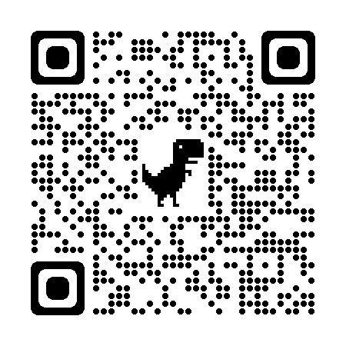
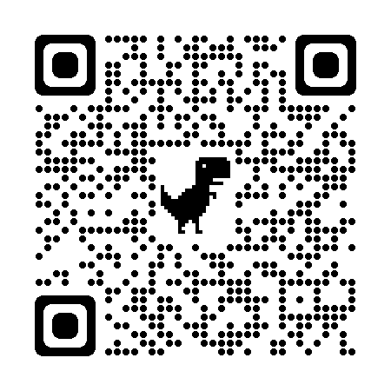
Safety Form
Know your
Rights Flyer
AACPS
Screening Lists
If you have questions related to leave if you or a family member contracts COVID-19, please call the TAAAC Office at 410-224-3330
Health and Safety
Notes:
You have seen these before, but it is just as important as ever to stay vigilant. It is up to us to keep each other and our students safe. We can advocate to make sure our students receive healthy learning environments. It is in our contract that we receive safe working environments. Don’t stay silent if there is a problem. Call me (your Building Rep) or the TAAAC office if you are concerned.

Slide 6
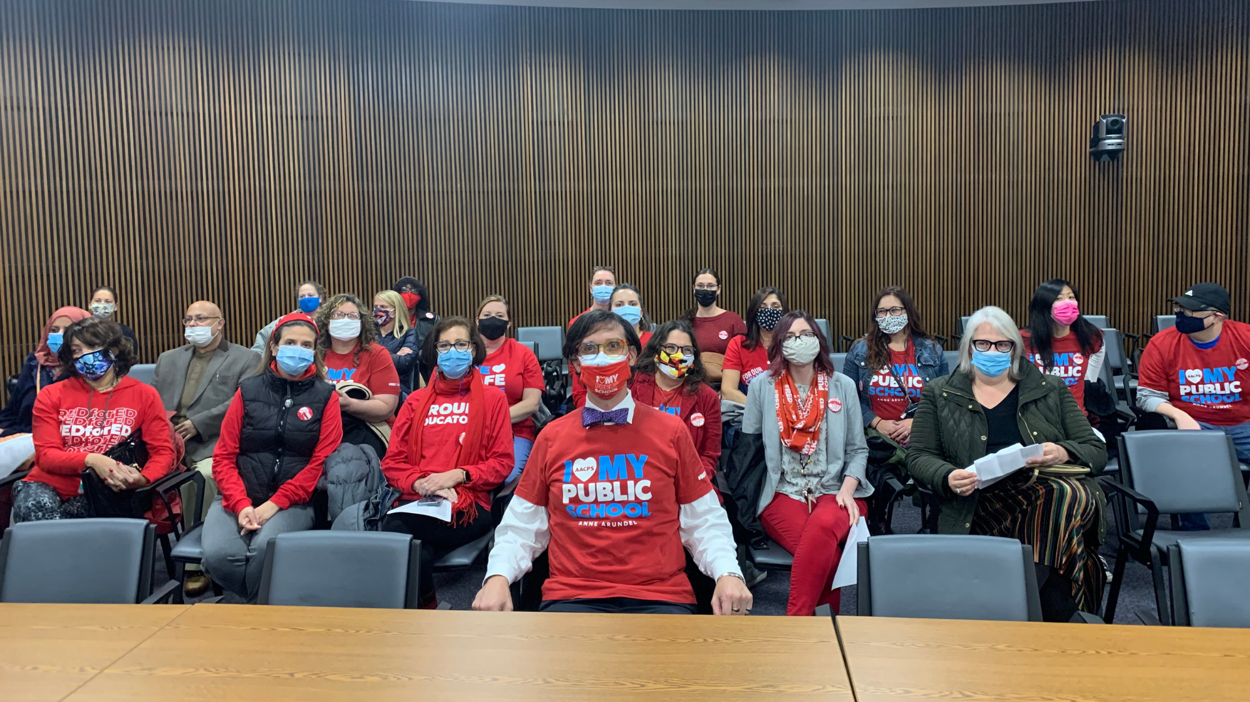
Questions?

Slide 7
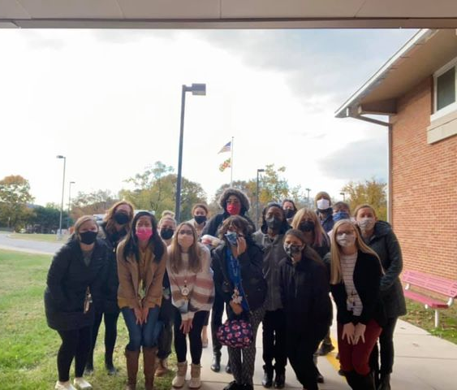
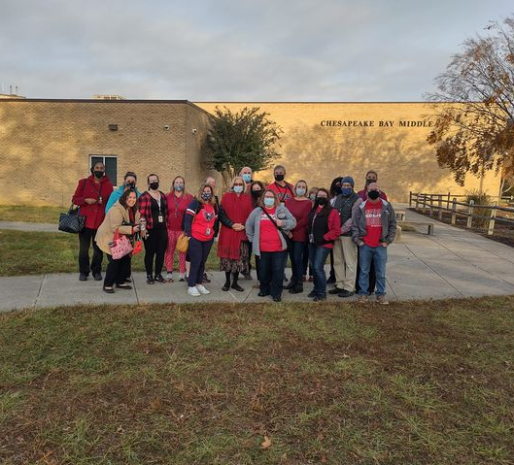
Make sure you track who attended!
Reps who host 10-minute meetings will receive a Panera gift card at the RA to provide food for your next meeting.
Notes:
Click here to log the number of members who attended

