Slide 1
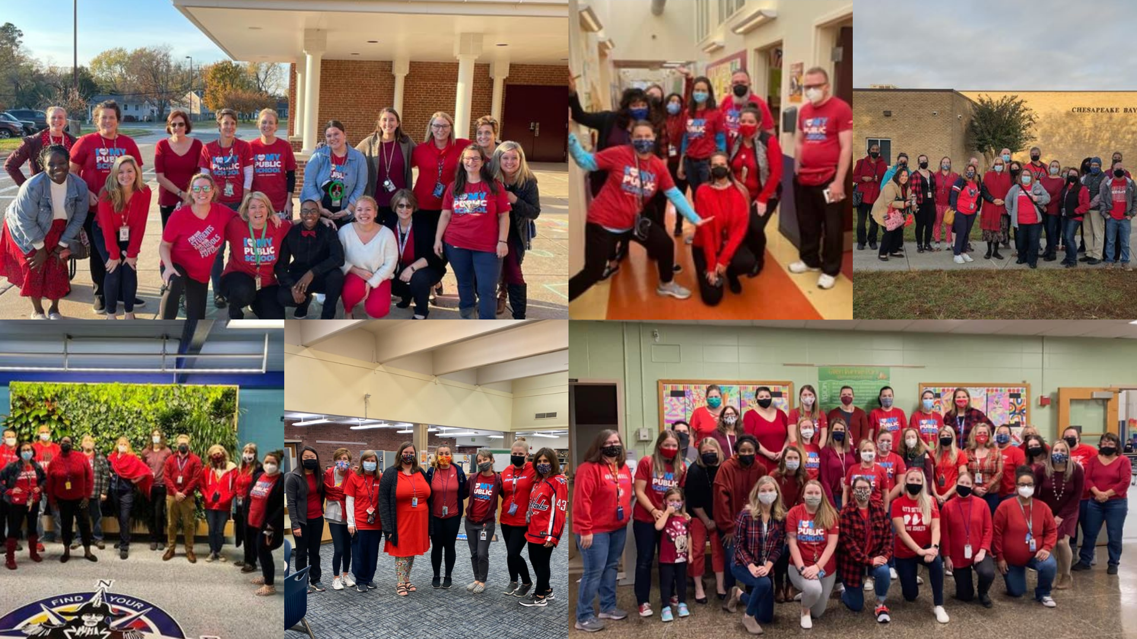
December 10-minute Meeting
Notes:
We’re excited to be meeting for the last 10-minute meeting of 2021. Glad you could come.
Our actions since our last 10-minute meeting have made huge strides toward improving our work conditions across the county! Almost 100 worksites participated in at least one day of action during the Enforce Our Contract Campaign!
Continuing that momentum, I want to make sure we all have resources and upcoming dates to be most effective for the rest of the semester.

Slide 2
Who should I tell if…
Our Building Reps
There is a violation to our contract?
A new employee wants to join TAAAC?
We want to change student discipline policies?
We feel unsafe?
Our FAC
Our TAAAC UniServ Director
Notes:
First, we have to know who to ask to when we need to make changes in our building. As your building rep, I am your first point of contact. Together, we can bring issues to our Faculty Council, our principal, or our UniServ Director depending on the situation.
We deserve safe, sustainable work conditions and can speak up when there are violations to our contract together.

Slide 3
Save the Date: Budget Season
15 Dec.
Superintendent presents budget to BoE
4 Jan.
Public Hearing at Old Mill High
16 Feb.
BOE Vote
1 Mar.
County Executive Receives budget
Notes:
And we can make these changes not just for our building, but for our entire county. In January, we have to be aware of the budget coming from the Board of Education to be able to advocate for things like hiring more support staff, increased tuition reimbursement, updates to our building infrastructure, and even a longer-term contract that ensures we receive fair pay!
Keep an eye out for these four important dates.

Slide 4
Notes:
For our FY 22 contract, we have received the designation of impasse and selected a mediator. Our actions during the Enforce Our Contract campaign directly led to AACPS returning to the bargaining table to have healthy and substantial conversations about workload and sub coverage. Our bargaining team is meeting again with AACPS December 13 for mediation. We hope to have more news soon and host an all-member meeting this month or next.

Slide 5
Nominations are open
Notes:
If you are interested in taking on a leadership role in our union, nominations for TAAAC President, Vice President, Board of Director, and NEA/MSEA delegates are open until December 14! Visit taaaconline.org/2022-taaac-nominations

Slide 6
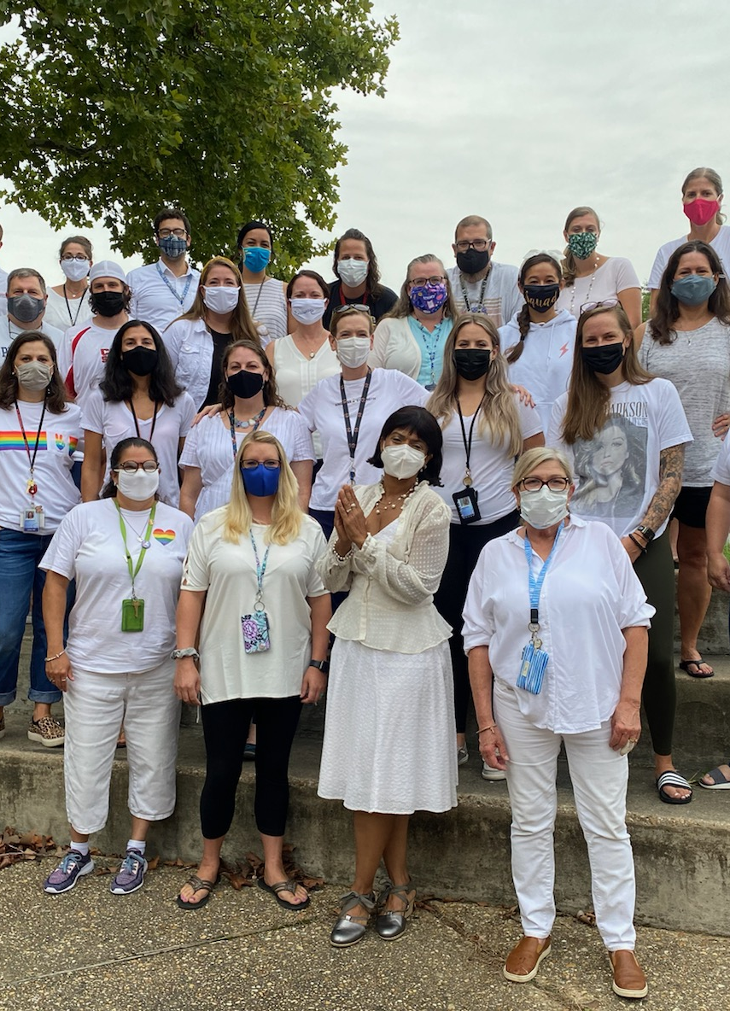
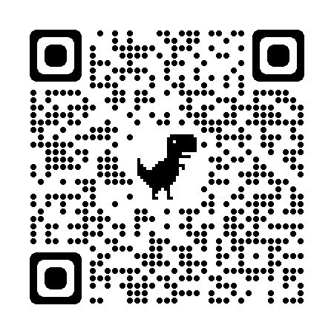
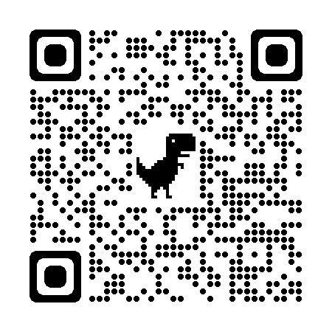
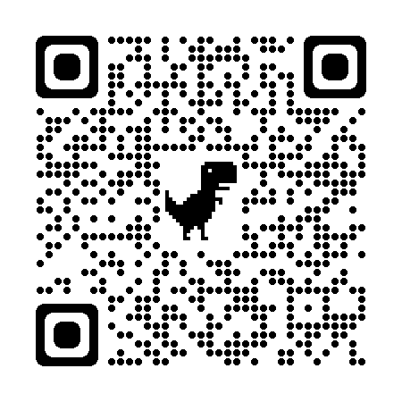
Health and Safety
Safety Form
Know your
Rights Flyer
AACPS
Screening Lists
If you have questions related to leave if you or a family member contracts COVID-19, please call the TAAAC Office at 410-224-3330
Notes:
As the weather gets colder and cases of COVID-19 rise again, it’s up to each of us to ensure we stay healthy. Our contract explicitly highlights our rights to healthy working conditions!
If you feel unsafe or are concerned about masking, air quality, cleaning or social distancing, we can work together to present issues to our FAC and principal using the daily safety checklist. Any issues should be resolved immediately.
Use the QR Codes to also check out the “know your rights” flyer, and AACPS screening lists. Bring these to me (the BR) and we can bring them to the principal together.

Slide 7
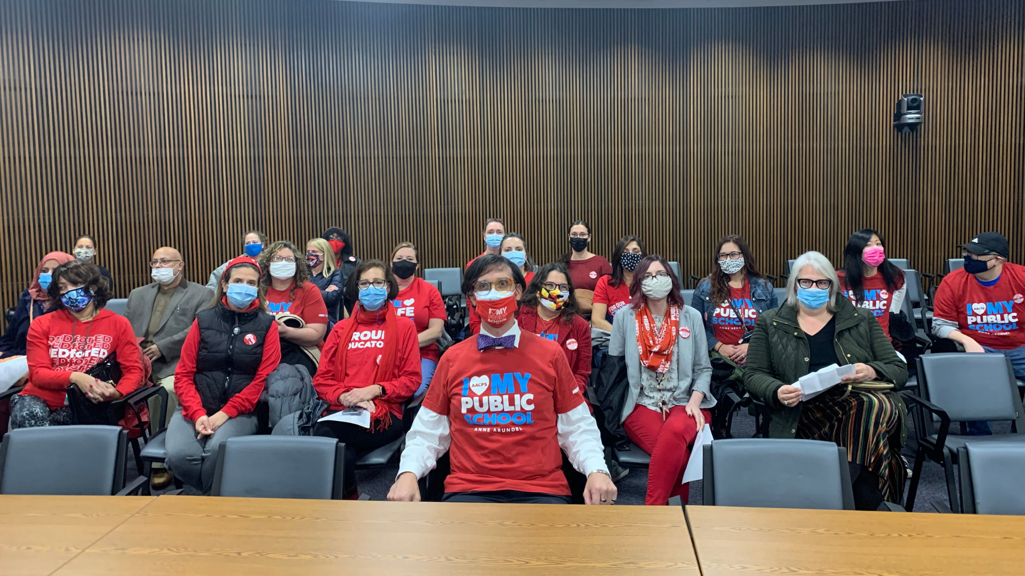
Questions?

Slide 8
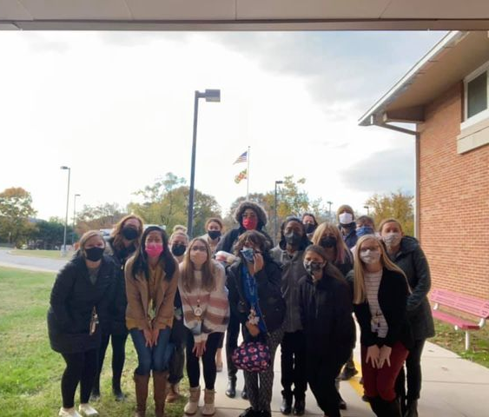
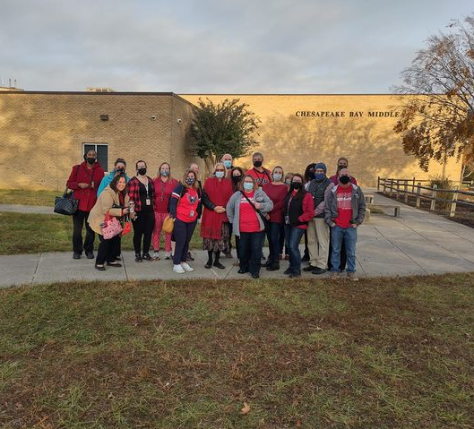
Make sure you track who attended!
Reps who host 10-minute meetings will receive a Panera gift card at the RA to provide food for your next meeting.
Notes:
Click here to log the number of members who attended: https://docs.google.com/forms/d/e/1FAIpQLSdBmwrPl6Vj3MzSWlay47XW_DHkr_ACs9mpTV_PEr5o0gMYeg/viewform?usp=sf_link

