Slide 1
November 10-minute Meeting
We’re enforcing our contract!
Notes:
I’m so glad you could join today! Attending 10-minute meetings is a small step we can all take to ensure we are working together as a union toward resolving workload issues.
We saw across the country over this last month workers exercise their power to stand up against stand up to unfair working conditions. Now, it’s our turn. We are starting an action today to highlight the extra hours all of us spend ensuring our students receive the world-class public education they deserve.
We are doing this by enforcing our contract.

Slide 2
What does it mean to Enforce Our Contract?
Notes:
Enforcing our contract means taking small steps to ensure we receive the respect we deserve from AACPS leadership, from our school admin, and from our school community.
How many of you have worked beyond your 37.5 hour workweek already this week? You deserve either comp time, reduced workload, or per diem pay for anything else you do! We’re highlighting these conditions for the public, and for AACPS leadership as they don’t believe us when we say our workloads and caseloads are out of control.

Slide 3
Action Plan
Nov 11 | Nov 12 | Nov 15 | Nov 16 | Nov 17 | Nov 18 | Nov 19 | Nov 22 | Nov 23
Beginning of Action Members attend 10-minute meeting and change Facebook Profile picture (track participation) | Members will send email to principals asking them to prioritize work for the following week | Members meet in the parking lot before school and walk in together | Members will sign commitment card | # RedforEd Wednesday (members wear Red) MOT meeting | Members meet in cafeteria and leave together Community Involvement meeting |  | Members will send email to their UD with all the additional hours worked since Nov 11 to start filing a grievance | End of Action Members post out-of-office email response
DAILY ACTIONS: Members will sign onto class action grievance
Educators and Community members will participate in a call/email campaign to the Board of Education
Notes:
The more of us who participate, the stronger we are. These are small actions for each day of the next two weeks ahead of Thanksgiving break that show our power. Congratulations to you all for participating in the first action, attending the 10-minute meeting!
We are taking these actions to show our power. We cannot be disciplined for participating as long as you comply with all of your usual requirements. You have the right to say no to our principal if they are in violation of our negotiated agreement, but if you prefer to obey, keep track of any hours you work beyond your 37.5 hour weeks, and forward to our UniServ director at the end of the action. There is a toolkit on the TAAAC website and social media that has guides for what to do if you work during your duty-free lunch or planning period, email templates for parents and students, and other actions we can take together. We know our building differs from the one down the street, and even members within our building differ in their comfort level in taking these actions. Do what you can, and the tenured employees amongst us will take the lead.
[For Member Organizing Team Member: IF POSSIBLE, TAKE A SELFIE – this will be posted online to show how many buildings around the county also held their 10-minute meetings today!] Building Action Team members will be helping with communication during these next two weeks to make sure we are all on the same page, and taking pictures to show our solidarity with other worksites!

Slide 4
Class Action Grievance
Notes:
As you saw, one of the actions during this week is to sign onto the class action grievance. TAAAC leadership filed a grievance for all members already, but AACPS rejected it saying we didn’t have standing because the workload issues didn’t impact all members. But we know that’s false- already 13% of members have signed on to show how out of touch AACPS is. Now, TAAAC leadership is filing the grievance again because we won’t be deterred.
We’re asking all members to sign onto the grievance, you can check as many boxes as are relevant to you, and we are asking for fair compensation for our hours worked. Your name will remain internal.

Slide 5
100th anniversary commitment card
Notes:
At the RA, [WORKSITE ANNOUNCED 11/10] won the commitment card contest, and they will be sent a food truck for having the highest percentage of members sign their commitment card! This card asks us all to commit to the small steps in our buildings that make us stronger as a union. We see that when we have the most updated information about what is happening with TAAAC, and what our contract does or does not allow, we can moderate our work conditions either in our building or through working together as a union. If we can get every member to sign on, it will show AACPS that we won’t be bullied any more.

Slide 6
At the Table: Bargaining Update
Notes:
The rally at the Board of Education last month kicked us off to make real change. Already over the last week, TAAAC leadership met with the PD/Equity coordinator, and had an informal conversation with the bargaining team to ensure our voices are being heard.
While we are still waiting for the designation of impasse from the Public School Labor Relations Board, TAAAC and AACPS have both agreed that we are at impasse, which allows us to make our case publicly. It is absurd that their response to overworked educators is to ask us to work more, three more nights, for no pay. The next step is to select a mediator who we hope will help us come to an agreement that does not force us to work evening activities for free. We are still confident in our stance moving forward.

Slide 7
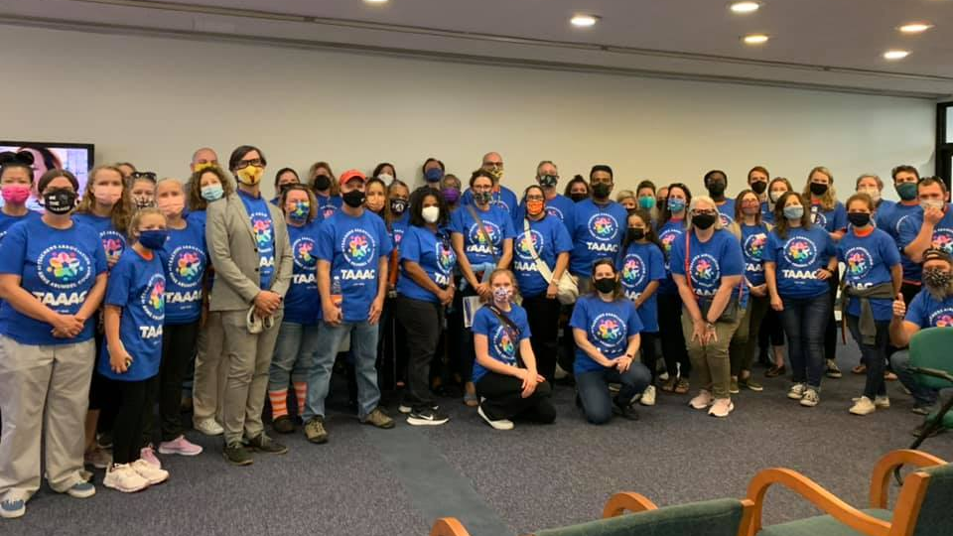
Questions?

Slide 8
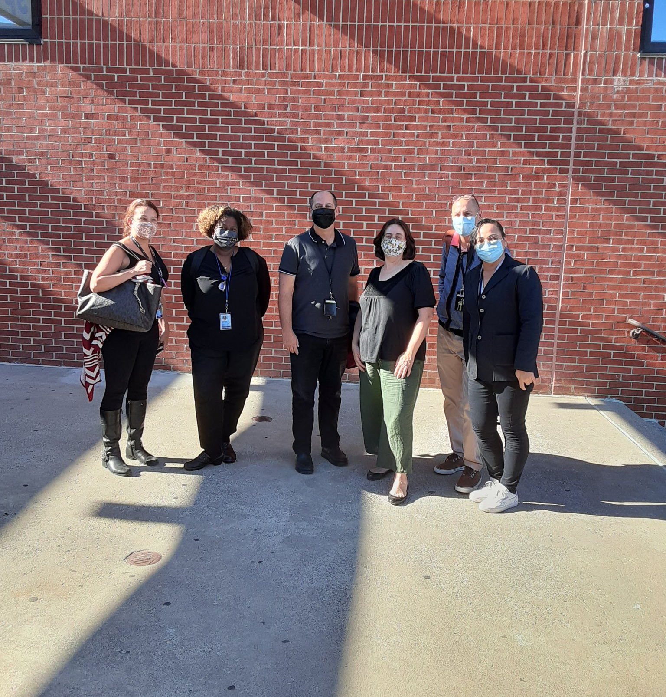
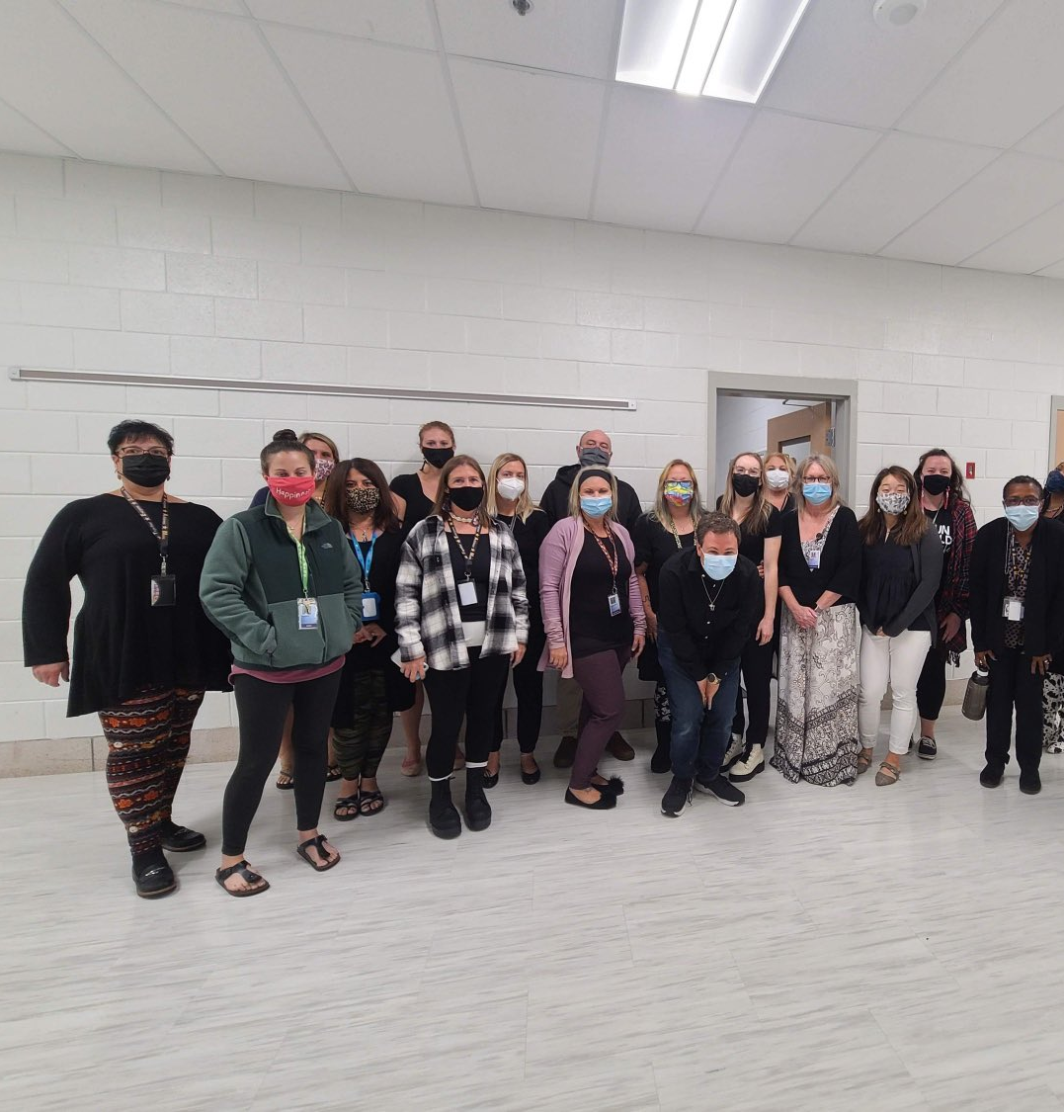
Make sure you track who attended!
Reps who host 10-minute meetings will receive a Panera gift card at the RA to provide food for your next meeting.
Notes:
Click here to log the number of members who attended: https://docs.google.com/forms/d/e/1FAIpQLScZcWQRItaDuje7BZySCRKce06e08mV3msB92FZe_6bPIxFbg/viewform?usp=sf_link

